Slide 1
SNOW DAYS FOR N.Y.C. STUDENTS
I. Bonet P.S./I.S. 127 Queens
A guide for Parents, Students and the District 30 Community

Slide 2
VIRTUAL LEARNING
No School Today- SNOW DAY
Google Classroom Meet ID :
23hijKlms

Slide 3
AGENDA
Agenda
Do Now
Guiding Questions
Review what PPA is
Slides/Class Conversations
Independent work
Exit ticket

Slide 4
Do Now:
Answer Guiding Question #1
How fair do you think it is for N.Y.C. Students to attend school during SNOW DAYS?
Click here for Jamboard Link

Slide 5
Jamboard Question #2
Do you believe the impact of learning from the pandemic will be the same learning remotely on Snow Days?
Please explain your experiences for both questions on a separate Jamboard.

Slide 6
Review of what PPA is:
The Public Policy Analyst (PPA)
A public policy is a government action usually intended to deal with a social problem. Every day policies are enacted in your school, city, state, country and throughout the world that will affect your life.
PPA is based on a model developed by W.D.Coplin & M.K.O'Leary

Slide 7
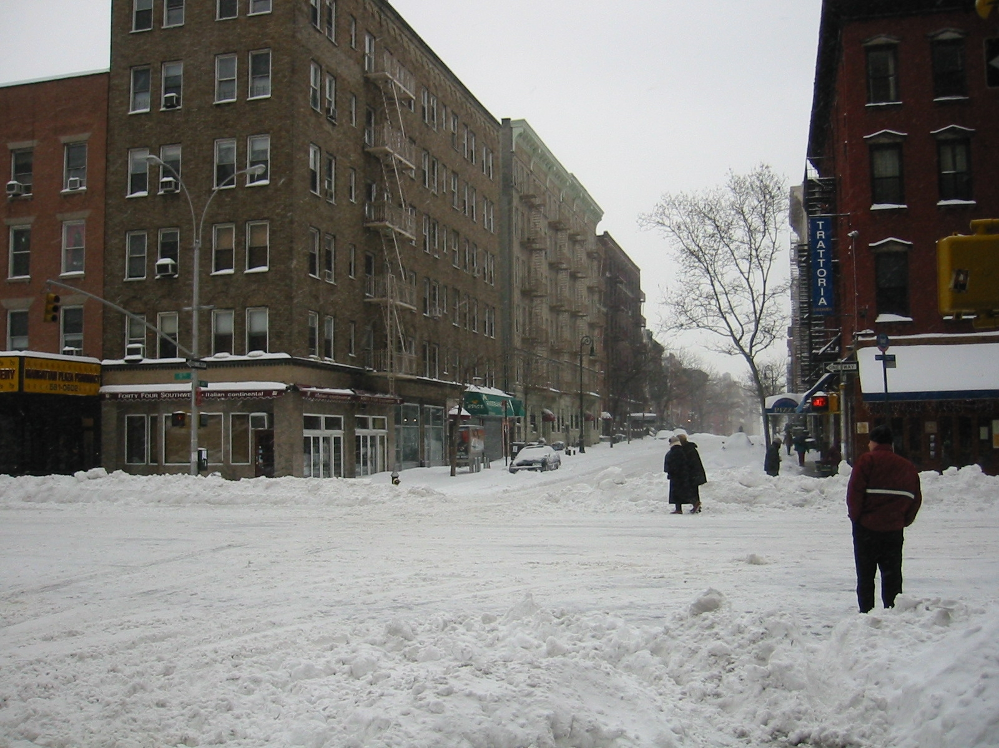
Defining the Social Problem
Watch the videos on this webpage to gather YOUR own facts and Evidence to determine if you Agree or Disagree of what Snow Days should be.
Click HERE to Website
Respond on the next slide with your opinions.
Notes:
Students can either read the Articles or once on Webpage, click on “Videos” to watch various videos.

Slide 8
Gathering evidence of the problem
I Agree and YOUR reasons:
I Disagree and YOUR reasons:

Slide 9
Identifying the causes of ANY problems:
Problems of Working Remotely at Home:
Problems of Too many days without any Learning:

Slide 10
Evaluating existing public policies
Teachers Responsibilities and Expectations:
Click Link Below
REMOTE FRAMEWORK For TEACHING
Student Responsibilities and Expectations:
Click Link Below
NY STATE EXAMS
NY STATE STANDARDS

Slide 11
Developing public policy solutions EXIT TICKET
Are you still FOR Snow Days/Remote Learning? Explain!
____________________________________________________________________________________________________
Are you Against Snow Days/ Remote Learning? Explain!
_____________________________________________________________________________________________________________________________

Slide 12
Selecting the best public policy Effective solution and Feasibility
Feasibility | HIGH | MEDIUM | LOW
Effectiveness
HIGH
MEDIUM
LOW

