Slide 1
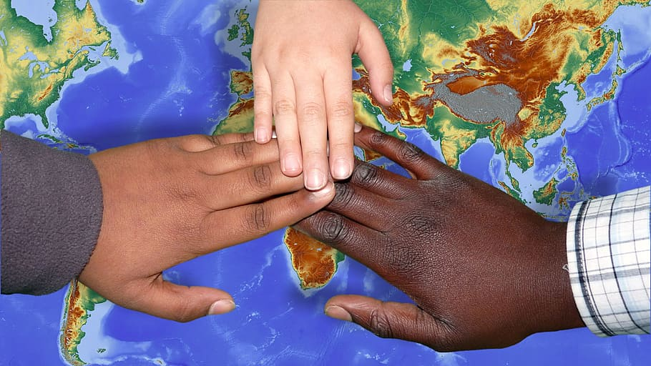
Inclusion?
Cristina Baron
30Q300
\

Slide 2
Learning Targets
I can identify a problem that can occur in our friendships in school by listening to the story The Game of Tag Story

Slide 3
Discussion Question with your buddy?
Has there ever been a time when you were not included? What did you do?
How did that make you feel?

Slide 4
Game of Tag
The Game of Tag Read Aloud

Slide 5
Define the Problem
Turn and Talk with your buddy about what problem is happening in the story?

Slide 6
Gather Information/Evidence
How many of you have not been included in something such as a game or a party? (Quick survey?)

Slide 7
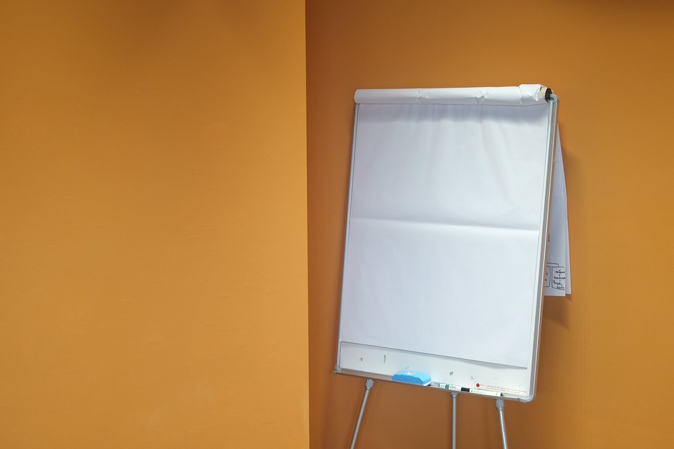
Identify Causes of the Problem
Why do you think students exclude others?
Turn and Talk to your buddy
.
Let’s chart it out!

Slide 8
Examine Existing Policy
What are some things we have in place to help students during recess?
We have community helpers during recess.
Adults are supervising at recess.
Buddies during Morning Meeting

Slide 9
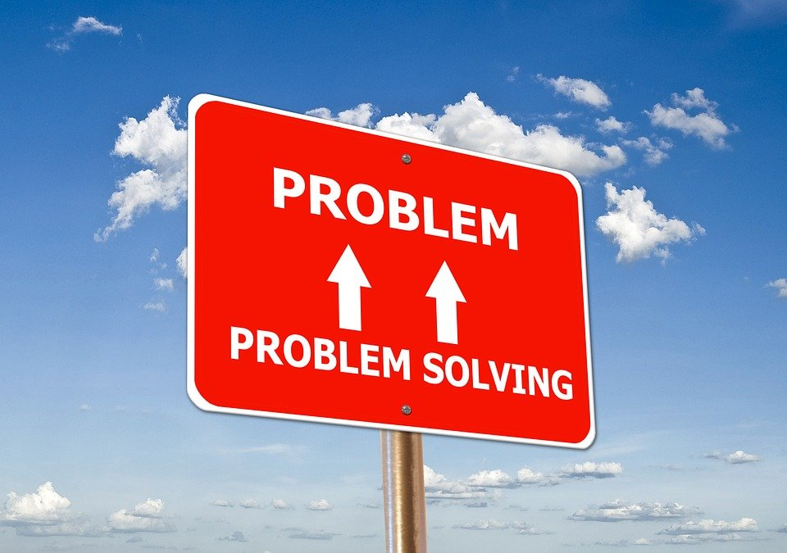
Develop Solutions
How can we solve the problem of excluding others at recess?

Slide 10
Develop Solutions
Work with your buddy on coming up with a plan to solve this problem of students feelings excluded.
Draw and write

Slide 11
Develop Solutions
What solutions did you come up with in solving this problem?

Slide 12
Select Best Solutions on Feasibility versus Effectiveness
Feasibility
 | High | Medium | Low
High
Medium
Low

