Slide 1
(A)I wrote this myself!
How can we use AI as support and not a substitute for work?

Slide 2
Steps of the PPA
Step 1: Define the Problem
Step 2: Gather Evidence
Step 3: Identify the Root of the Problem
Step 4: What policy exists for dealing with this problem?
Step 5: Develop Solutions
Step 6: Pick the best solution based on effectiveness and feasibility

Slide 3
Step: 1 Hi, I’m Bard. Define the Problem
Enter a prompt below
Schools are struggling with managing use of generative AI due to teachers not being familiar enough to implement it with their curriculum.

Slide 4
Step 2: Gather Evidence
Only 10% of surveyed educators use generative AI in their classrooms
Only 1 in 5 feel equipped to harness generative AI tools in their classrooms.
9th Annual Educator Confidence Report (HMH)

Slide 5
Step 3: What causes the problem?
Teachers don’t have enough experience with generative AI
There’s no existing cohesive policy regarding AI in the classroom

Slide 6
Step 4: Evaluating Existing Public Policy
Consider questions about cybersecurity and privacy
Look for ways to use AI-powered tech responsibly for teaching and learning
Examine how to communicate with parents about AI-powered tech
Determine whether and how AI can be used in lesson planning and other teacher tasks
Think about the ethics of allowing students to use generative AI tools like ChatGPT for school assignments
DOE Forthcoming AI Policy Lab
Currently there is no existing policy regarding AI in the classrooms. However, the DOE will be implementing an AI Policy Lab that seeks to:

Slide 7
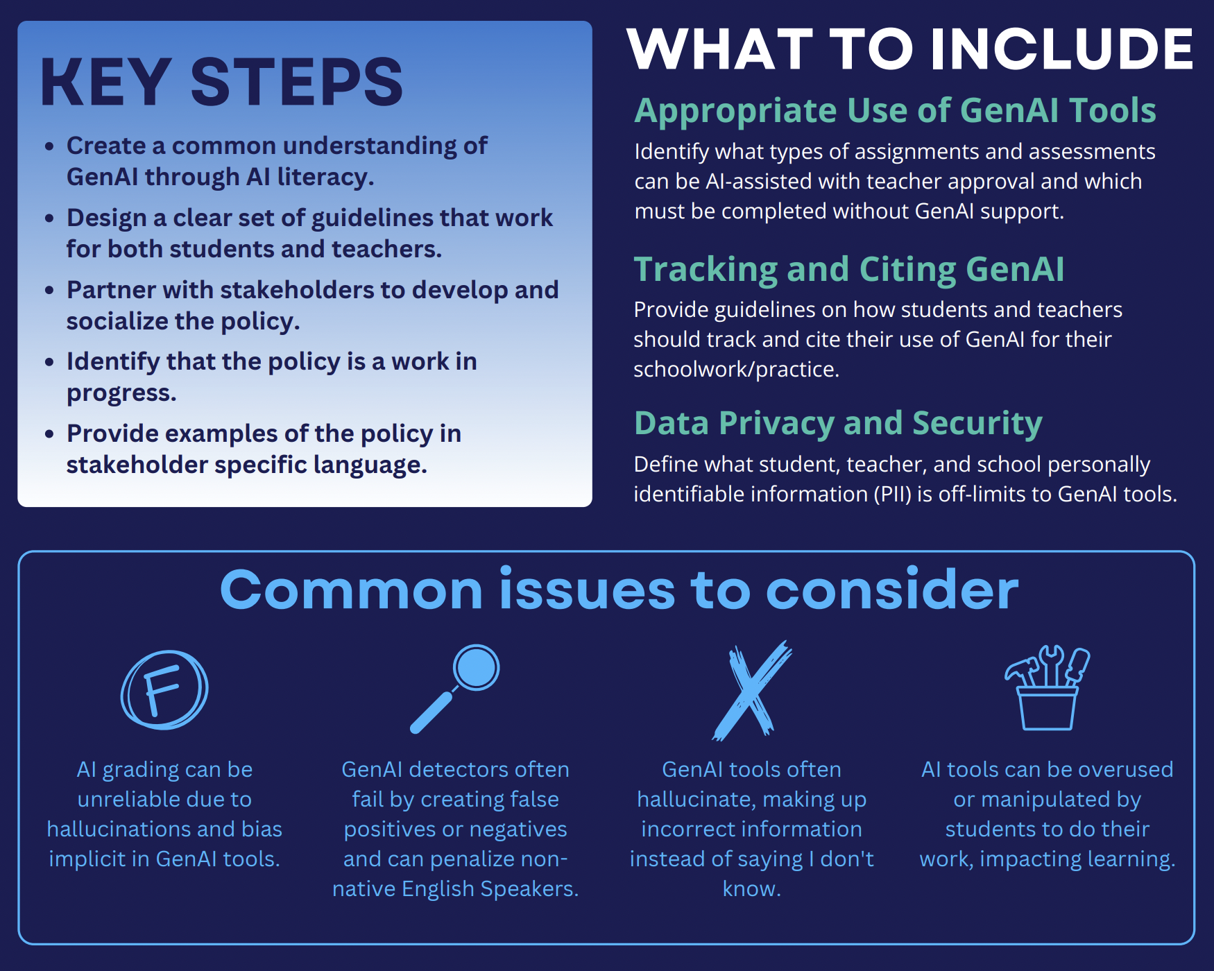
Step 5: Developing Public Policy Solution
Survey children about their experiences using AI
Offer PD for teachers to improve their AI literacy
Develop a school AI policy that is shaped by the needs of both teachers and students

Slide 8
Step 6: Selecting Best Public Policy Solution
Feasibility
 | High | Medium | Low
High |  | Provide Teachers with PD
Medium | Survey children about their experiences using AI | Shape AI policy based on Teacher and Student needs
Low
Effectiveness

