Slide 1
Cyberbullying
In
Schools

Slide 2
Vicky Ageletopoulos
vageletopoulos@schools.nyc.gov
PS/IS 127Q

Slide 3
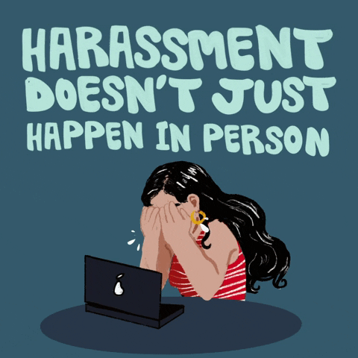

Slide 4
What are the steps of Public Policy Analyst? (PPA)
Step#1 Defining the Social Problem:
Step #2: Gathering Evidence of the Problem:
Step #3: Identifying the Causes of the Problem
Step #4: Evaluating Existing Public Policies
Step #5: Developing Public Policy Solutions
Step #6: Selecting the Best Public Policy Solution

Slide 5
Step 1~ Defining the Social Problem:
In pairs at your tables, please think & discuss the following below:
What does it mean “to be a cyberbully”?
What does it mean “to be cyberbullied”?
****** Turn & Talk *******

Slide 6
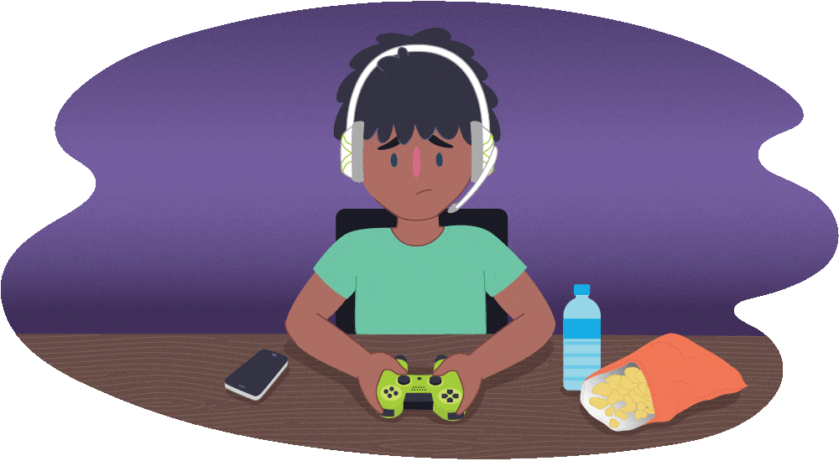
Step 1~ Defining the Social Problem:
Students who are cyberbullied can struggle to concentrate and do well in school, as well as it negatively affecting their everyday life. Cyberbullying has increased in recent years due to increased use of technology and social media. It not only hurts and affects the person being bullied, but also the friends & families of the those being bullied.

Slide 7
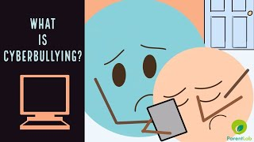
What is Cyberbullying?

Slide 8
What is Cyberbullying?
Cyberbullying is when students use the internet, cell phones, or other technological devices or social media platforms to post text or images intended to hurt, embarrass, threaten, taunt, humiliate, or intimidate their victim.

Slide 9
Step 2~Gathering Evidence of the Problem:
About 37% of young people between the ages of 12 and 17 have been bullied online. 30% have had it happen more than once.[1]
95% of teens in the U.S. are online, and the vast majority access the internet on their mobile device, making it the most common medium for cyber bullying.[2]
23% of students reported that they’ve said or done something mean or cruel to another person online. 27% reported that they’ve experienced the same from someone else.[3]
Girls are more likely than boys to be both victims and perpetrators of cyber bullying. 15% of teen girls have been the target of at least four different kinds of abusive online behaviors, compared with 6% of boys.[4]
About half of LGBTQ+ students experience online harassment -- a rate higher than average.[5]
Instagram is the social media site where most young people report experiencing cyberbullying, with 42% of those surveyed experiencing harassment on the platform.[6]
Young people who experience cyberbullying are at a greater risk than those who don’t for both self-harm and suicidal behaviors.[7]
83% of young people believe social media companies should be doing more to tackle cyberbullying on their platforms.[8]
60% of young people have witnessed online bullying. Most do not intervene.[9]
Only 1 in 10 teen victims will inform a parent or trusted adult of their abuse.[10]
https://www.dosomething.org/us/facts/11-facts-about-cyber-bullying

Slide 10
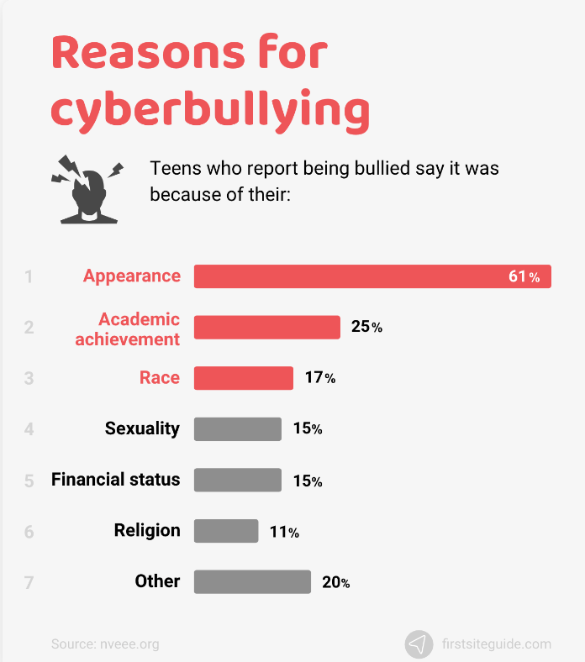
Step 3~Identifying the Causes of the Problem:
Why do you think people Cyberbully???🤔💭💡
What are reasons people Cyberbully?

Slide 11
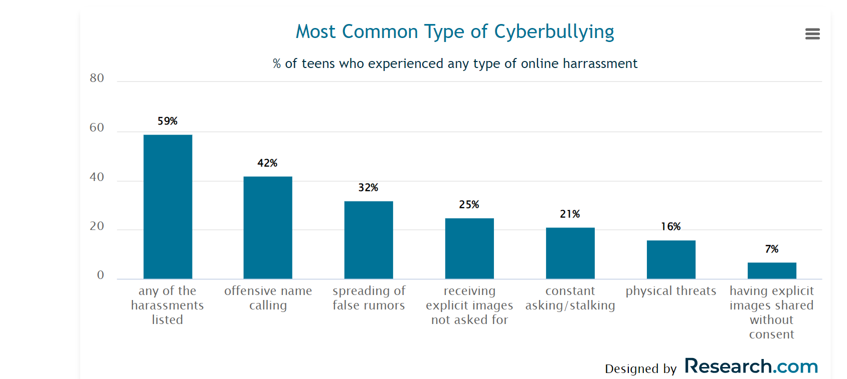

Slide 12
Step 4~ Evaluating Existing Public Policies
In pairs at your tables, please think & discuss the following below:
What are some ways your school prevents bullying from happening at your school?
What are ways you can prevent bullying?
***** TURN & TALK *****

Slide 13
Step 4~ Evaluating Existing Public Policies
● School Mission Statement
● School Code Of Conduct
● Classroom Rules
School Programs

Slide 14
Step 4~ Evaluating Existing Public Policies
RESTORATIVE CIRCLES
When people come together for interactions, they sit in circles. Classroom circles support the two main goals of restorative practices: building community; and responding to harms through dialogue that sets things right.
What are the 5 restorative questions for those who caused harm?
What happened?
What were you thinking at the time?
What have you thought about since?
Who has been affected by what you have done? In what way?
What do you think you need to do to make things right?

Slide 15
Step 5~Developing Public Policy Solutions
How can we stop bullying??
In pairs at your tables, please think & discuss the following below:
What are some strategies we can implement in our schools to help stop bullying?
******** Turn & Talk *********

Slide 16
Step 5~Developing Public Policy Solutions
How can we stop bullying??
●More strict punishments/implementation of these punishments
●Increased education in schools about bullying and the consequences that come with it
●More support from guidance counselor/social worker- Push in program

Slide 17
Step 6~ Selecting the Best Public Policy Solution:
Which Solution fits our school best?
Effectiveness: How well will it work?
Feasibility: How easily can we make this happen?

Slide 18
 |  | FEASIBILITY
 |  | HIGH | MEDIUM | LOW
EFFECTIVENESS | HIGH
 | MEDIUM
 | LOW

