Slide 1
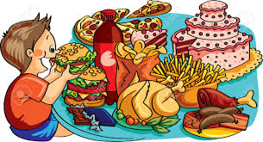
Public Policy Analyst (PPA)
Analyzing Social Problems
Topic: Unhealthy Eating

Slide 2
Define the Problem
Think of a social problem you see around you.
What are some social problems in health?
Examples:
Obesity
Diabetes
Unhealthy Eating
The problem: students at PS 149 are not choosing healthy foods to eat.

Slide 3
Gather the Evidence
There are different kinds of evidence we can collect and use:
Data (numbers, percentages, infographics)
Articles
Observations
Surveys
Interviews

Slide 4
Identify the Causes
What are some of the causes or reasons why students are not eating healthy at PS 149?
Limited options of food choice?
Uneducated about eating healthy?
No curriculum on eating healthy?
The cause: Students lack the knowledge of how to eat healthy.

Slide 5
Evaluate an Existing Policy
What is the policy (a plan for doing something) in school about eating healthy?
Department of Education Wellness Policy https://infohub.nyced.org/in-our-schools/policies/doe-wellness-policy
A salad bar in the cafeteria
Serve vegetables with meals
A water fountain to refill own water bottle

Slide 6
Develop Solutions
What can we amend (change) or add to the existing policy?
Implement (use) a curriculum about eating healthy?
Apply (go for) for a healthy eating program? (Ex. Brighter Bites)
Parent workshops

Slide 7
Select the Best Solution
Solution: Brighter Bites and Parent Workshops

