Slide 1
Who really cares about the environment anyway?
Class ⅘-246
Created by:Tiffany Toro
P.S 234 Q

Slide 2
Public Policy Procedure
Define the problem
Gather evidence
Identify causes
Look closer at existing policies
Develop solutions to the problem
Select the best solution

Slide 3
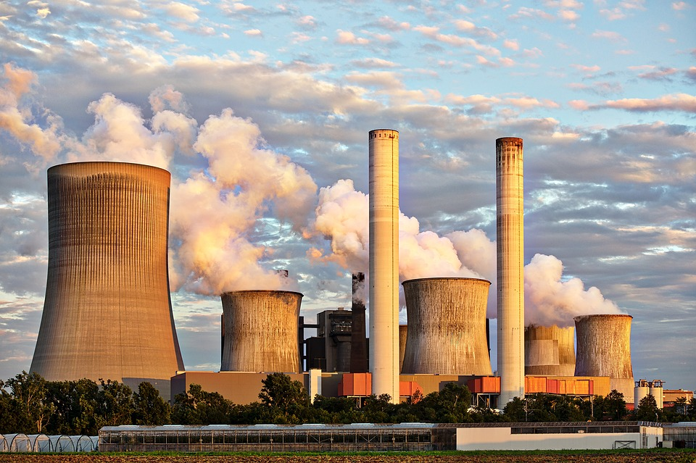
Let’s define the problem...
Globally humans are dealing with problems such as climate change, pollution and demishing of natural resources due to daily choices that have
lasting negative effects on the environment.

Slide 4
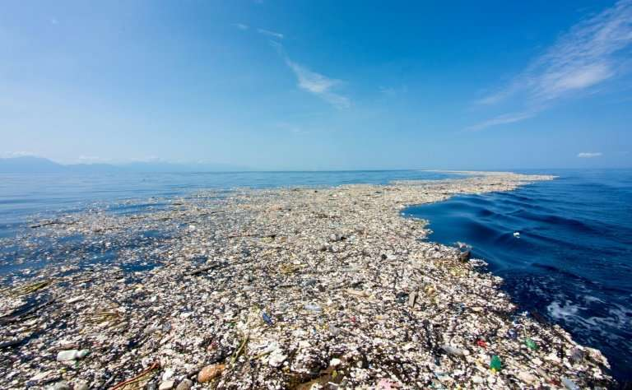
The Great Pacific Garbage Patch in the Pacific Ocean is made of
about 79,000 metric tons of plastic! Click here to learn more via Brainpop!
Evidence of the problem!
Notes:
https://www.brainpop.com/science/ourfragileenvironment/humansandtheenvironment/

Slide 5
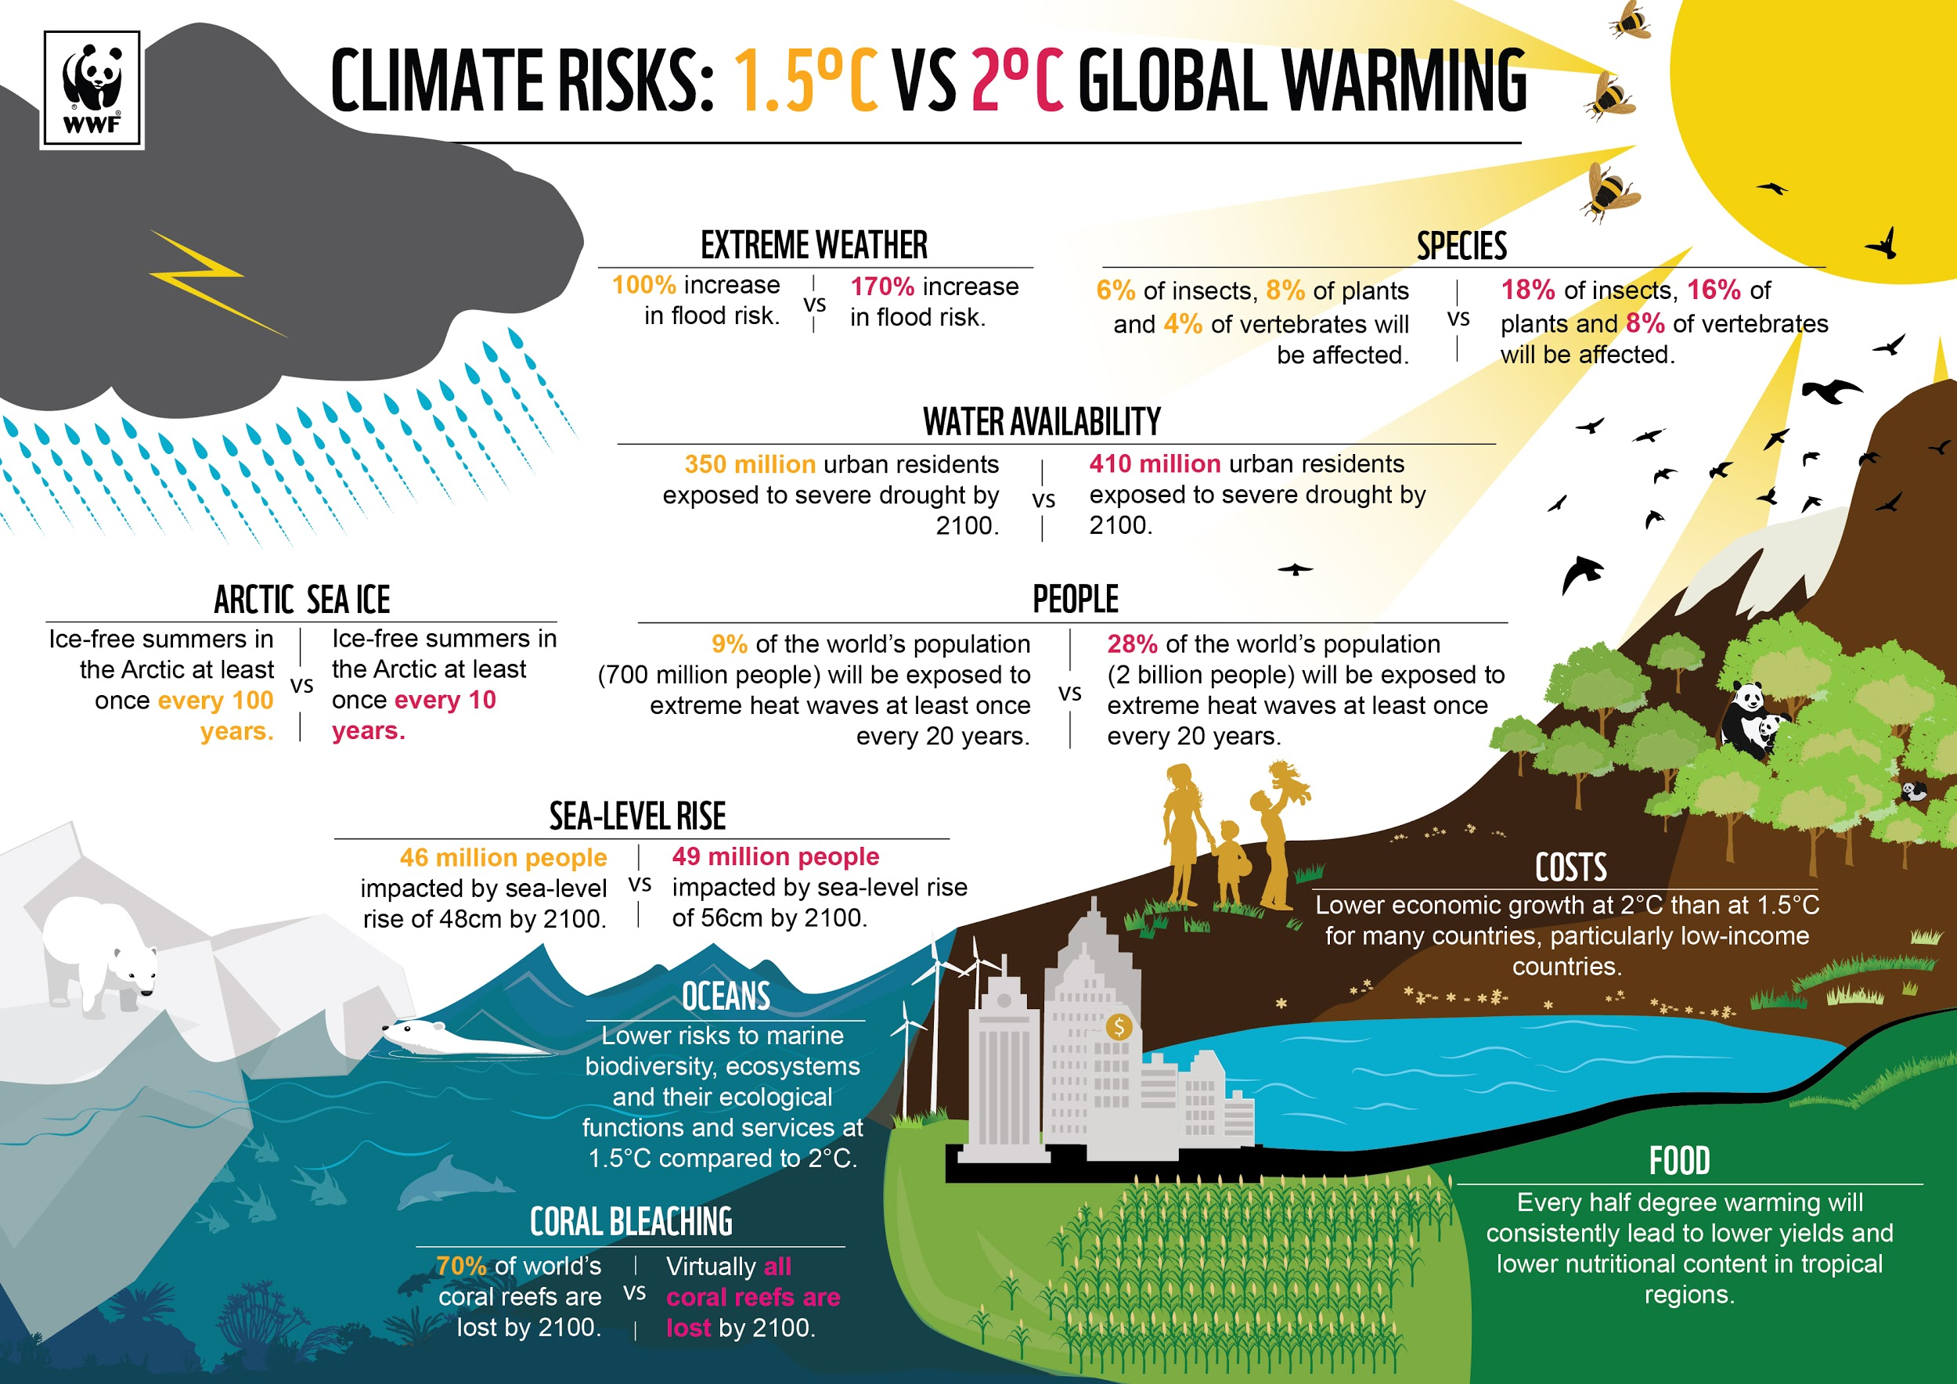
Additional Evidence!

Slide 6
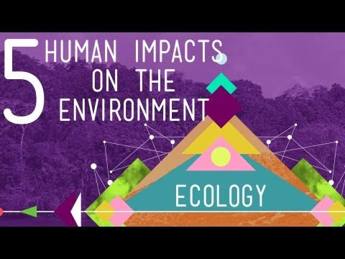
Causes of the problem...
Look closer at the impacts humans have on the environment of our plant

Slide 7
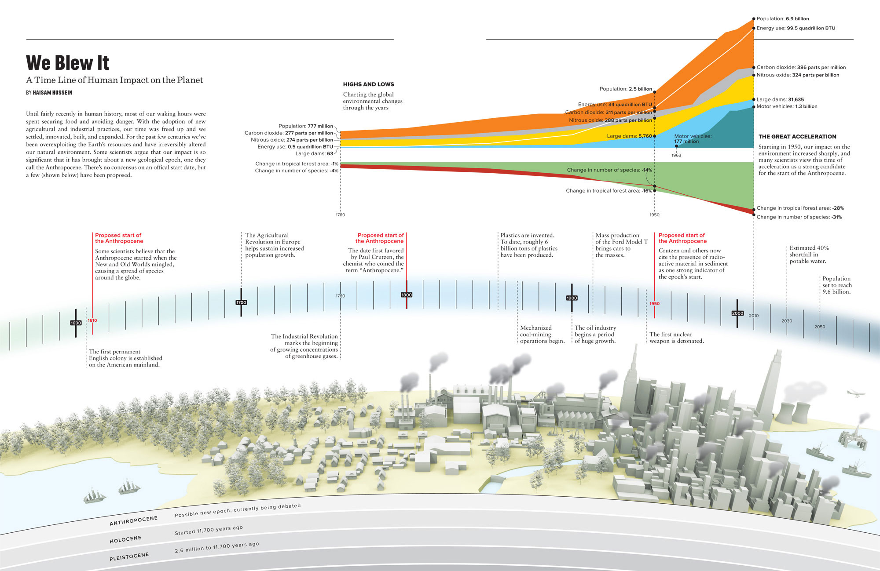
A Timeline of Human Impact on the Planet
What changes can you observe based on the infographic provided?

Slide 8
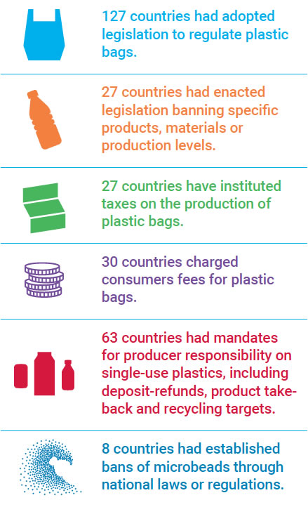
Existing Policies
Buying Fairtrade products can help make sure a farmer is paid equal pay. This means they can cover their costs, earn enough money to have afford a decent life, and invest in their farms to keep their crop healthy, without needing to resort to cheap methods of farming which can further damage the environment.
A law called the 1964 Wilderness Act protected 9 million acres of American wilderness. And U.S. Supreme Court Justice William O. Douglas advocated tirelessly on behalf of environmental causes.
One of the most important groups dedicated to the worldwide preservation of animals and their habitats is the World Wide Fund for Nature, formerly known as the World Wildlife Fund. Established in 1961, it has more than 5 million supporters and sponsors around 2,000 conservation projects around the world—many of them designed to preserve the habitats of endangered species.
According to the United Nations 2018 Annual Environmental Report

Slide 9
Public Policy Solutions
Feasibility
Mindful Energy Use
At home
Public
Transportation
Energy Efficient
Light Bulbs,Solar Panels
 | High | Medium | Low
High
Medium
Low
Mindful use of
water
Mindful of parks,
Building regulations
Effectiveness

Slide 10
Share your thinking on
our class Padlet here!
Consider how feasible (easy/affordable/likely for it to happen) and effective (biggest impact). Remember it is okay for to choose to a different best policy to move forward with than your classmates, as long as you can explain why!

