Slide 1
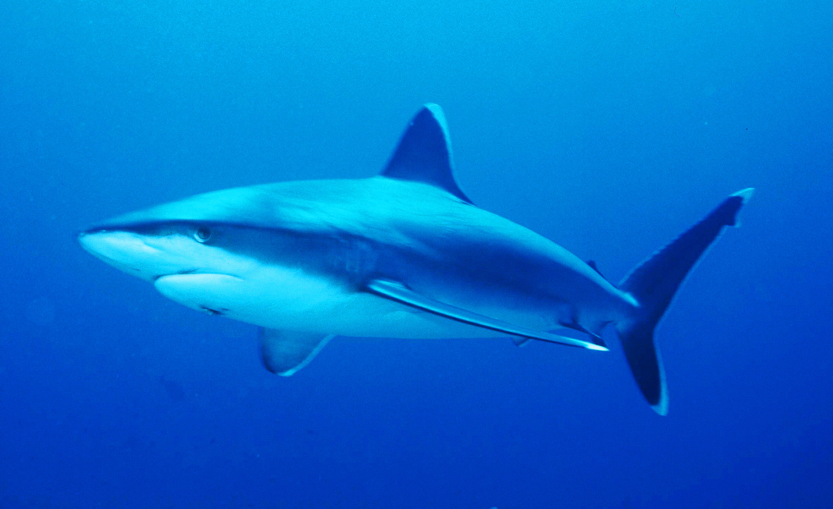
Why should we stop shark finning?
By: Miss Soren

Slide 2
Public Policy Analyst Steps
Step #1: Defining the Social Problem: Creating a social problem based on your curriculum
Step #2: Gathering Evidence of the Problem
Step #3: Identifying the Causes of the Problem
Step #4: Evaluating Existing Public Policies
Step #5: Developing Public Policy Solutions
Step #6: Selecting the Best Public Policy Solution

Slide 3
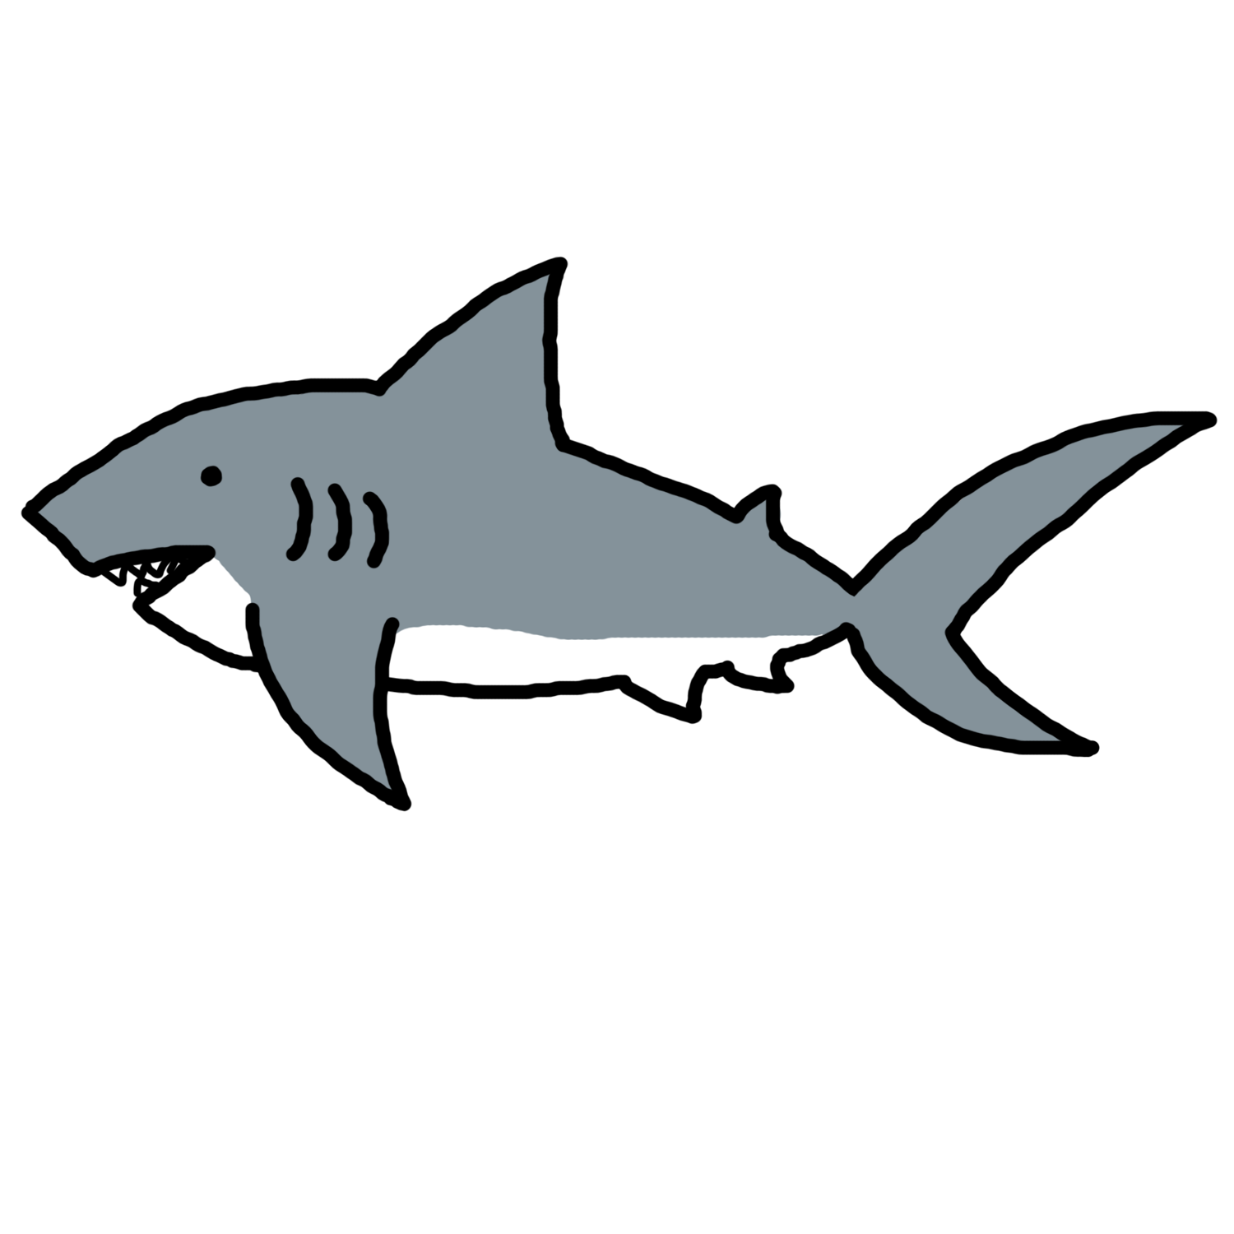
Define the Problem
The problem is that sharks are being killed for their fins. There are many different effects that this has on the ecosystem.

Slide 4
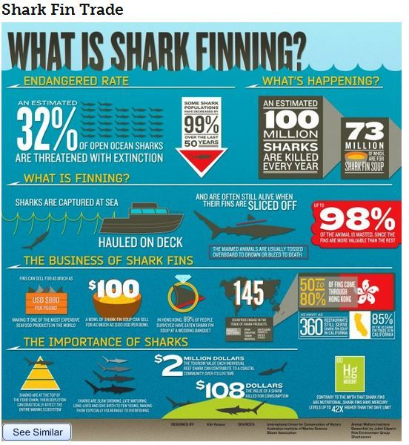
Gather The Evidence

Slide 5
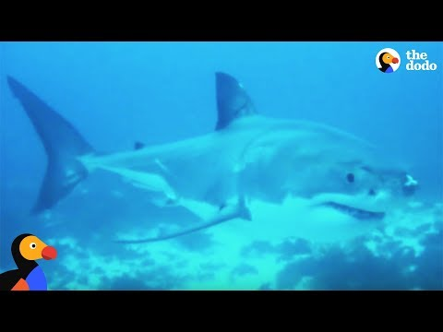
The Evidence Continues...

Slide 6
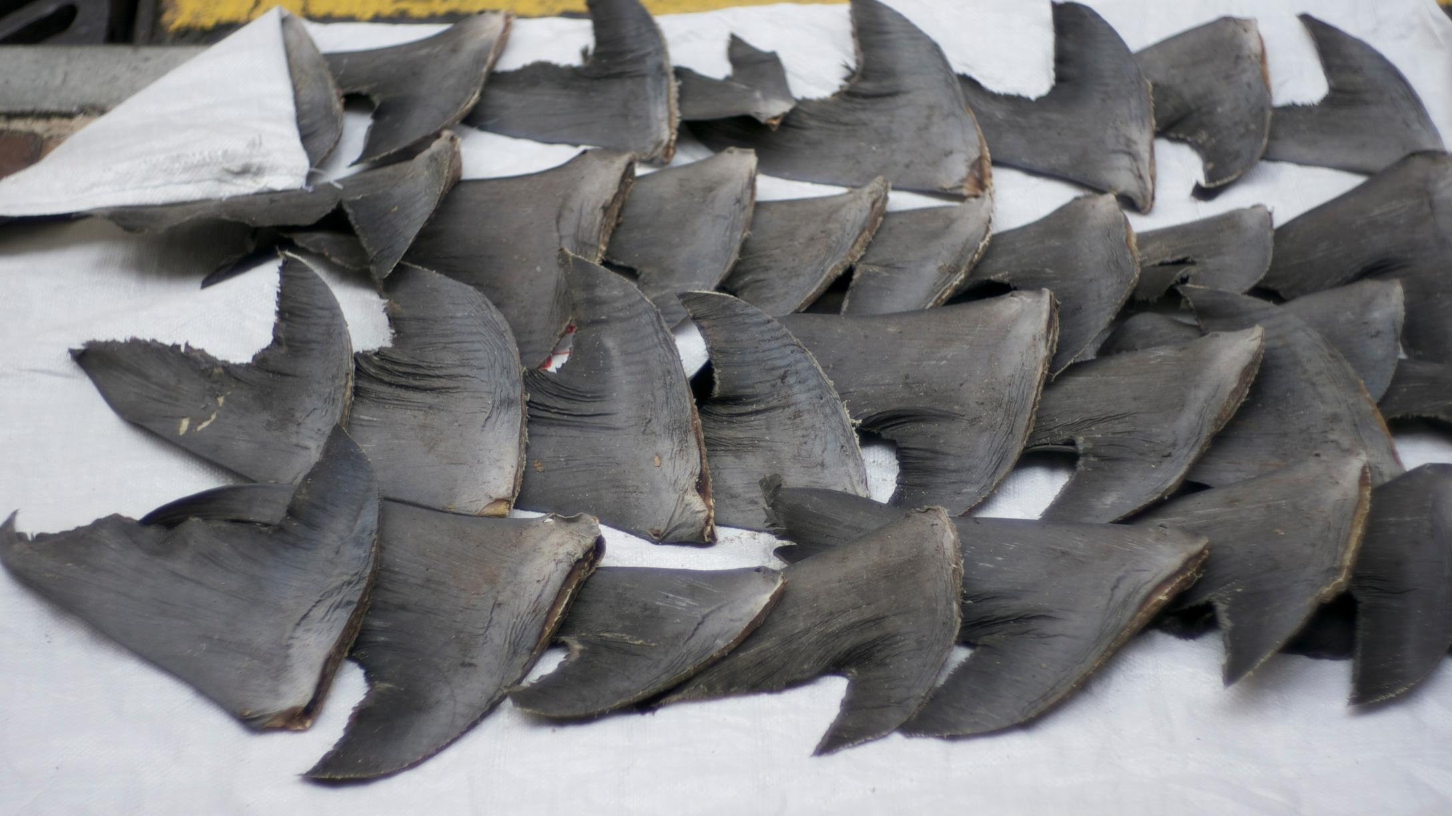
Identify the Causes of the Problem
Sharks fins are being targeted because the fins have a very high monetary value. People cut off the fins to make shark fin soup. After the fins are cut the sharks are thrown back in ocean.

Slide 7
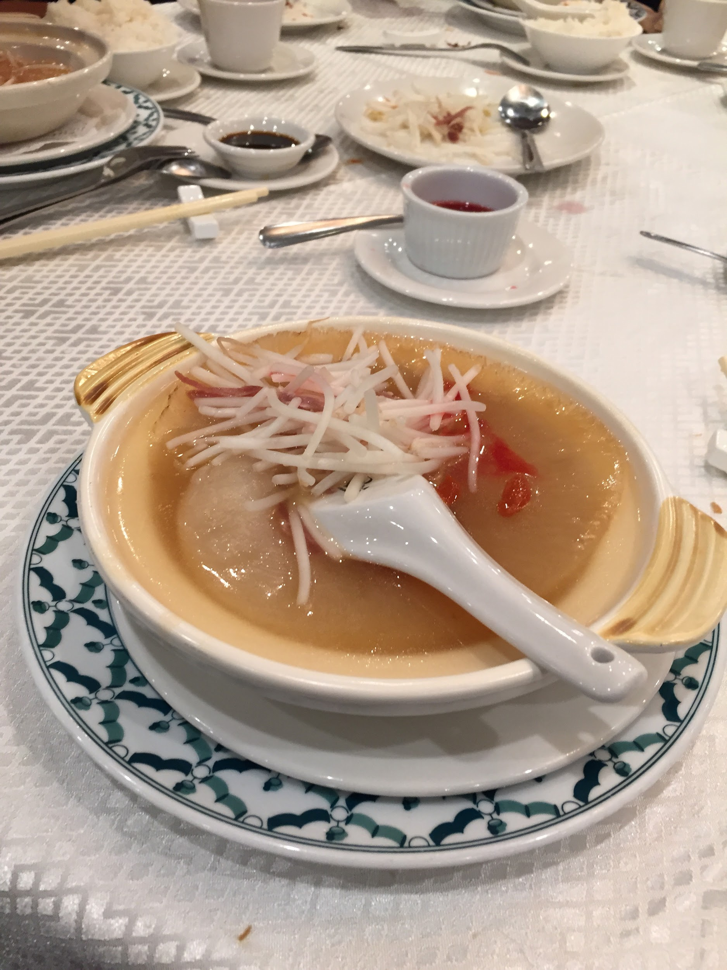
Evaluate Existing Public Policies
There are many existing policies on shark finning, let’s view this website so we can educate ourselves on this matter.
https://awionline.org/content/international-shark-finning-bans-and-policies
-Some places have bans on shark finning or shark fishing
-Some companies such as airlines have refused to transport shark fins
-Others have refused to sell shark fins or shark fin soup

Slide 8
Developing Public Policy Solutions
What do you think would be the best public policy to solve this problem?
-What are the advantages and disadvantages of this policy?
-Meet with your group and chart your thinking!

Slide 9
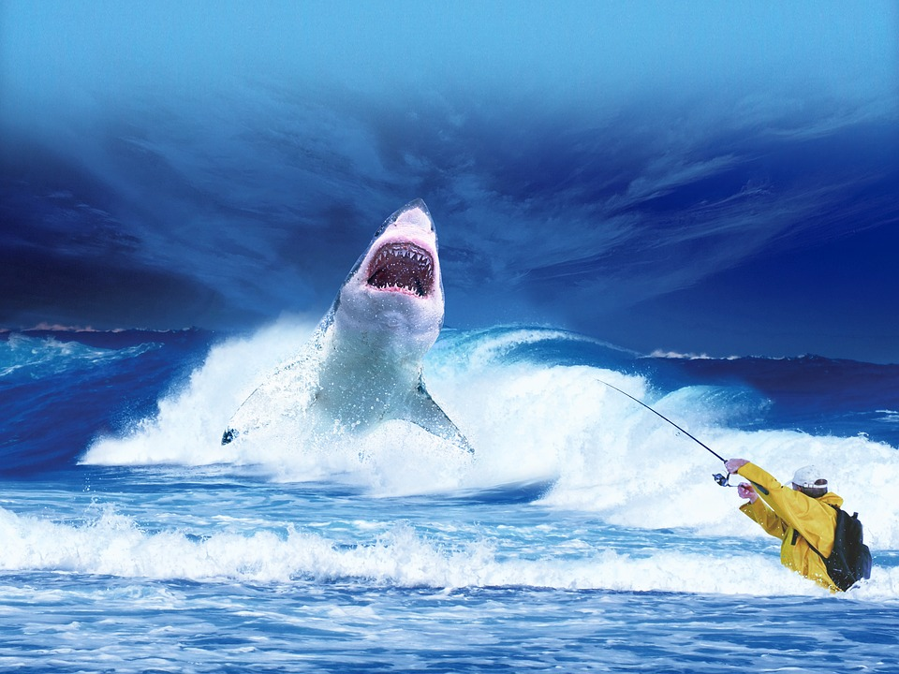
Select the Best Public Policy
Which one do you think would be the best to protect the sharks from shark finning?

Slide 10
How Feasible is This Solution?
Now I want you to think about how we can put this plan into action, how feasible is this?
*Turn and Talk to the Person Next to you About your Thoughts**

