Slide 1
Testing Anxiety
Michelle Santoro P.S. 122Q

Slide 2
The Six Steps of the Public Policy Analyst Steps
1. Define the Problem
2. Gather the Evidence
3. Identify the Causes
4. Evaluate an Existing Policy
5. Develop Solutions
6. Select the Best Solution (Feasibility vs. Effectiveness)

Slide 3
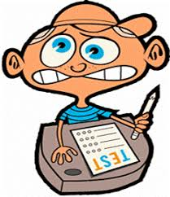
Define the Problem
Students are having anxiety about upcoming exams and state tests that they have to take at P.S. 122Q.
How can we prevent student from having anxiety over tests?
Do I have testing anxiety?

Slide 4
Gathering Evidence of the Problem
It is okay to be nervous!
Testing anxiety can lead to panic attacks. It may make you feel like you are unable to breathe.
It may make you feel like you are disappointing yourself or others.
How do you feel when you find out you have a test?
Survey

Slide 5
Identifying the Causes of the Problem
Fear of failure: Poor testing scores in the past. Have you done poorly on a test before? Does that make you nervous you won’t do well on an upcoming test?
Pressure: You may feel pressure from others around you like classmates, teachers, parents that you HAVE to do well which causes you to be nervous. You may feel pressure to study all night.
Low Self-Esteem: You may feel like you are not good enough and are confident in yourself. It may make you second guess yourself.

Slide 6
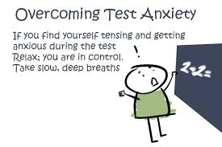
Examining Existing Public Policies
Some teachers allow for students to take brain breaks during tests so they can breathe and relax to help calm their nerves if they become frustrated.
Some teachers give students studying habits and teaching them how to effectively study for an upcoming exam.
Some teachers teach students to have a positive mind using mindfulness activities
Giving extra recess

Slide 7
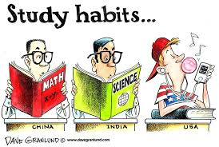
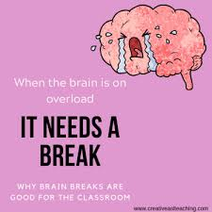
Developing Public Policies Solutions
Social Class- A class where students can learn about testing anxiety and how to cope with your feelings.
Breaks- Brain breaks during tests so students aren’t becoming restless and frustrated
Studying Habits- Learning how to study for exams in advance, instead of cramming everything in the night before and then forgetting it.

Slide 8
Selecting the Best Public Policy Solution
 | High | Medium | Low
High
Medium
Low

