Slide 1
Social Emotional Health
Polyxeni Petratos
ppetratos@ps361q.org

Slide 2
Public Policy Analyst (PPA)
PPA is a problem solving method that can be used in our school.
Define the problem
Gather the Evidence
Identify the Causes
Examine an Existing Policy
Develop New Solutions
Select the Best Solutions

Slide 3
Step 1: Identify the Problem
What is the problem?
Reacting to conflict in aggressive ways that leads to not building and maintaining friendships.

Slide 4
Step 2: Gather the Evidence
Where is the evidence that the problem is a real problem?
Surveys
Student Interviews

Slide 5
Step 3: Find the causes of the problem
What is causing the problem?
Limited Time to hold discussions within the classroom.
Academic priorities.
Little/ no known knowledge about assertive behavior.

Slide 6
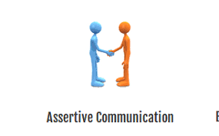
Step 4: Examine the existing policy in place.
What policy is currently in place to solve the problem?
Advisory Class - once per week
Earning Superhero Tickets
Community Meeting Time

Slide 7
Step 5: Developing Public Policy Solutions
What are 3 possible solutions (policies) that we can develop to solve the problem?
Learning more about assertiveness (Assembly)
Role-playing with peers.
Reading books related to social emotional awareness/health.
(Classroom read alouds / Classroom Library section)

Slide 8
Step 6: Selecting the Best Public Policy Solution
Take the 3 policies from step 5 and examine their feasibility and effectiveness.Then select the best solution.
Feasibility (Is this possible?)
High
Medium
Low
High
Medium
Low
High
E
F
F
E
C
T
I
V
E
N
E
S
S
 | High | Medium | Low
High
Medium
Low

