Slide 1
Overweight backpacks in Middle School
Irene Pappas
PS/IS 122Q

Slide 2
Components of a Public Policy Analysis (PPA)
The purpose of the PPA is to help you better understand social problems in your school & community. Below are the steps:
1.Define the Problem
2.Gather Evidence
3.Identify Causes
4.Evaluate Existing Public Policies
5.Develop Public Policy Solutions
6.Selecting the Best Policy Solution

Slide 3
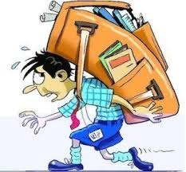
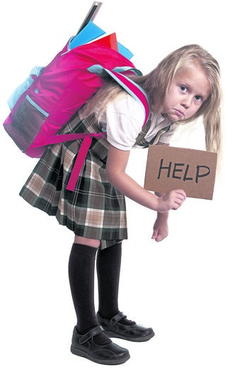
Define the Problem
The middle school students at PS/IS 122Q are burdened by their overweight backpacks. Often they are filled to capacity and can’t be zippered! Since the children travel to each class and do NOT have lockers, they are required to carry all their belongings with them at all times. Students have shared that their backpacks weigh anywhere from 7-20 pounds!

Slide 4
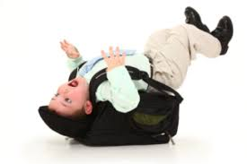
Gather Evidence
Overweight backpacks are highly problematic for two reasons:
They lead to chronic back and neck pain.
It becomes increasingly more difficult and time consuming to locate belongings when there are so many items buried in the backpack.
The U.S. National Library of Medicine published a case study in 2017 (can be found here) which states that a child’s backpack should ideally be 10% of their body weight in order to minimize possible damage to the spine.

Slide 5
Gather Evidence

Slide 6
Identify Causes
Middle school students at PS/IS 122Q do not have lockers.
Homeroom isn’t always accessible so important belongings must be carried throughout the day.
Students have seven classes in addition to lunch daily. Each class period has different requirements and therefore different resources are needed.
Often each teacher will ask for (at minimum) a notebook and a folder.
There are no water coolers so students carry (multiple) water bottles with them.

Slide 7
Evaluate Existing Public Policies
Students can visit homeroom three times a day - in the morning and before/after lunch to alleviate some of the extra weight they’re carrying.

Slide 8
Develop Public Policy Solution(s)
Allow students to leave subject specific materials in that classroom.
Provide iPads to

Slide 9
Selecting the Best Policy Solution
Feasibility
 | High | Medium | Low
High
Medium
Low

Slide 10
https://flippedtips.com/plegal/ltgd30/ltgcontact.html

