Slide 1
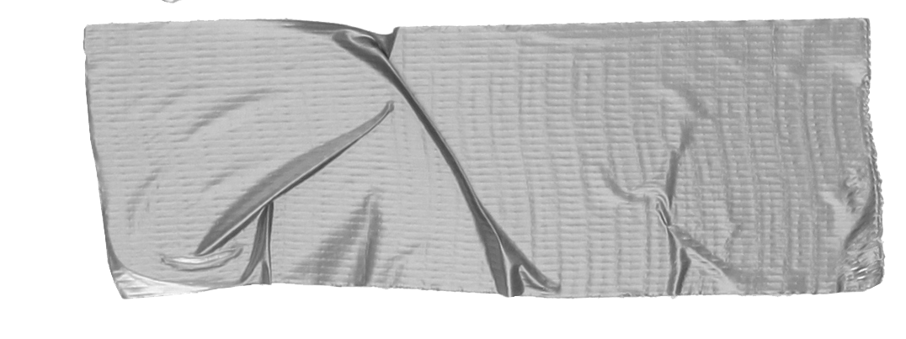

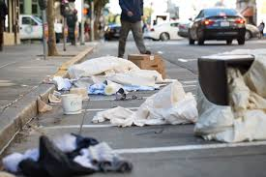
Litter in Astoria, Queens
Pollution is defined as “a presence of a substance or something that has harmful or poisonous effects on the environment.”
Litter is defined as “trash, such as paper, cans, and bottles, that is left lying in an open or public space.”
Maria Panagiotakis
Q300
Class 301

Slide 2
Public Policy Analysis Steps
Step 1: Define the Problem
Step 2: Gather Evidence
Step 3: Identify Causes
Step 4: Evaluate Existing Public
Policies
Step 5: Develop Public Policy Solutions

Slide 3
Step 1: Define the Problem
Litter (pollution) is a problem around our school neighborhood.
Why is litter (pollution) a problem?
Stop Pollution

Slide 4
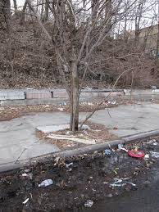
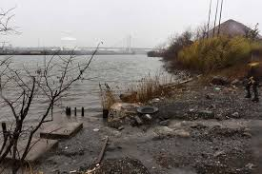
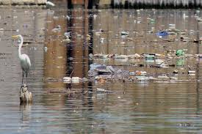
Define the Problem
Why is this a problem?
How does this harm our environment?

Slide 5
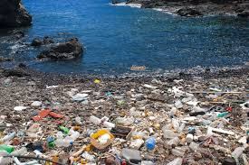
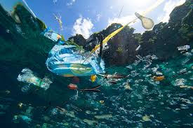
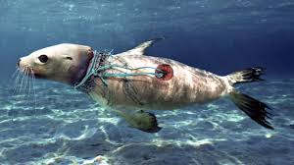
Define the Problem
Why is this a problem?

Slide 6
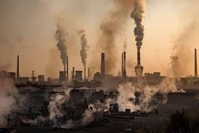

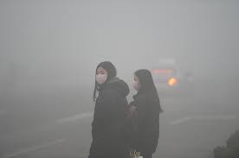
Define the Problem
Why is this a problem?

Slide 7
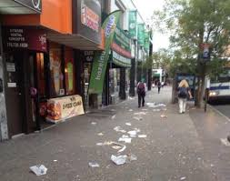
Step 2: Gather Evidence
When we walk to school every morning, we notice trash on the sidewalks and in the streets. Sometimes we even see people throw trash on the floor.

Slide 8
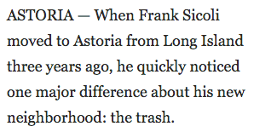

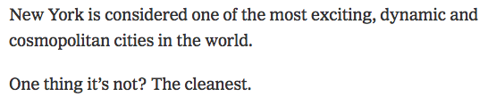
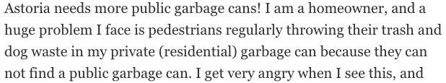
Step 2: Gather Evidence
What the residents/
people of Astoria are saying
Article on littering in Astoria, Queens

Slide 9
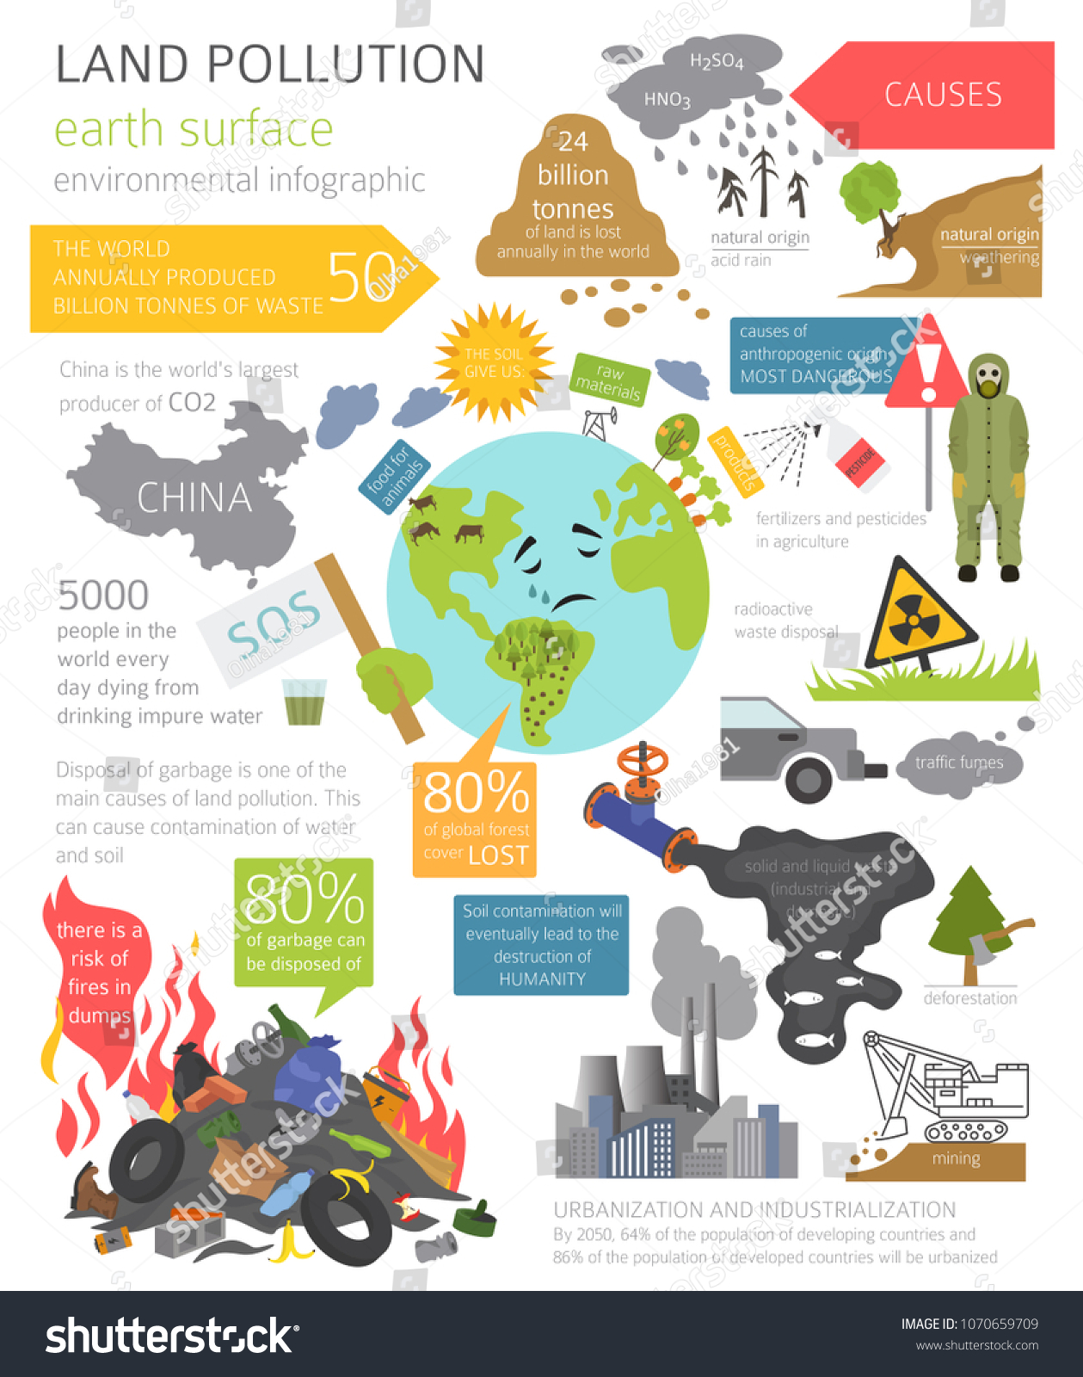
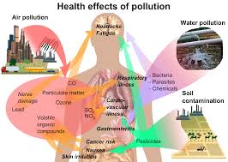
Step 2: Gather Evidence

Slide 10
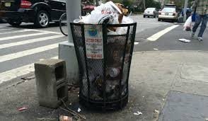
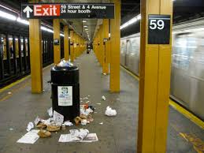


Step 3: Identify causes of the problem
What do you notice?
What do you
wander?
Video on what happens when people pollute.

Slide 11

Step 4: Evaluate Existing Public Policies
NYC Department of sanitation https://www1.nyc.gov/assets/dsny/site/home
NYC Department of Environmental Protection https://www1.nyc.gov/html/dep/html/home/home.shtml
The 3 R’s: Reduce, Reuse, Recycle https://www.conserve-energy-future.com/reduce-reuse-recycle.php
Let’s review what our city already does to fight pollution.

Slide 12
Step 5: Develop Public Policy Solutions
What can we do to help protect our environment from litter (pollution)?
Place NYC Department of Sanitation trash cans on every street corner around our school and the surrounding neighborhood.
Speak to students about the importance of recycling and throwing out trash.
Walk-A-Thon with posters displaying the effects of pollution on our environment.
Build sculptures from recycled trash and sell to families and donate money to a non-profit green environment.

Slide 13
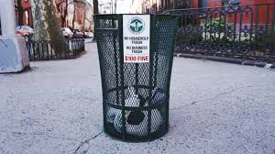
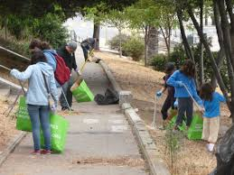
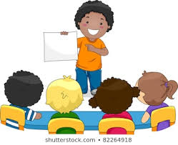
Step 6: Select the Best Public Policy Solution
Feasibility
 | High | Medium | Low
High
Medium
Low
Effectiveness

