Slide 1
Lifetimes of Decomposition
Carolyn Menges
P.S. 11 Queens
Lifetimes--- Taking many generations to happen.

Slide 2
Public Policy Analyst (PPA):
Define the Problem
Gather Evidence
Identify Causes
Evaluate An Existing Policy
Develop Solutions
Select the Best Solution

Slide 3
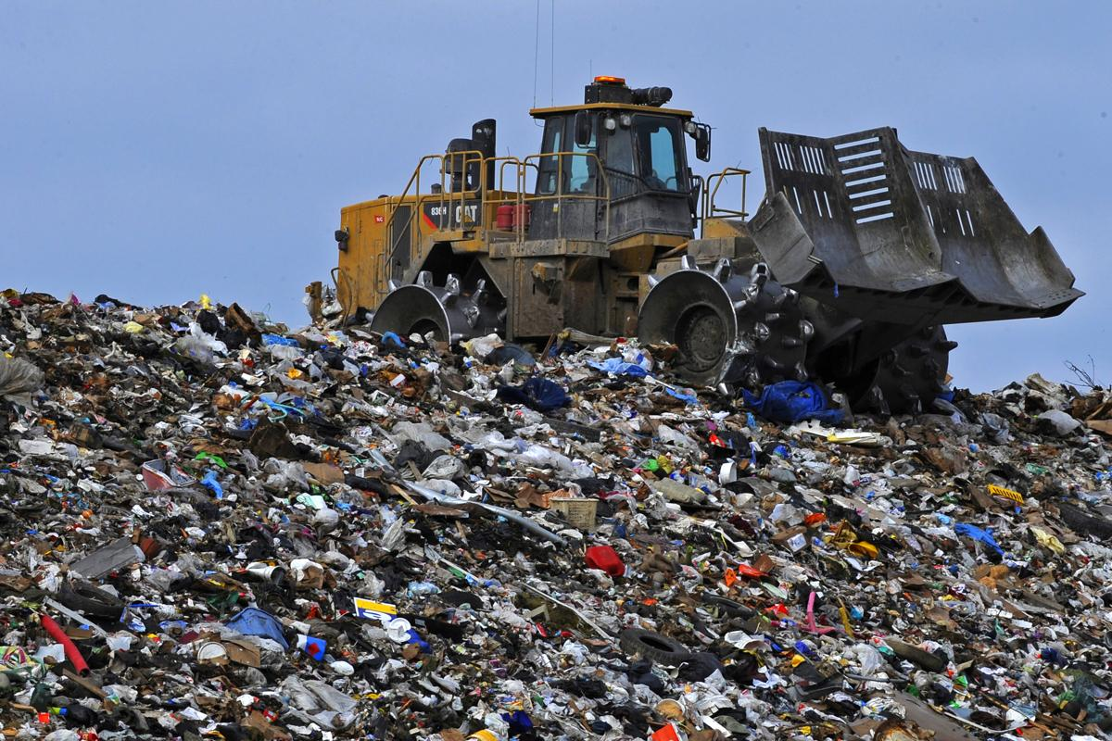
Problem:
Plastic waste can take up to 1,000 years to decompose in landfills.
1,000 years from now will be the year 3019!!!!!

Slide 4
Gathering Evidence:
Let’s watch this video to better
understand why this is a problem:

Slide 5
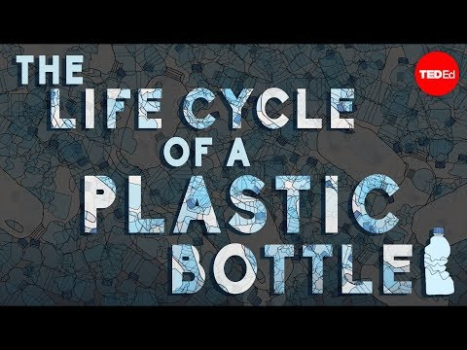

Slide 6

Don’t let the video
bum you out!!!!
Soon we’ll be thinking about solutions to this problem but first let’s gather some more evidence……...

Slide 7
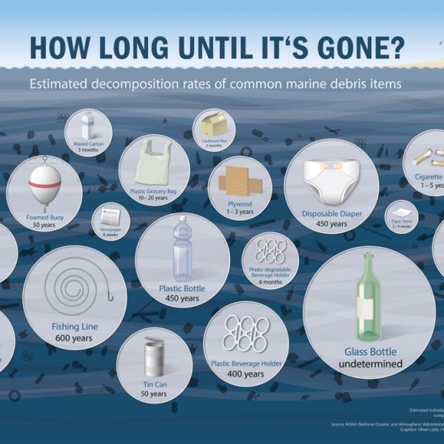
Find 2 items you or your family use regularly.
Turn and Talk about how long the things you use will take to decompose.
Share your opinions about these facts.

Slide 8

Why do we continue to use items that will
remain on Earth long after we are gone?

Slide 9
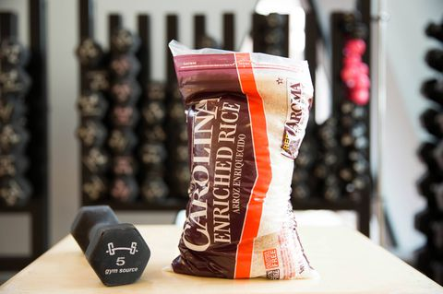
What Causes This Problem?
Garbage - The average person in the United States produces around 4 1/2 pounds of trash every day!
Approximately the weight of this bag of rice.
Remember that’s per person NOT per family.
Online Reference

Slide 10

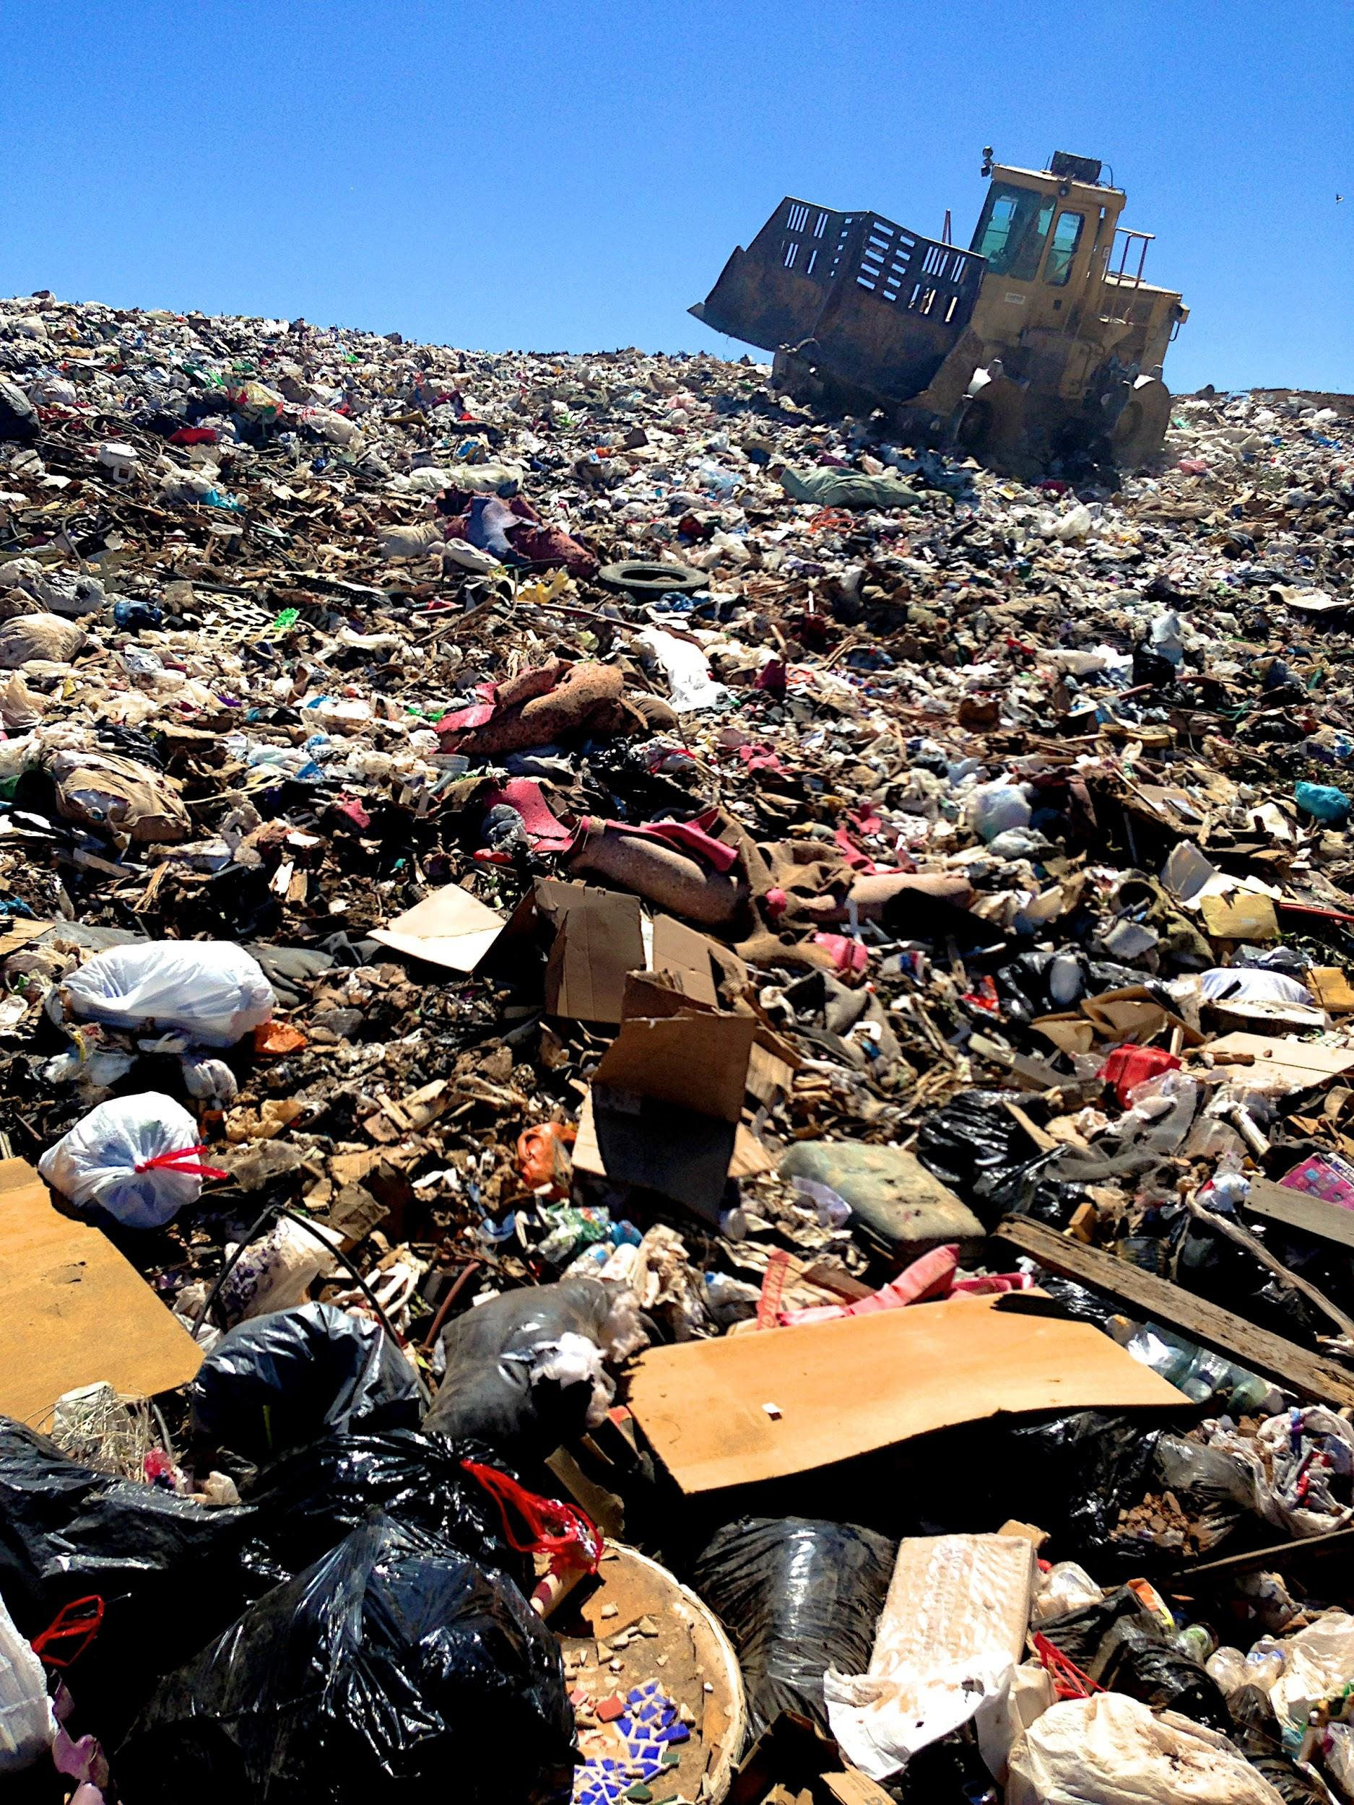
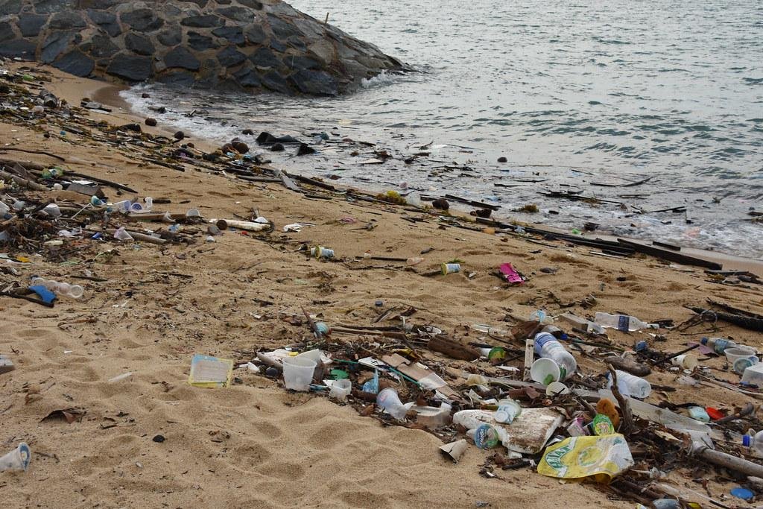
Some of this trash gets recycled,
but much of it ends up in a landfill
or on the ground.

Slide 11
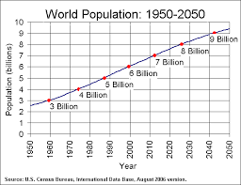


Increases in population
led to increases in the demand for manufactured materials and goods.

Slide 12

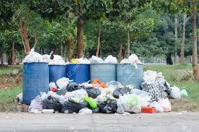
Increase in manufactured goods
Causes an increase in solid waste.
Online Reference

Slide 13
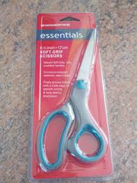


The main cause of plastics piling up in landfills are
the plastic packaging used to protect and sell products in stores.
Online Reference

Slide 14

The Good News:
Improvements are being made to reduce the use of items that take a long time to decompose.
Let’s explore some existing policies that hope to reduce land pollution…..

Slide 15

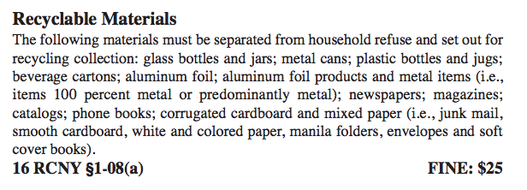
Evaluate Existing Policies:
Online Reference

Slide 16

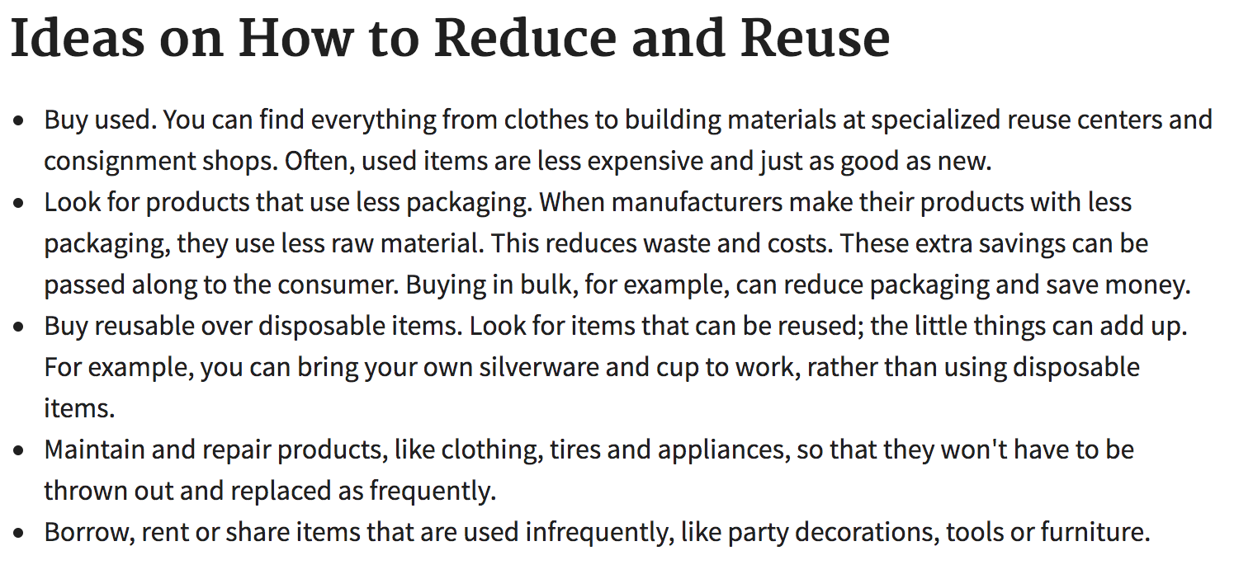
Online Reference

Slide 17

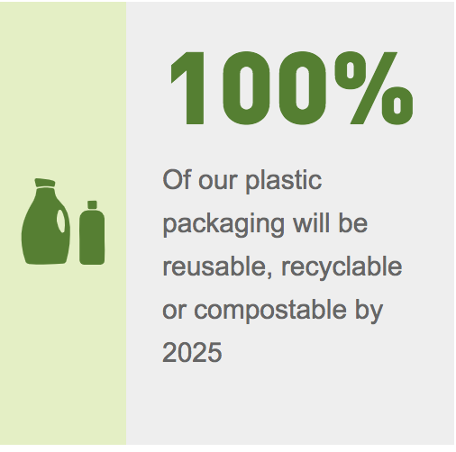
Online Reference

Slide 18

Bad News:
Scientists say we still need to do a lot more to reduce the build-up of waste.

Slide 19
WHAT CAN WE DO????????
Let’s
Brainstorm
Solutions

Slide 20
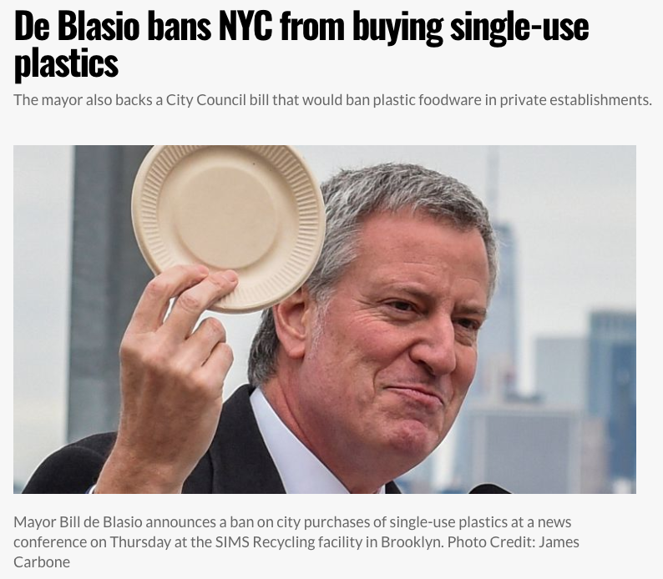
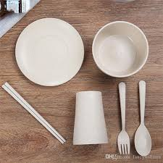
Develop Solutions:
Option #1-- Ban all one-time use plastic items in homes, businesses and community groups.
Online Reference

Slide 21
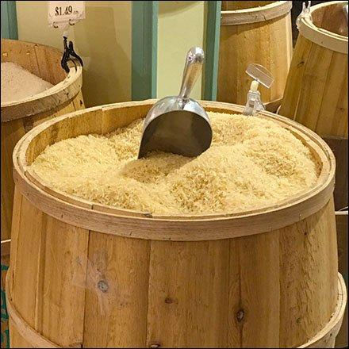
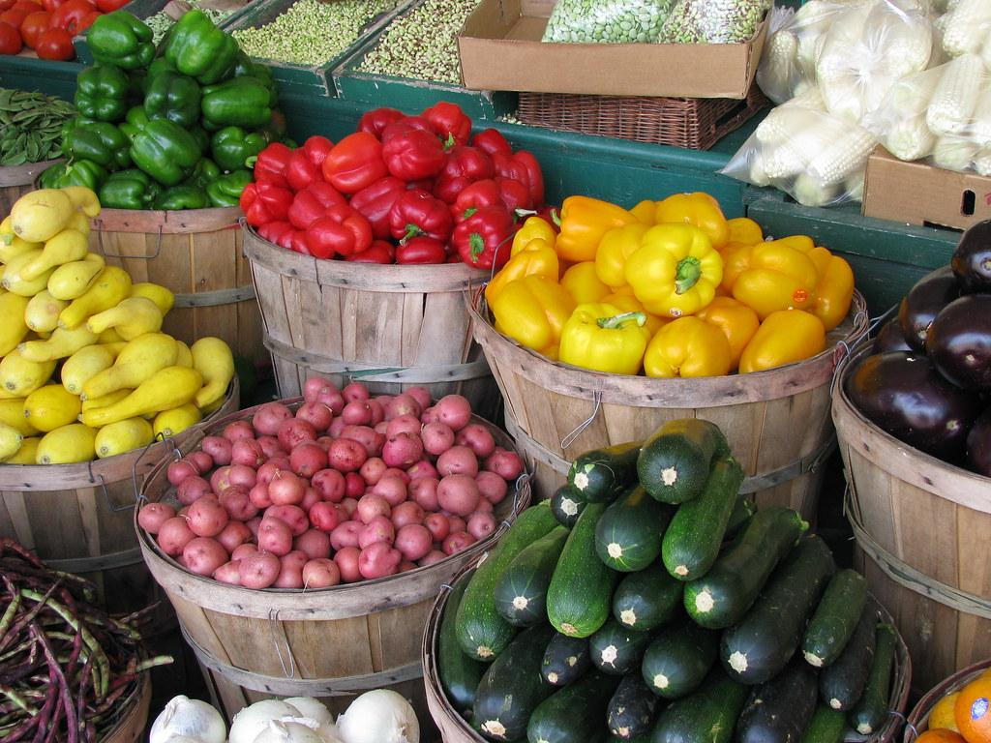
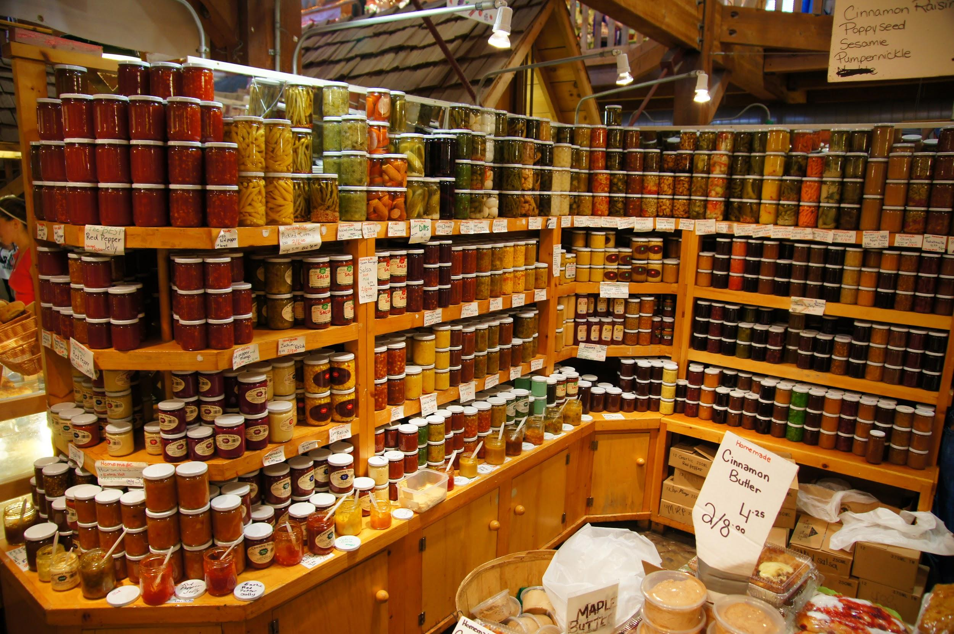
Option #2-- Supermarkets could be more like farmer’s markets where food is often stored in large quantities. Packaged food can be in containers that are made from natural materials.

Slide 22
Option # 3--
Students will discuss in groups another option for dealing with the problem of using plastics that take hundreds of years to decompose.

Slide 23
Selecting the Best Solution:
Before we can choose the “best” way to solve the problem with plastic waste, we need to consider two important words:
Feasibility----how easily can it be implemented?
Effectiveness--- how much good will it do improve the problem?

Slide 24


