Slide 1
A Closed, Fixed Mindset
By Ms. Liso
P.S. 398Q

Slide 2
Public Policy Analyst (PPA)
The purpose of the PPA is to help you better understand social problems in your school and community. Here are the steps:
Define the Problem
Gather Evidence
Identify Causes
Evaluate Existing Public Policies
Develop Public Policy Solutions
Selecting the Best Policy Solution

Slide 3
Turn and Talk: What is the problem she had in the story? When do you have that problem?
https://www.youtube.com/watch?v=8QSPfnQCIY0

Slide 4
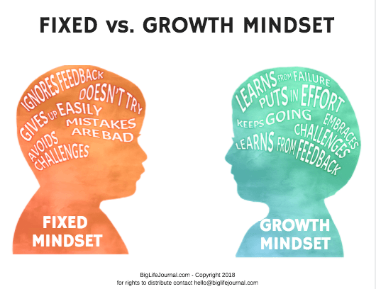
Step 1: Define the problem
What is the problem?
List:
Student responses

Slide 5
Step 2: Gather Evidence
Is it a real problem? - Survey Time!
| | | | | | = 6
| | = 2

Slide 6
Step 3: What are the causes?
List:
Student responses

Slide 7
Step 4: Examine the policy
What do you do now when you have this problem?
List:
Student responses

Slide 8
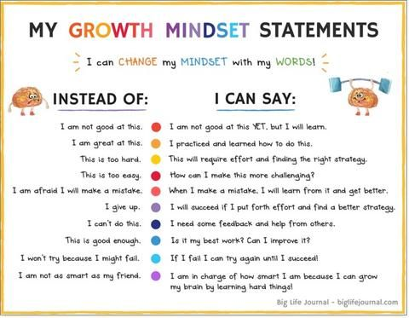
Step 5: Develop Solutions
How can you fix the problem?
How can we have a growth mindset or an elastic brain?

Slide 9
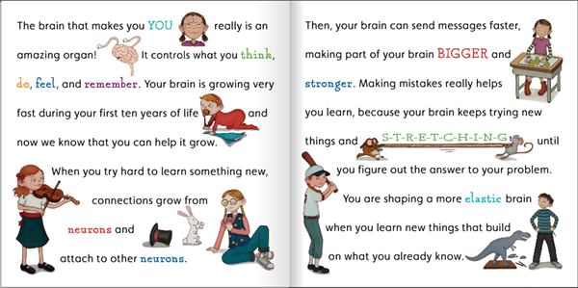
Step 5: Develop Solutions
How can you fix the problem?
How can we have a growth mindset or an elastic brain?
List:
Student responses

Slide 10
Step 6: Select the Best Solution
What is the best solution?

