Slide 1
Diversity at Q300
Alison Lisberger
Ali@q300.org

Slide 2
Public Policy Analyst (PPA)
The purpose of the PPA is to help you better understand social problems in your school and community. Here are the steps:
Define the Problem
Gather Evidence
Identify Causes
Evaluate Existing Public Policies
Develop Public Policy Solutions
Selecting the Best Policy Solution

Slide 3
What is the Problem?
One problem we have at Q300 is that students and staff know little about one another on a personal level (such as their culture, religion and languages spoken).

Slide 4
Where is the Evidence?
Surveys
Inability to answer questions about each other
Interviews

Slide 5
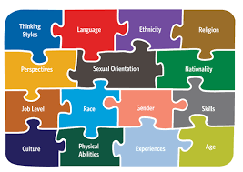
What are the Causes?
Limited Time in the School Day
More Pressing Academic Priorities

Slide 6
What is the Existing Policy?
PTA’s International Potluck
Third Grade Invites Parents to Teach about Culture

Slide 7
What Policies Can You Create to Correct the Problem?
School-wide Assembly
Purchase more culturally diverse texts

Slide 8
What is the BEST Policy to Correct the Problem?

Slide 9
Feasibility (is this possible?)
 | High | Medium | Low
High
Medium
Low
Effectiveness (will is help?)

Slide 10
Solution 1 | Reasons
Solution 2 | Reasons
Solution 3 | Reasons

