Slide 1
Students do not read during the summer...
Why?

Slide 2
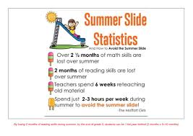
Gather The Evidence

Slide 3
FIND MORE EVIDENCE
https://www.idtech.com/blog/summer-slide-facts-for-productive-sc
10 Facts About Summer Slide for a Productive School Break
Hool-break FINDING THEIR STORY
https://www.scholastic.com/readingreport/home.html

Slide 4
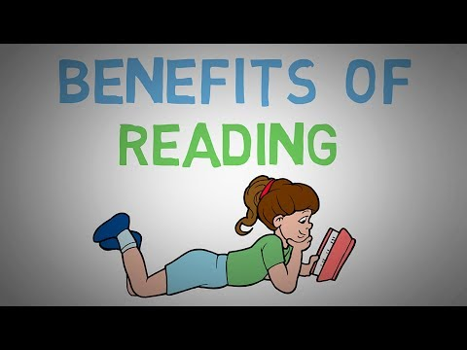

Slide 5
P.S. 171Q Summer Reading Statistics
ONLY X AMOUNT OF STUDENTS READ OVER THE SUMMER
X NUMBER OF STUDENTS READING LEVEL DROPPED

Slide 6
Identify the causes
WHY ARE YOU NOT READING DURING THE SUMMER?
TAKE THE SURVEY
Kids
Parents

Slide 7
Evaluating the summer reading policy we have now...
Summer reading Kick-Off (June)
Summer Reading Promise/Logs
Public Library Access to books and Lunch
Summer Reading Celebration (September)

Slide 8
Developing Solutions
https://www.waterford.org/resources/free-summer-learning-activities-for-kids

Slide 9
Selecting the Best Policy

