Slide 1
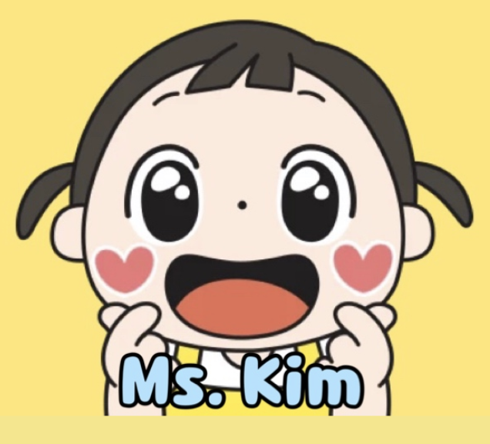
KINDNESS COUNTS
How can we create a positive environment?
Created by Esther Kim Hong

Slide 2
PUBLIC POLICY PROCEDURE (PPA)
Define the problem
Gather evidence
Identify causes
Look closer at existing policies
Develop solutions to the problem
Select the best solution

Slide 3
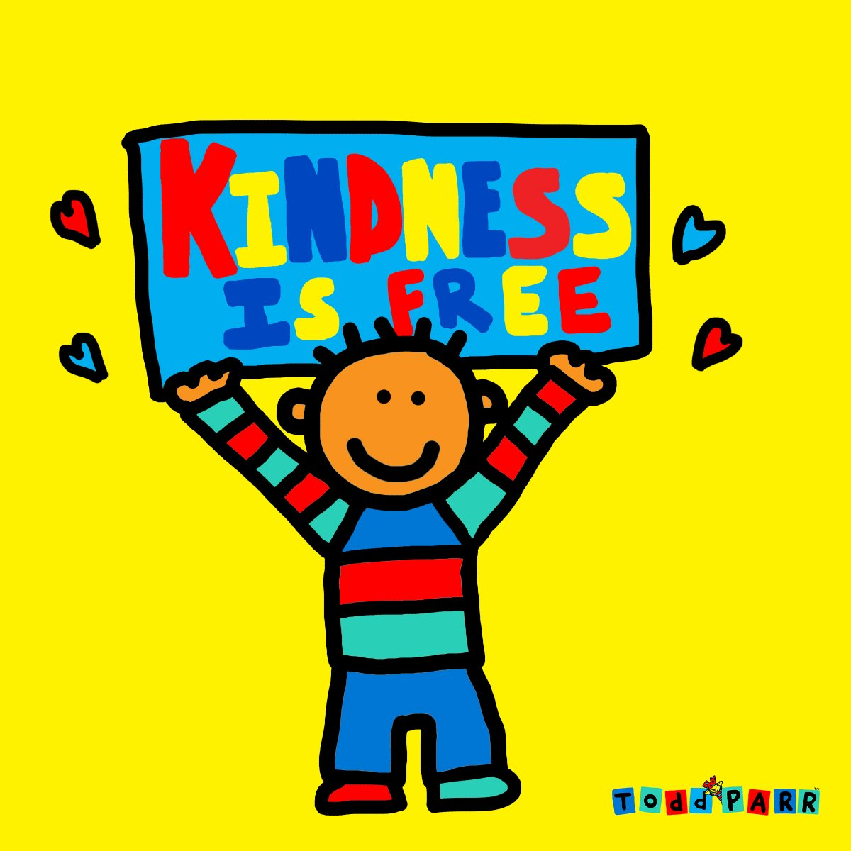
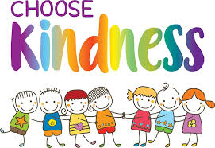
Step 1: Define the Problem
Students are not always kind to one another resulting in many negative behaviors displayed. What would happen if more students learned to respect and tolerate one another and showed kindness towards others?

Slide 4
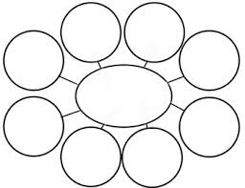
What is kindness?
What does it mean to be kind? Let’s come up with examples that show kindness!
kindness

Slide 5
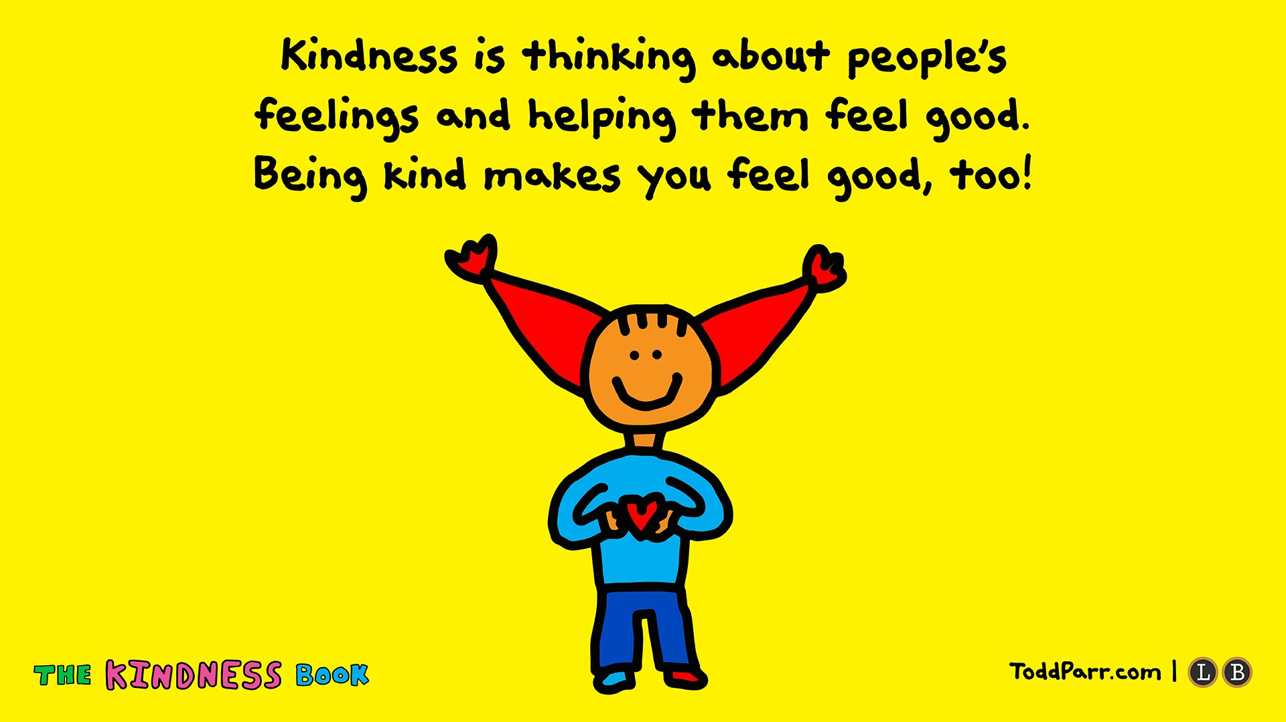

Slide 6
Step 3: IDENTIFY CAUSES
●Why do you think someone might be mean or rude?
●Why do you think someone might not be treated with respect?
●What do you think may be the biggest cause showing disrespect?
Turn and talk with your partner and come up with reasons why you may think this way.

Slide 7
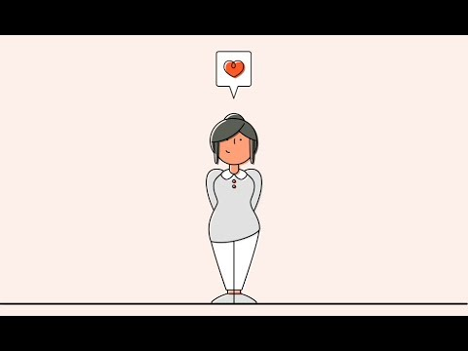
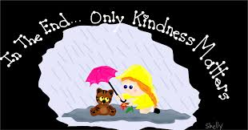
Step 2 : GATHER EVIDENCE
Did you know that there are scientifically proven benefits of being kind?
Watch The Science of Kindness here.

Slide 8
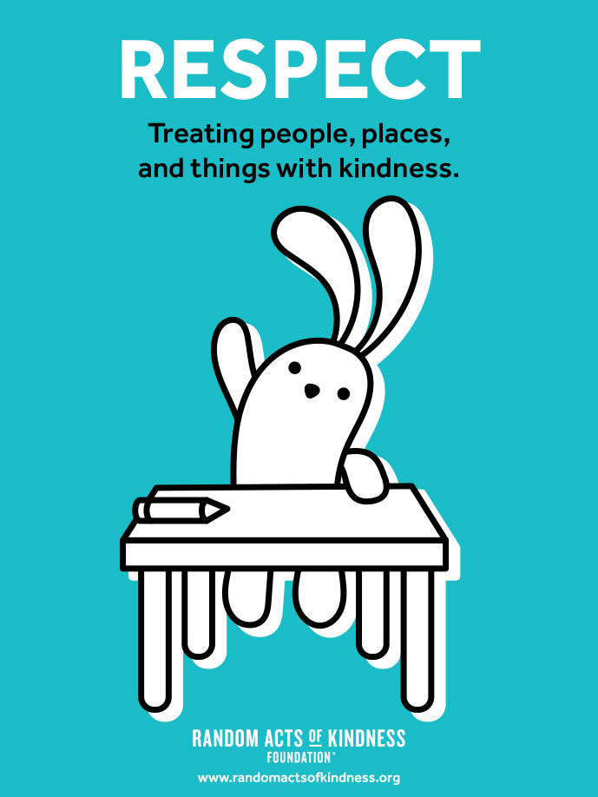
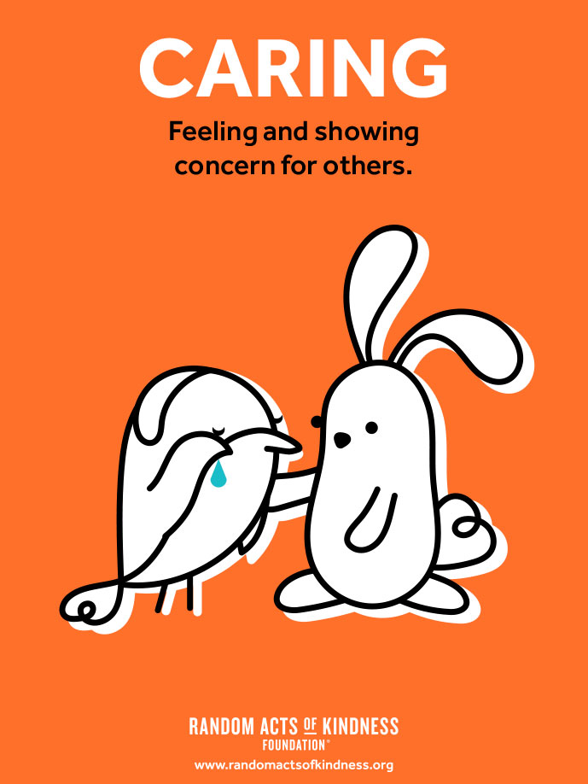
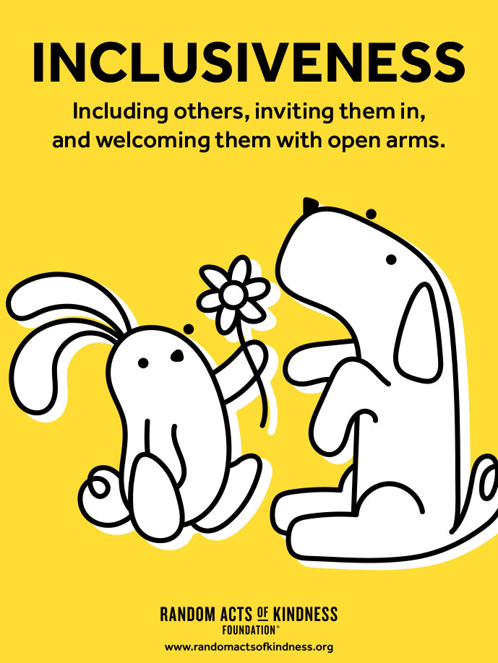
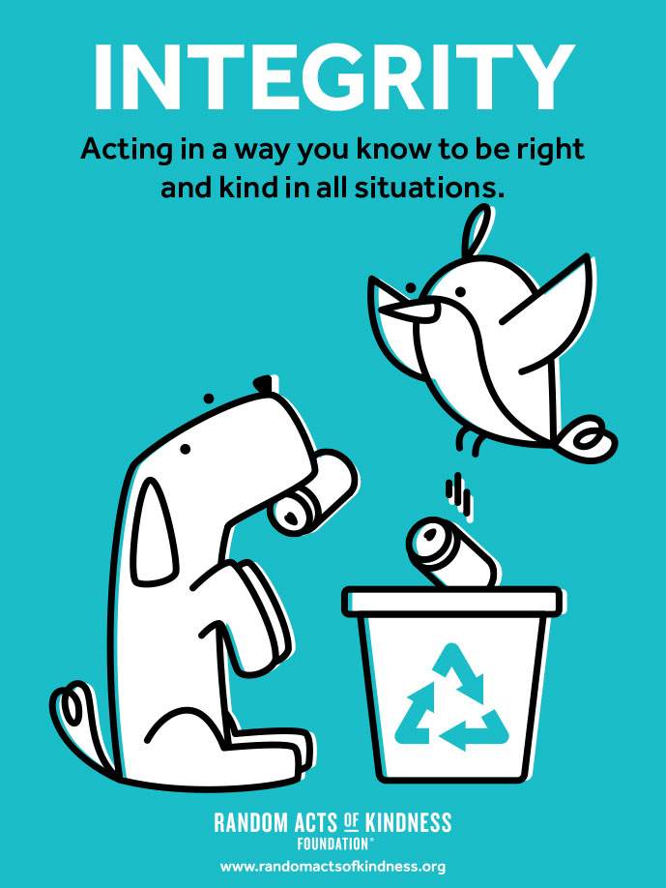
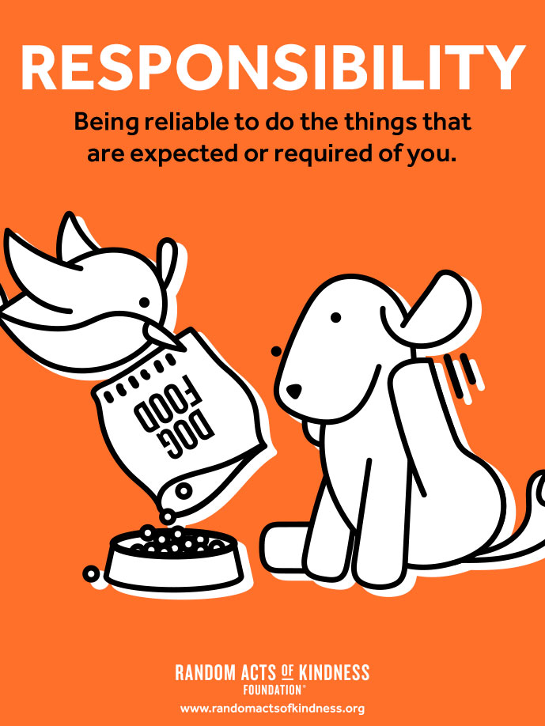
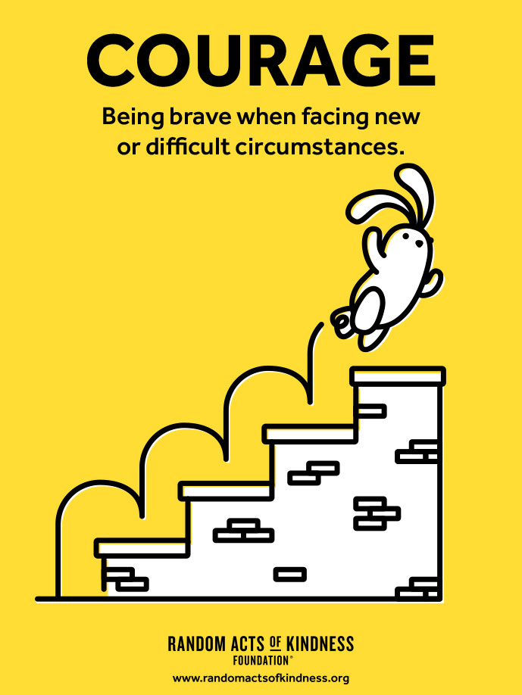
Six core kindness concepts
Step 4: EXISTING POLICIES
Go to the website by clicking on the icon.

Slide 9
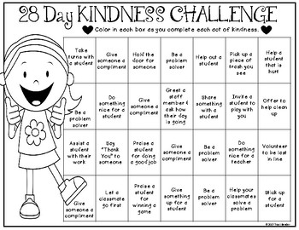
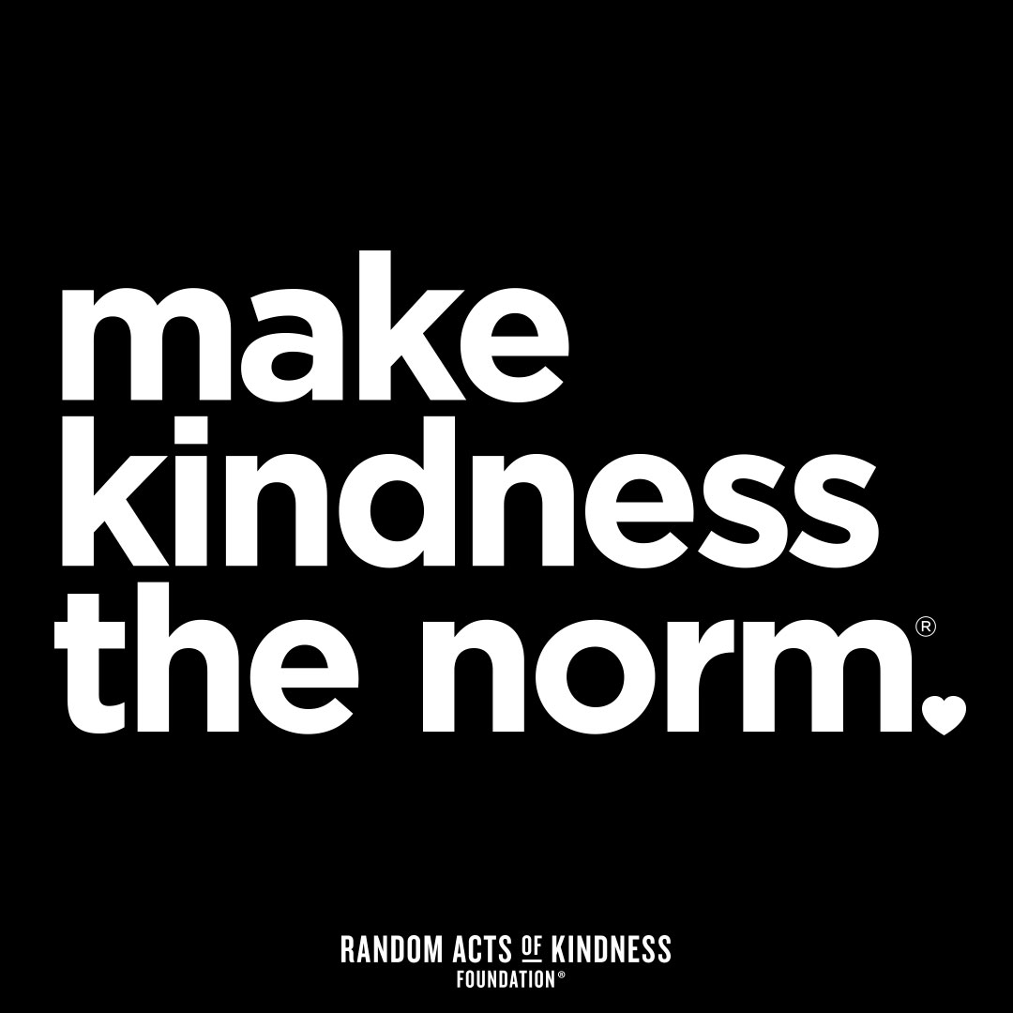
Step 5: DEVELOPING SOLUTIONS
Kindness is contagious!
Kindness Challenge {Promoting Kindness in the Classroom}
Random Acts of Kindness Initiative

Slide 10
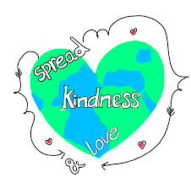
Step 6: SELECTING THE BEST SOLUTION
 | High | Medium | Low
High
Medium
Low

Slide 11
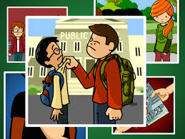
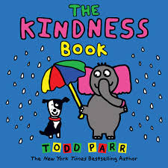
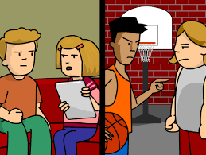
Other Resources
Watch the videos on conflict resolution and bullying by clicking on the images.

Slide 12
