Slide 1
Bullying
How do we prevent bullying?
Eleni Handras
PS112Q

Slide 2
Step 1: Define the Problem
When you identify a problem make sure to be specific and include the problem and the location.
The problem is students are bullied in school. Is it happening more often or are we labeling bullying when it isn’t?

Slide 3
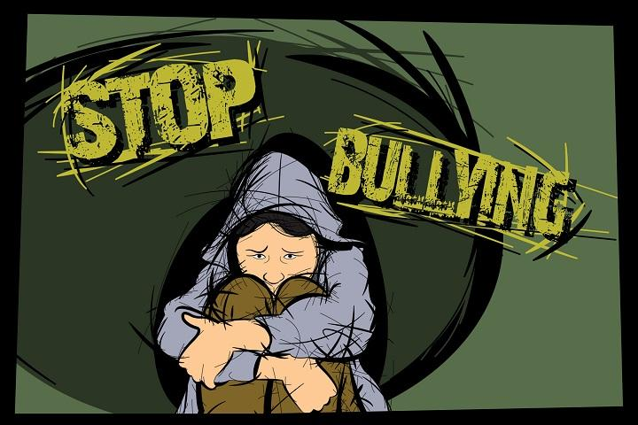
What is Bullying?
Turn and talk to the person next to you.
Discuss the definition of bullying.
Bullying is...
Bullying is not...

Slide 4
Bullying defined by operation respect.org
P – reflect an imbalance of Power- the person engaging in bullying has a real or perceived power over the person being bullied (i.e. age, size, popularity, role, group, etc.)
A – be Aggressive – (including various forms of aggression: physical, emotional, relational)
I – be Intentional – in person or via social media (cyberbullying)
N – occur Numerous times (Repetitive)

Slide 5
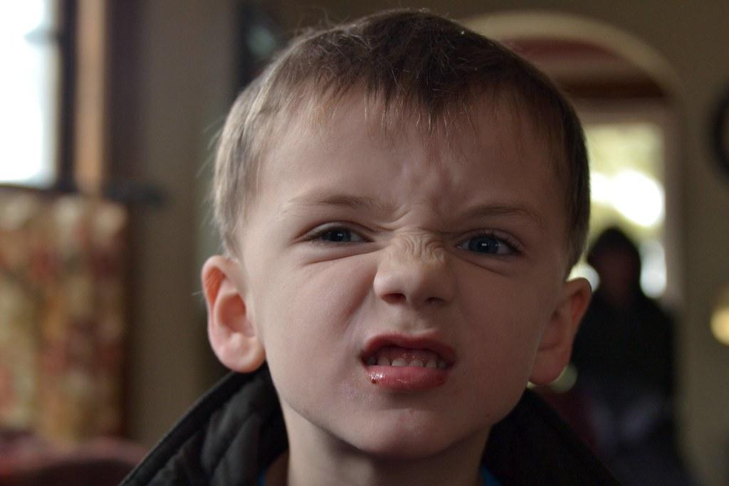
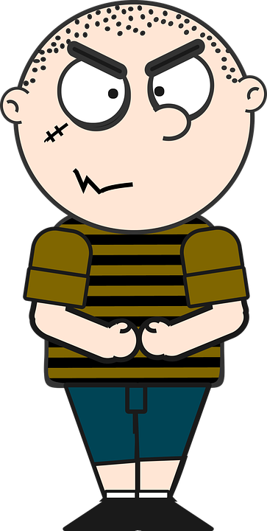
Bullying is not...
Bullying is not a one-time offense.
If someone says or does something unintentionally hurtful and they do it once, that’s RUDE. If someone says or does something intentionally hurtful and they do it once, they are being MEAN.

Slide 6
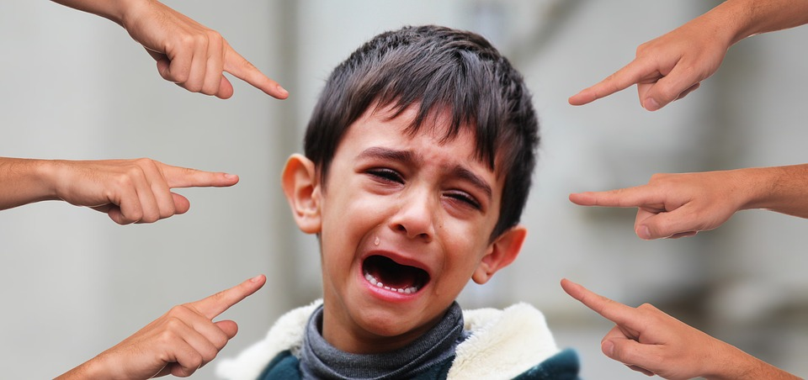
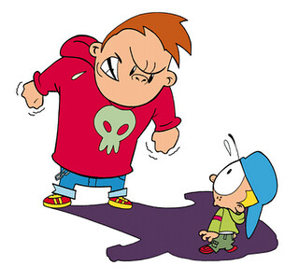
Have you ever felt bullied before?
How did you feel?
Jot it down on a post-it.
Who would like to share?
Notes:
Students will share out if they have ever been bullied. If the student who is sharing feels comfortable enough,

Slide 7
What are the different kinds of bullying?
Turn and Talk to the person next to you!
Let’s make a list:
Notes:
Students will discuss and create a list as a whole group what they think the different kinds of bullying is.

Slide 8
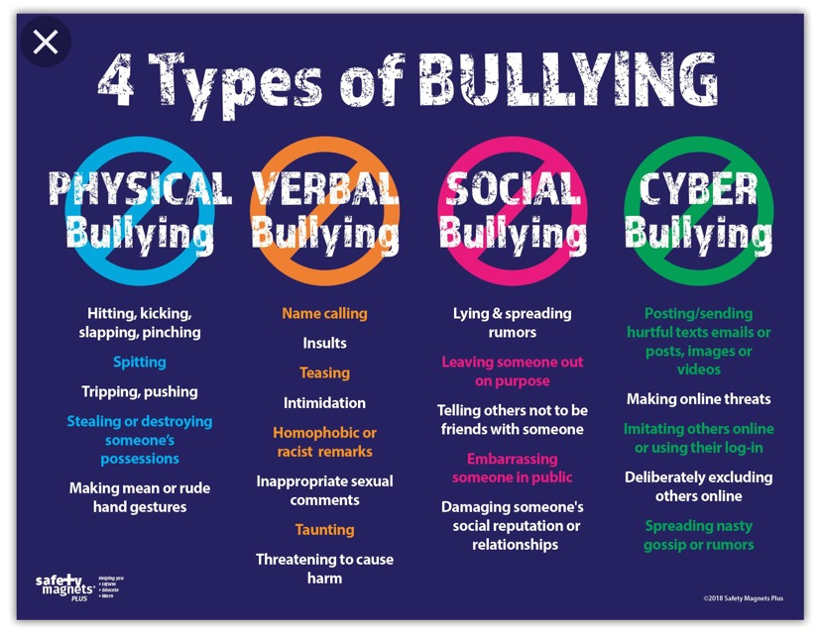

Slide 9
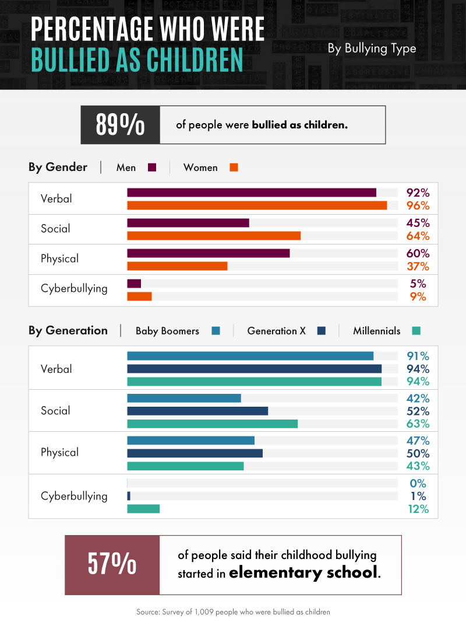
Step 2: Gather Evidence
When you face a problem, you need to collect data, proof of what you are questioning. The best way to understand this problem is to have empathy- putting yourself in someone else’s shoes.
How would you feel if you were the victim of bullying?
How would you want someone else to help you if you were caught in the middle?

Slide 10
Step 3: Determine the Causes
Is the bully having a hard time and projecting his problems on others?
Is it the way some people are raised or taught?
Is it because no one cares when bullying happens?
Is it because when you tell an adult that something is happening, nothing changes?
Is it because the bully has been bullied before?

Slide 11
Step 4: Evaluate existing policies
PS112Q Student Behavioral Expectations state:
Treat others as we would like to be treated: This means that students
offer positive help and support to adults and peers
respect people’s personal space
Do not touch things that belong to others, unless given permission
use appropriate language and speak respectfully to adults and peers
DOE Chancellor’s Code of Conduct: Referral to Counseling Services for Bullying, Intimidation, or Harassment
When a student or group of students engages in bullying, including cyberbullying, intimidation, or
bias-based harassment, of another student or group of students, both the target of the behavior
and the student who engages in this behavior should be referred to separate appropriate
counseling, support, and education services provided by school staff or a community-based agency. Neither mediation nor conflict resolution is, under any circumstances, appropriate interventions for bullying, intimidation, or harassment.

Slide 12
Step 5: Developing Solutions
Thinking about what problem solving strategies or solutions can help in this situation?
How would you help?
Be very specific in what will help make the situation better.
Take a look at Face Bullying With Confidence: 8 Kidpower Skills We Can Use Right Away
TURN AND TALK
What are your thoughts about what they have to say? Do you have any ideas on how to STOP bullying?

Slide 13
Step 6: Selecting the BEST Policy Solution
Why is this solution the best option?
FEASIBILITY
 | High | Medium | Low
High
Medium
Low
EFFECTIVENESS

