Slide 1
School lateness
By:Mallory Goldberg

Slide 2
The 6 steps of public policy analyst (ppa)
1. Define the Problem
2. Gather the Evidence
3. Identify the Causes
4. Evaluate an Existing Policy
5. Develop Solutions
6. Select the Best Solution (Feasibility vs. Effectiveness)

Slide 3
Problem: Many students are late to class every day.

Slide 4
What time does school start?
8:10 A.M.
School starts at…
We have to be in our seats at…
Ms. Goldberg starts the day at..

Slide 5
Let’s take a deeper look
At what being late looks
Like…
You MISSED your reading instruction! (FUNDATIONS/SPIRE)
YOU WERE MARKED LATE (AGAIN)
AN ATTENDANCE OFFICER WILL VISIT YOUR HOUSE
YOU MISSED THE SPELLING QUIZ ON FRIDAY
late·ness
/ˈlātnəs/
Learn to pronounce
noun
1. the fact or quality of happening or arriving after the expected or usual time; unpunctuality.

Slide 6
Why were you late?! (that one, two , or three times?)

Slide 7
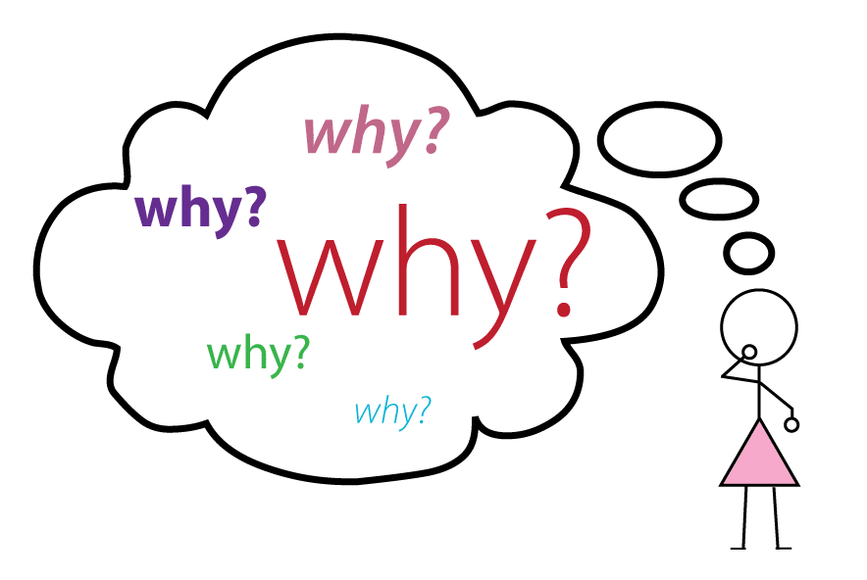
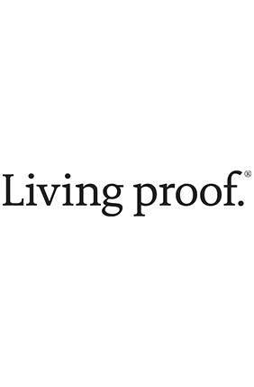
When you face a problem, you need to collect data, or proof of what you are questioning. The best way to understand this problem is to understand why it is happening!

Slide 8
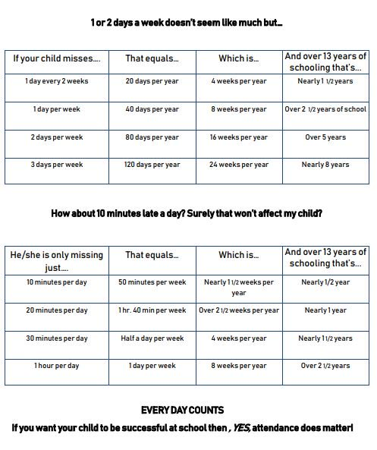
Step 2: gather evidence

Slide 9
Lateness effects...
late·ness
/ˈlātnəs/
Learn to pronounce
noun
1. the fact or quality of happening or arriving after the expected or usual time; unpunctuality.
1: routine
2: social awareness
3: low achievement
4: responsibility

Slide 10
Step 3: Determine the Causes
Do you set an alarm?
Are you going to sleep too late?
Is mom or dad helping you get to school on time?
Do you know who is taking you to school every day?
***how does this make you feel?***

Slide 11
Step 4: Evaluate existing policies
From the chancellor himself...
D. Ensuring Regular Student Attendance: Schools must establish and maintain a system for recognizing patterns of student absence. A student whose attendance rate is less than 90% is chronically absent. Schools must establish and implement specific interventions to reduce the number of students who are chronically absent.
Did you know that a student with 90% attendance has missed one month of school by the end of the year? Students with less than 90% attendance are more likely to have lower test scores and not graduate from high school.

Slide 12
Lets chat...
1: Ms. Goldberg misses you when you are not here...
2: Ms. Goldberg is not mad at you because you are late...
3: I want the best for you ...
4: Can Ms. Goldberg talk to mom/dad about getting you here on time?!

Slide 13
Step 5: Developing Solutions
-let’s talk with mom and dad :)
-let’s create a journal?
-let's get you a relaxing night time routine
-can we earn rewards for being on time?
-Message me on class dojo when you are on your way!

Slide 14
Step 6: Selecting the BEST Policy Solution
Why is this solution the best option?
FEASIBILITY
EFFECTIVENESS
 | High | Medium | Low
High
Medium
Low

