Slide 1
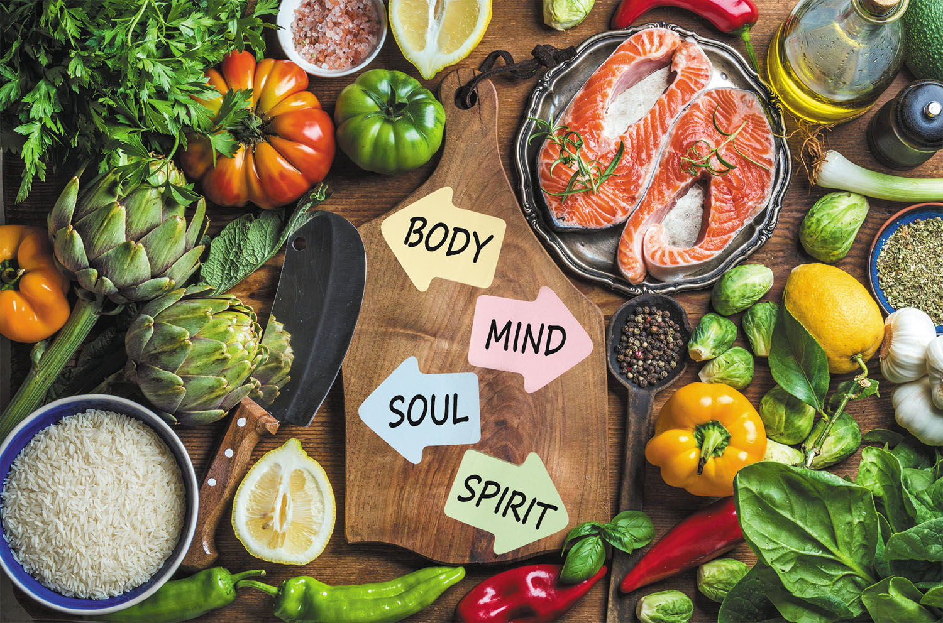
Let’s Talk Food

Slide 2
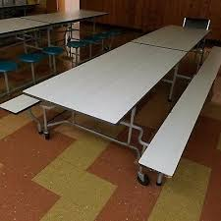
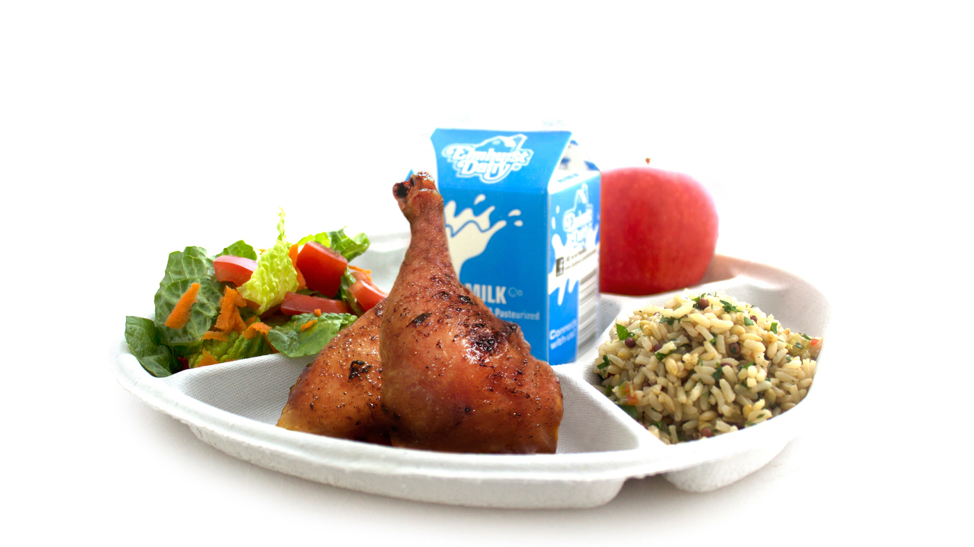
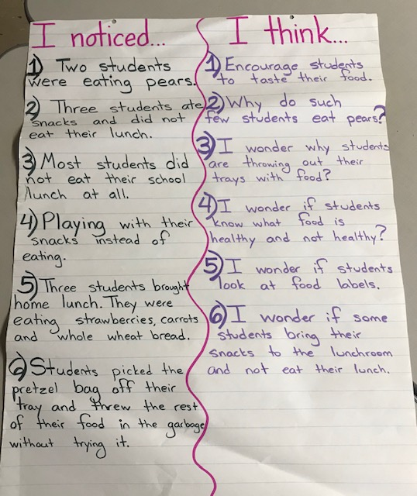
We observed! We visited the cafeteria and observed what the kindergarteners were eating and not eating. We COLLECTED DATA!
We notice: We think:
Step 1 of the PPA *Define the problem*

Slide 3
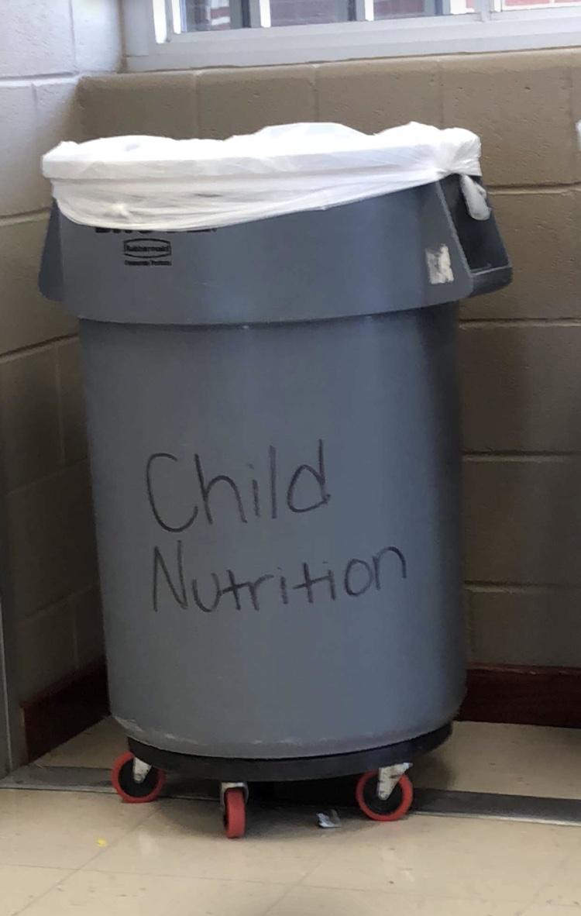
We noticed a problem!
Students at P.S. 17 have not been making healthy food choices!
They are throwing away healthy food and eating unhealthy food!
Step 2 of the PPA
*Gather evidence*

Slide 4
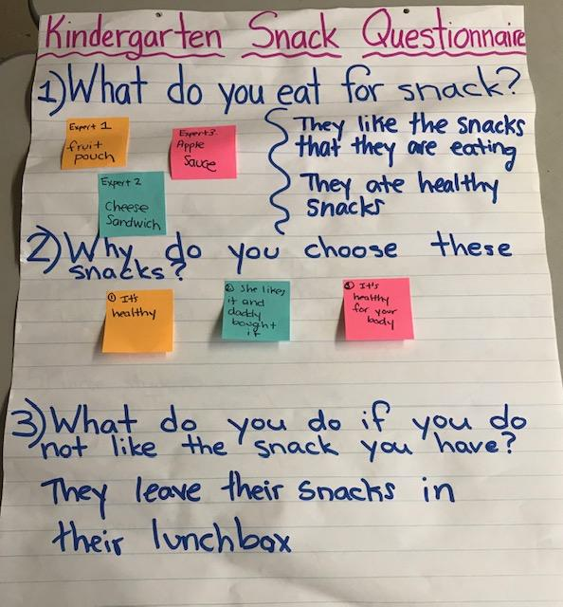
Let’s gather more information! (We need more evidence)
We created a Snack Questionnaire!
We collected more
DATA by asking kindergarteners about their eating habits!
Step 3 of the PPA *Determine the Causes*

Slide 5
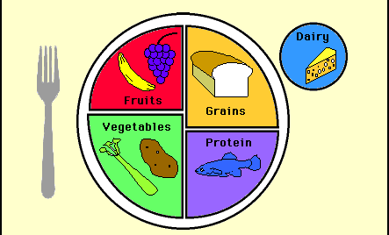
Let’s Talk Food:
My Plate
Eating food from the 5 Food Groups keeps our bodies healthy and strong!
There are 5 Food Groups!
What did you eat today?

Slide 6
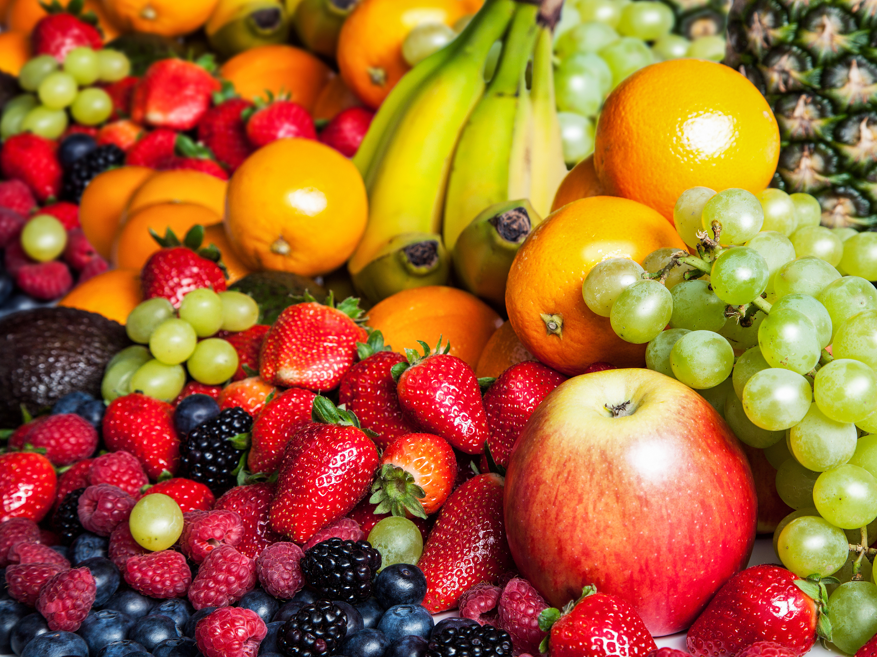
Let’s Talk Fruit!
Where can we get these healthy fruits?
What are some fruits we can eat?
Research: What are some healthy facts about fruits?

Slide 7
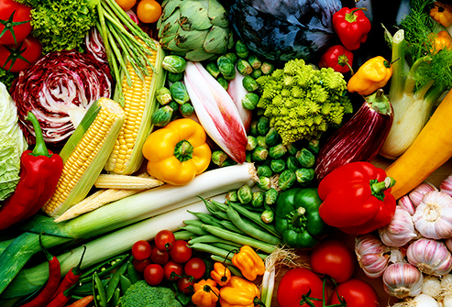
Let’s Talk Vegetables!
Can you think of recipes that have vegetables inside?
What are some vegetables we eat?
Research: What are some healthy facts about vegetables?

Slide 8
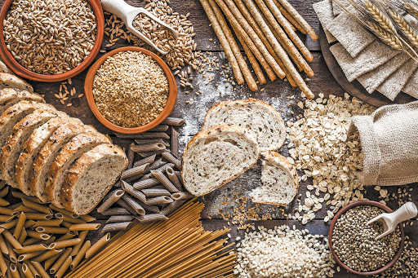
Let’s Talk Grains!
What kind of grains would you recommend to your friends and why?
What are some grains we eat?
Research:What is the healthiest type of grain?

Slide 9
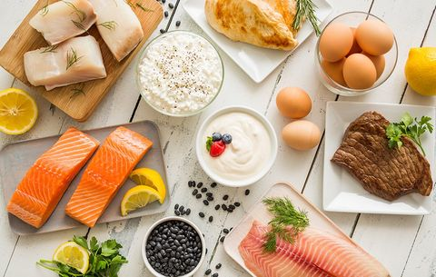
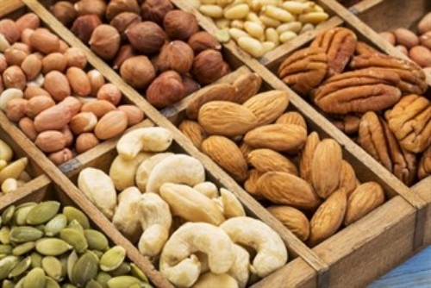
Let’s Talk Protein!
Research: Why do we need to eat protein?

Slide 10
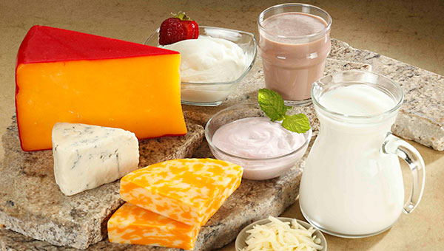
Let’s Talk Dairy!
What did you eat today that had dairy in it?
Research: How can dairy help our bodies?

Slide 11
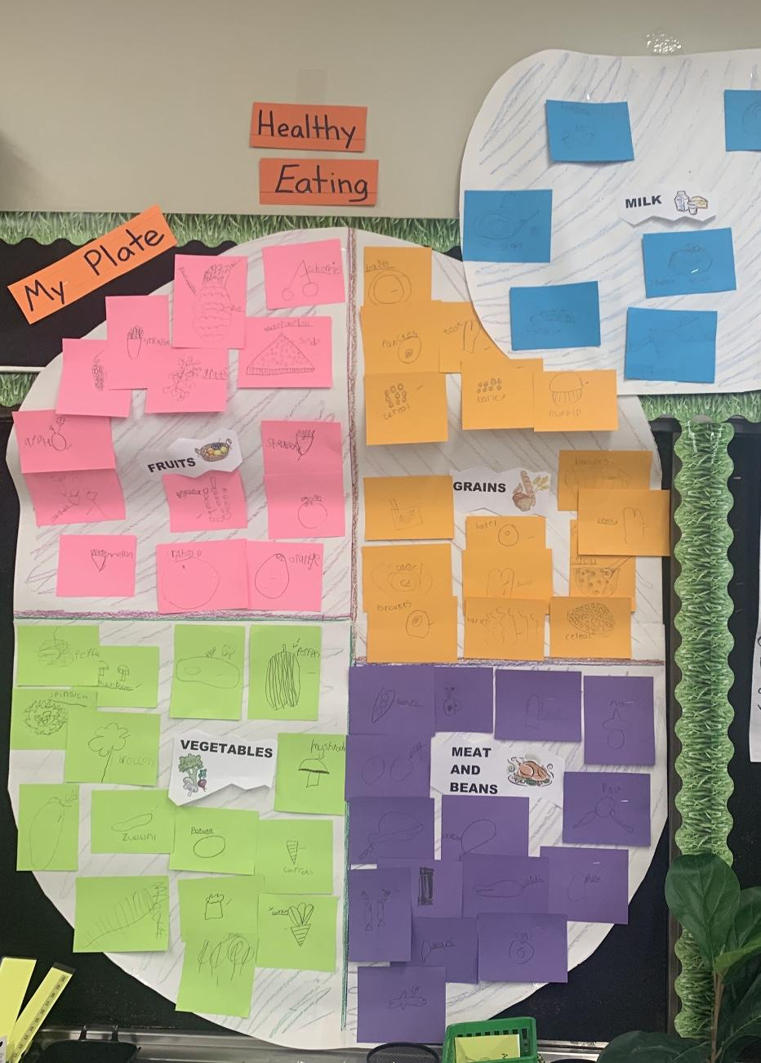
We chose food groups and worked in teams! We used sources! We drew and labeled foods!
We created a HUGE MyPlate for all to see!
Was it part of the 5 Food Groups?
Let’s Reflect!
What did you
eat today?
If so, which food groups?

Slide 12
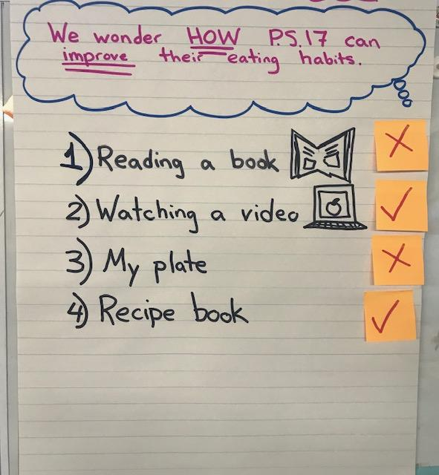
HOW can we help the students at PS 17 make healthier food choices?
Generated solutions -->
We chose 2 best solutions! ---->
Step 5 of the PPA *Develop solutions*

Slide 13
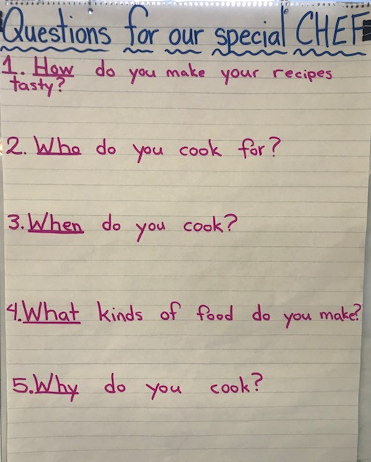
We need some help! Time to Ask an Expert!
We found out that there is a chef working in our school!
We generated questions that can help us learn more about recipes!
We will soon create our own healthy recipes!

Slide 14
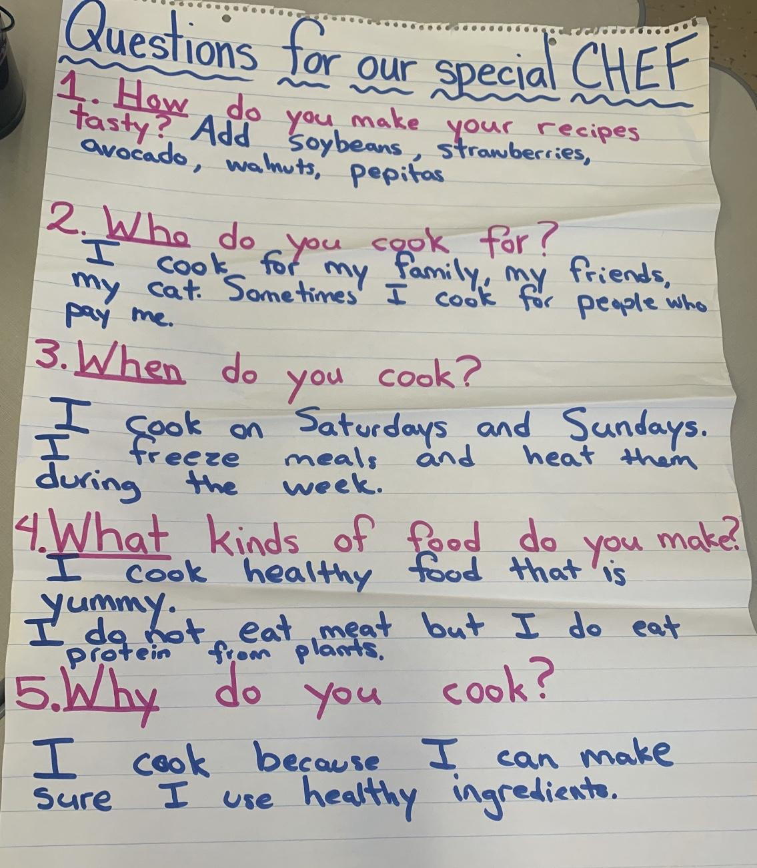
Chef Vince arrived to our classroom!
We asked Chef Vince questions about her recipes and her choice of ingredients!
We learned so much from Chef Vince!

Slide 15
We were inspired by Chef Vince! We did research on healthy and easy-to-make snacks! We made a plan: 1. Make a recipe 2. Taste it 3. Rate it 4. Ask ourselves:
Should we promote it in our school?
Step 6 of the PPA
*Selecting the best policy*

Slide 16
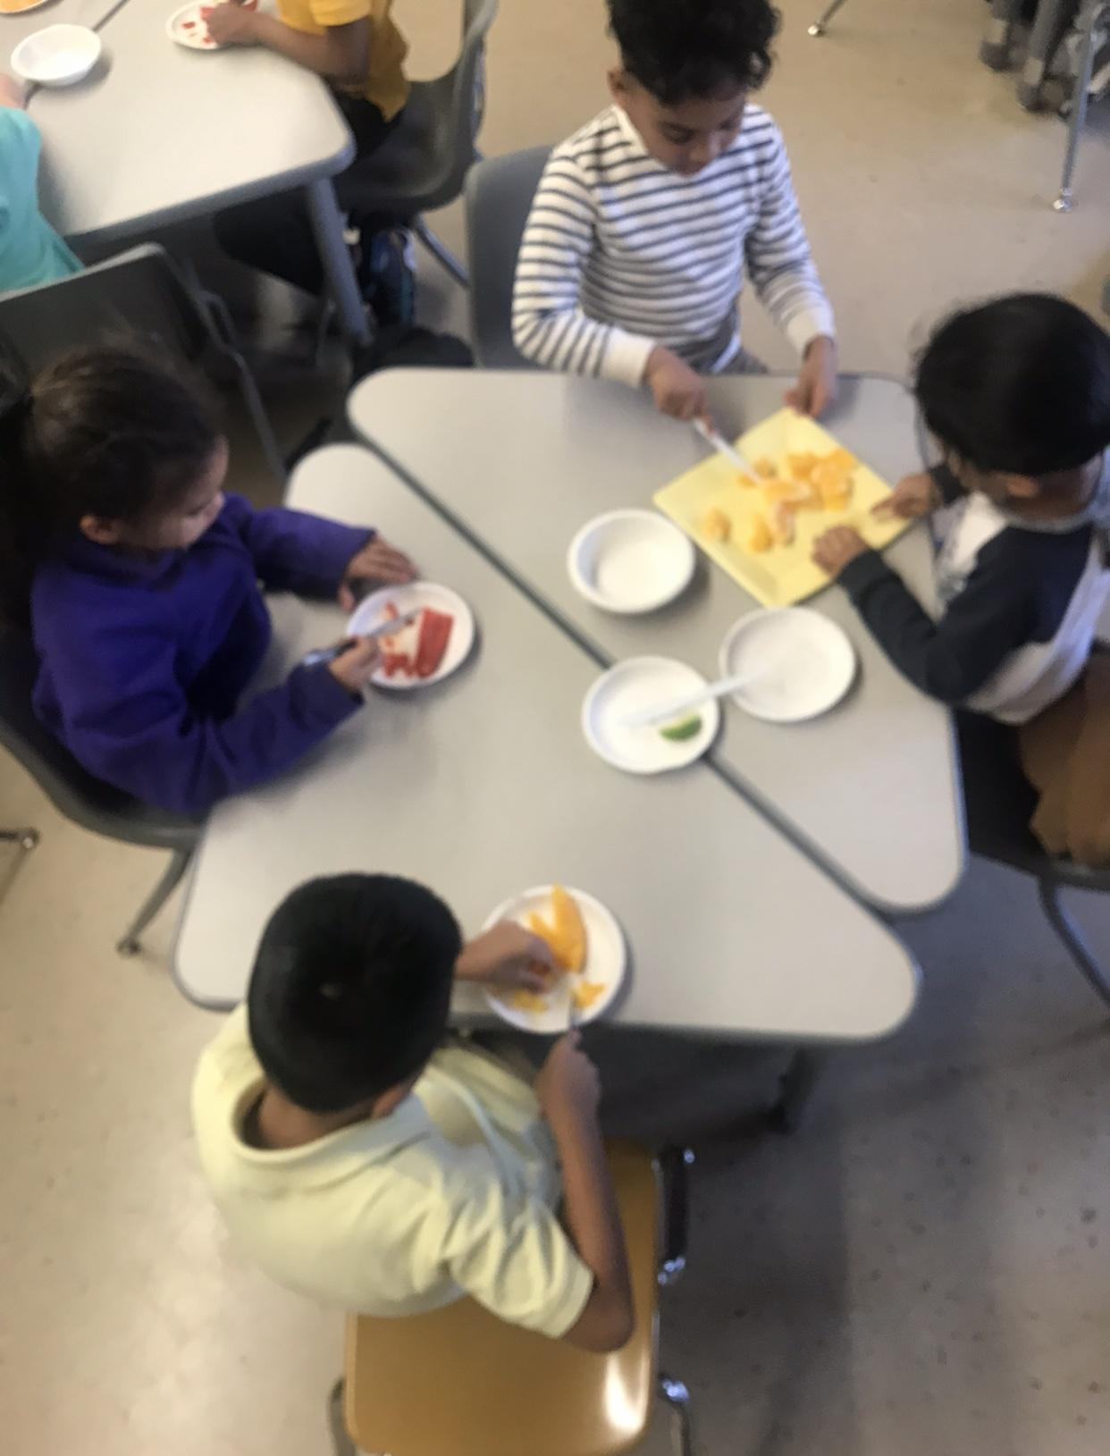
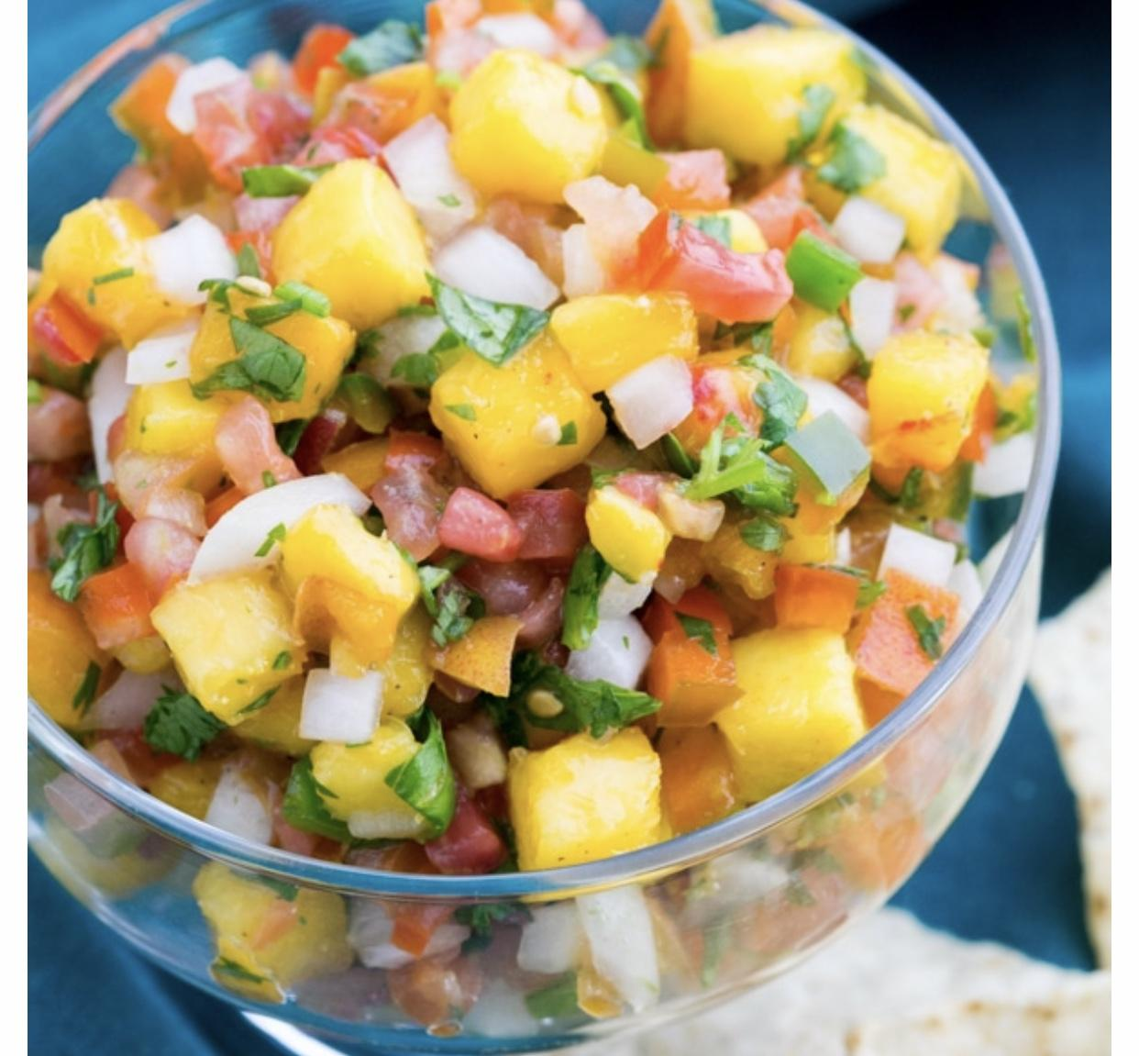
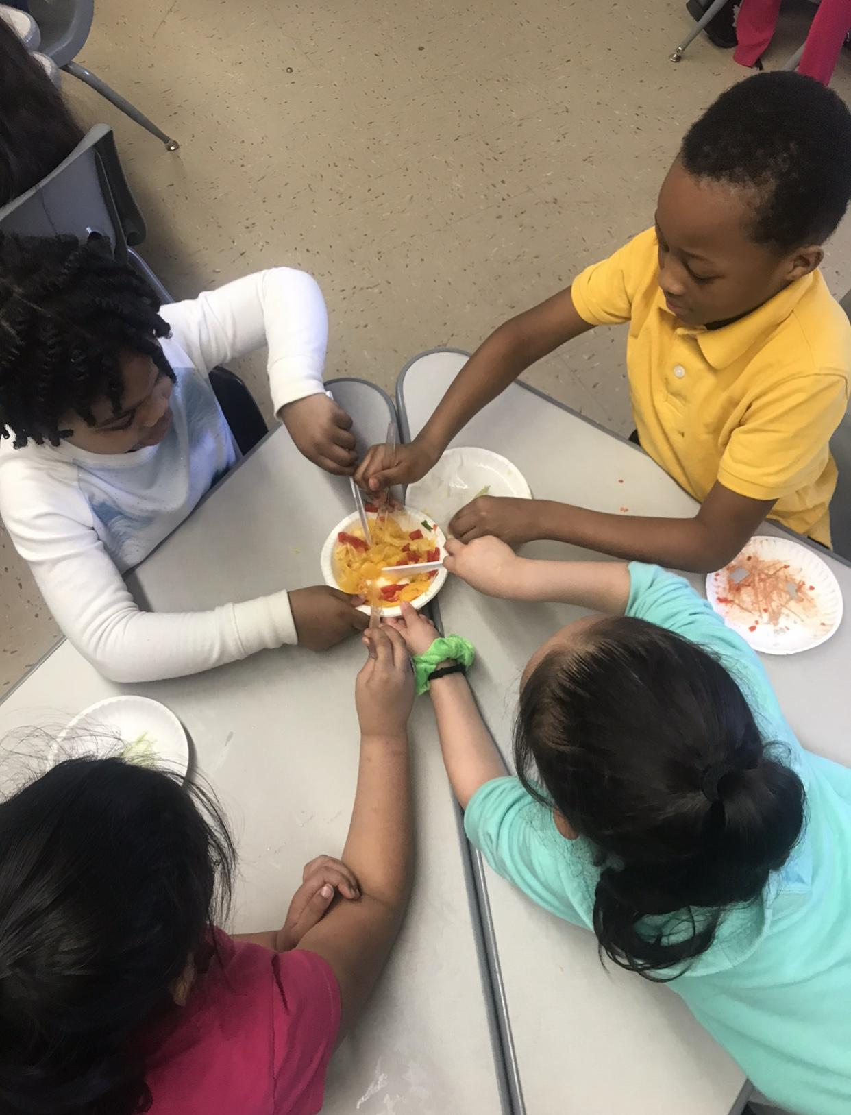
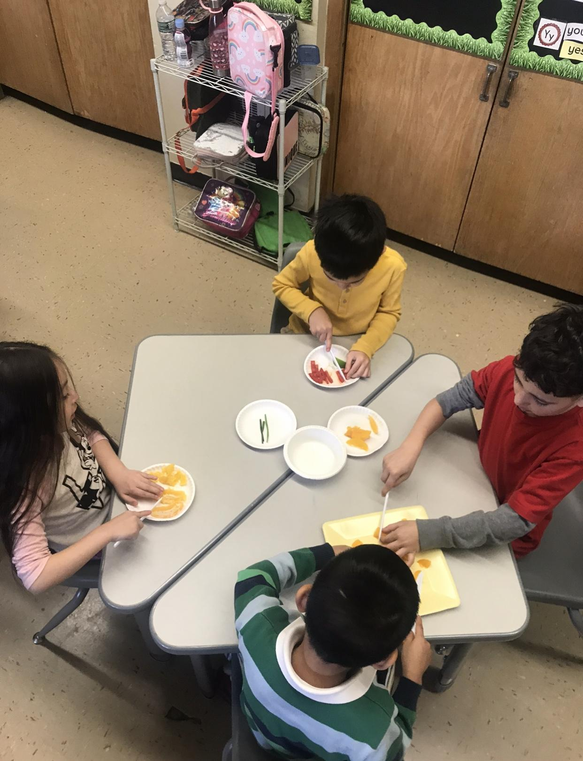
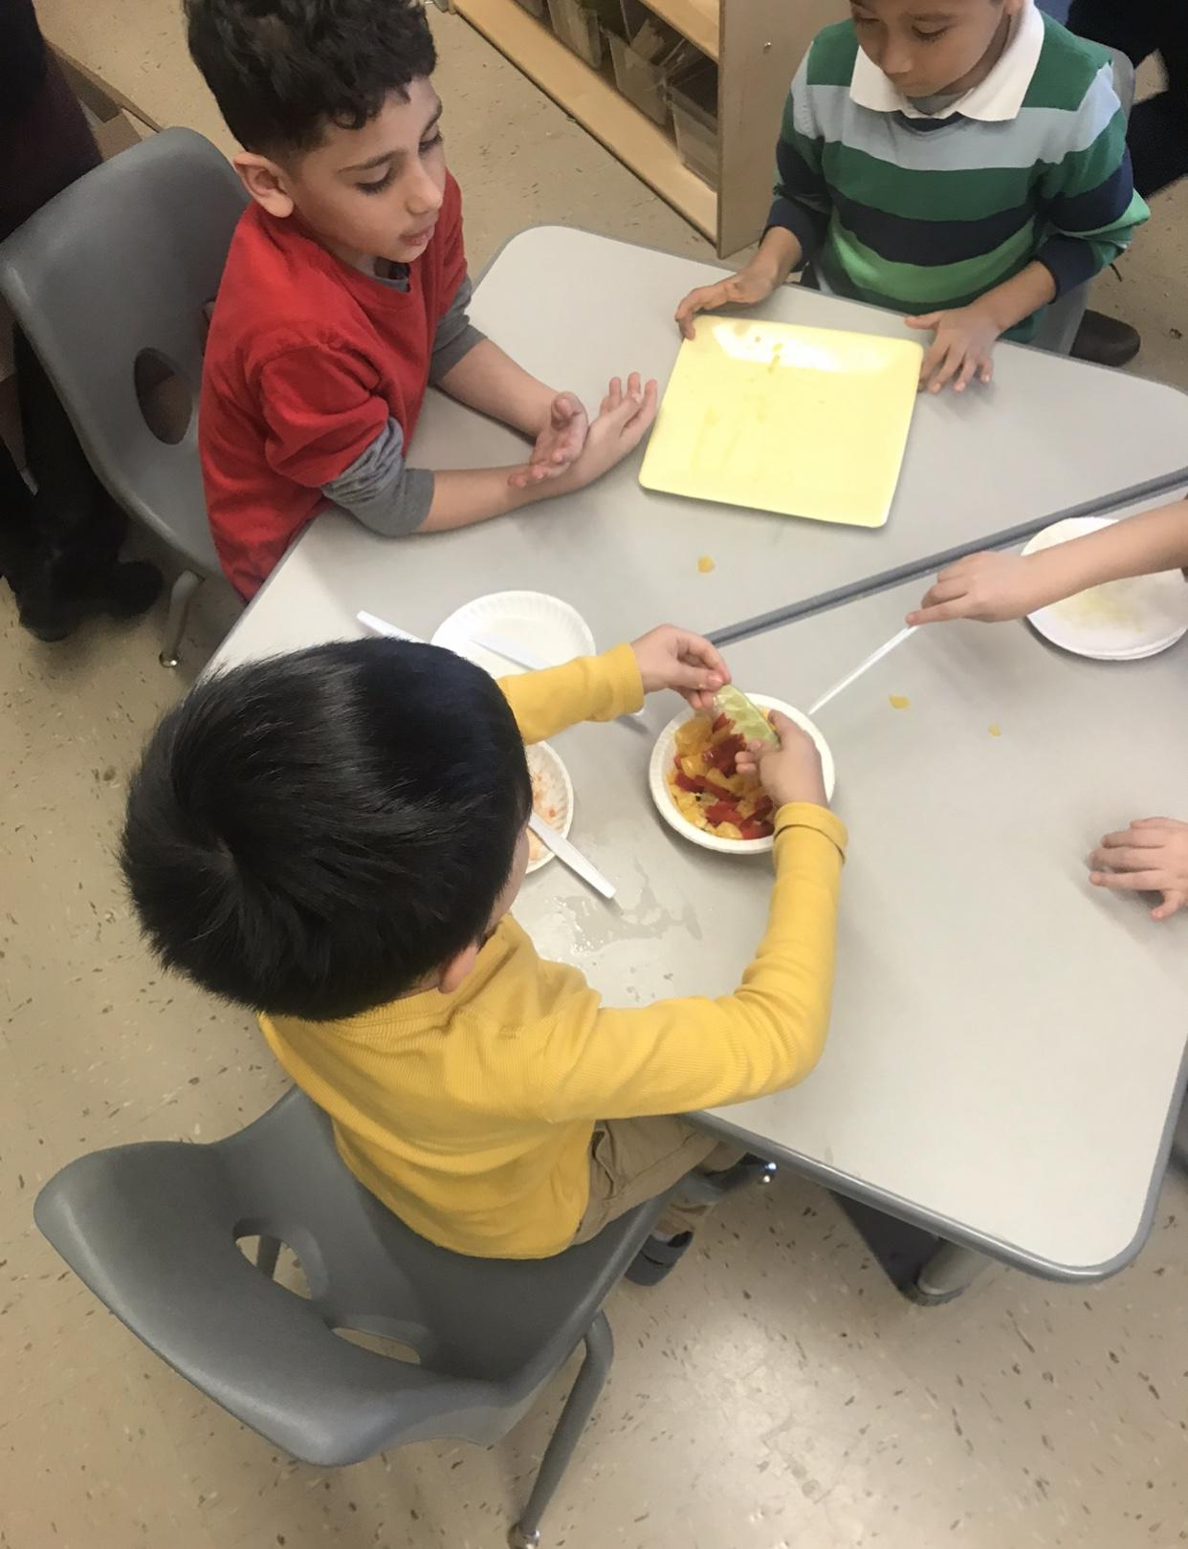
We tried our first recipe! Peachy- Orange Salsa!
Hmm...would our school like to make and eat this healthy snack?
Let’s rate it!

Slide 17
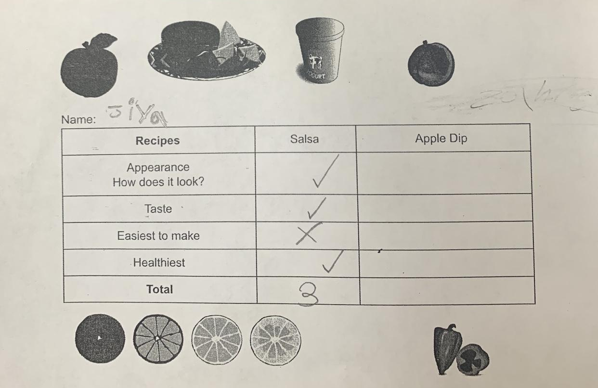
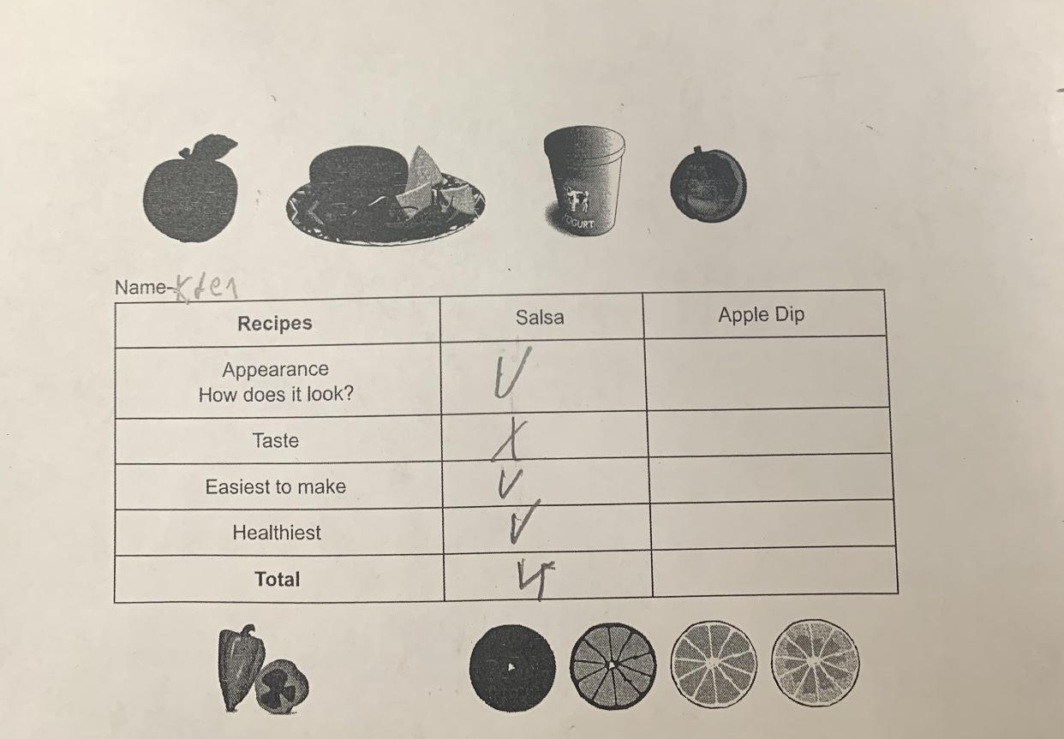
We Rated our FIRST Recipe!
We rated:
The food’s appearance
Its taste! How easy it is to make!
How healthy it is!

Slide 18
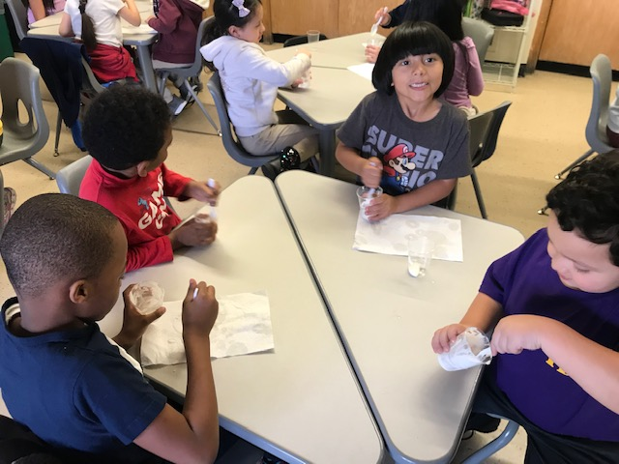
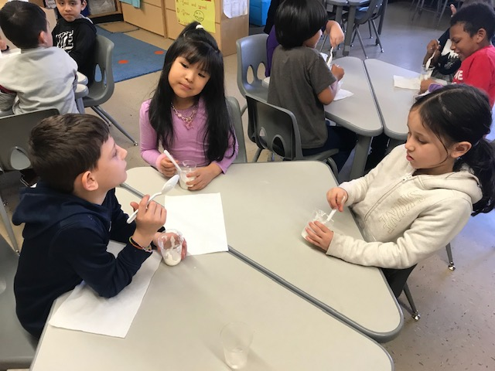
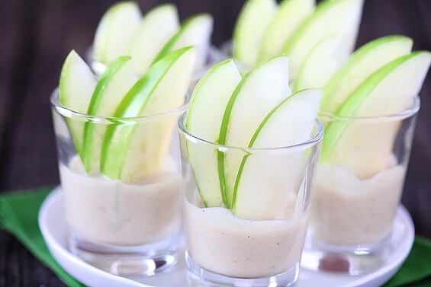
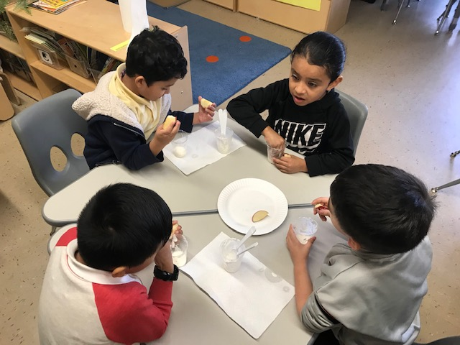
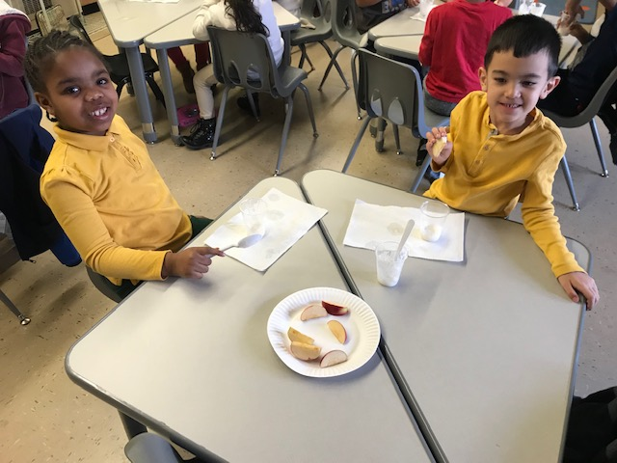
We tried our second recipe! Apple Dippers!
Hmm...would our school like to make and eat this healthy snack?

Slide 19
We Voted!
Peachy- Orange Salsa!
OR Apple Dippers!

Slide 20
APPLE DIPPERS WON!

Slide 21
ALLOW US TO SHARE THE RECIPE WITH YOU!
Ingredients: Green apple Red apple Pear Step 1: Wash hands Yogurt Step 2: Cut apples and pears into Honey slices. Cinammon Step 3: Pour yogurt in a bowl/cup Step 4: Add a tablespoon of honey in the yogurt. Step 5: Sprinkle cinnamon on top Step 6: Mix together and DIP fruits! Step 7: ENJOY!

Slide 22
We hope you enjoy the APPLE DIPPERS as much as we did! AND
Remember to try to eat healthy food!

