Slide 1


Positive homework habits
J. Fasano
PS 112

Slide 2
Step 1: Define the Problem
Step 2: Gather the Evidence
Step 3: Identify the Causes
Step 4: Evaluate Existing Policies
Step 5: Develop Public Policy Solutions
Step 6: Select the Best Public Policy Solution
6 STEPS OF THE PUBLIC POLICY ANALYST

Slide 3




PROBLEM- many students are not completing their homework IN OUR CLASS.
STEP 1: Identify the Problem.

Slide 4
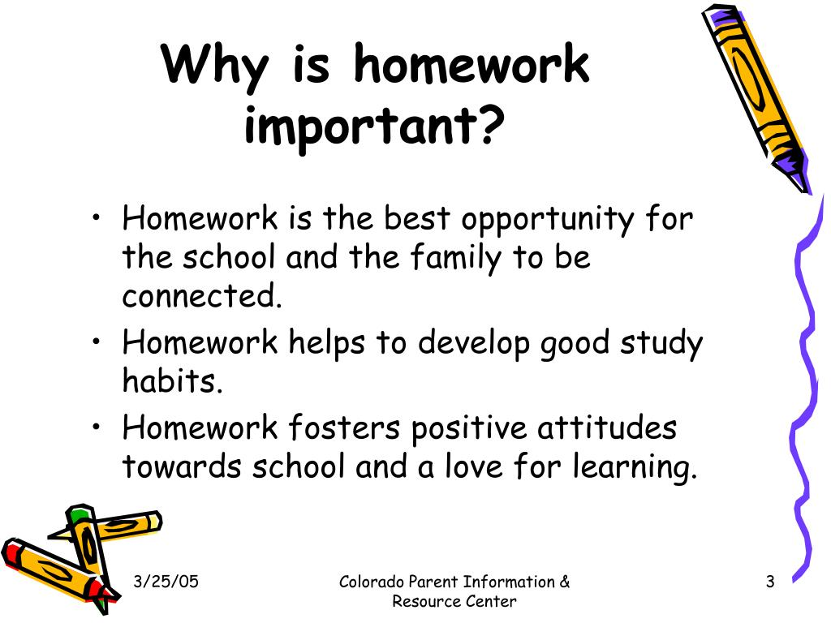
why is homework important?

Slide 5


STEP 2- GATHERING EVIDENCE OF THE PROBLEM
ON ANY GIVEN DAY IN OUR CLASSROOM, AT LEAST 12 STUDENTS OUT OF 22 ARE MISSING A HOMEWORK ASSIGNMENT.

Slide 6
STEP 3: identifying THE CAUSE OF THE PROBLEM
WHY ARE you NOT COMPLETING HOMEWORK?
IS THE HOMEWORK TOO HARD?
ARE KIDS ENROLLED IN AFTERSCHOOL PROGRAMS?
Are Parents Not Helping?

Slide 7


Slide 8
STEP 4- Evaluating existing policies
School homework policy
The purpose of homework is to reinforce skills learned at school by providing practice at home. This helps families understand the learning that is taking place in school. In addition, homework helps students learn routines at home, to be responsible, and develop time management skills. The classroom teachers will assign homework and you should expect your child to have reading, writing and math on a nightly basis. However, students will receive limited homework on holidays and vacation days. We feel that this is important time for families to spend together.

Slide 9
How can we solve the problem?
What would get you more excited to do your homework?
What do you want your teacher to know about homework?
3 Solutions To Our Homework Problem.
1-
2-
3-
?

Slide 10


What is our best solution to our homework problem?
Feasibility.... Can We Do It?
High Medium Low
High
Medium
Low
Effectiveness...Will It Work?

Slide 11

OUR BEST SOLUTION IS …..

Slide 12
Thank
You

