Slide 1
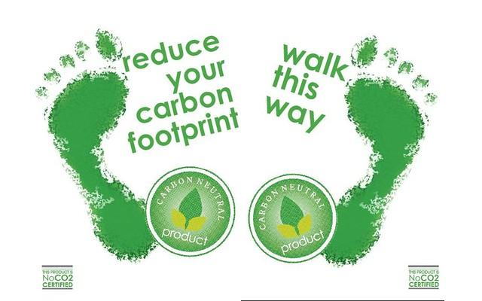
Eliminating Plastics From Our Daily Lives

Slide 2
Plastics are polluting the oceans and is life threatening.

Slide 3
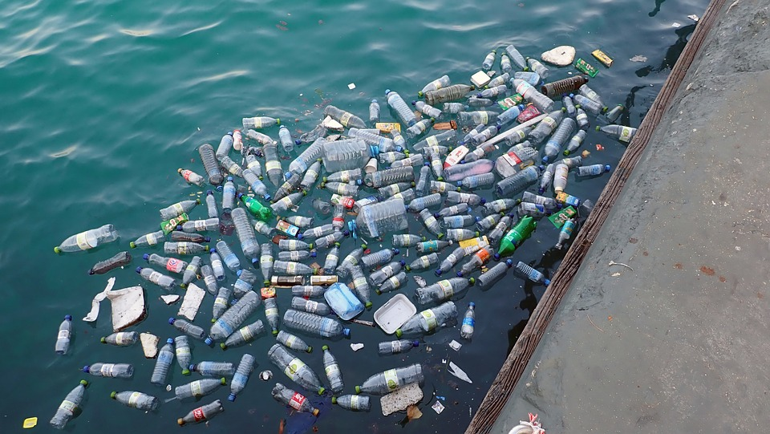

Slide 4
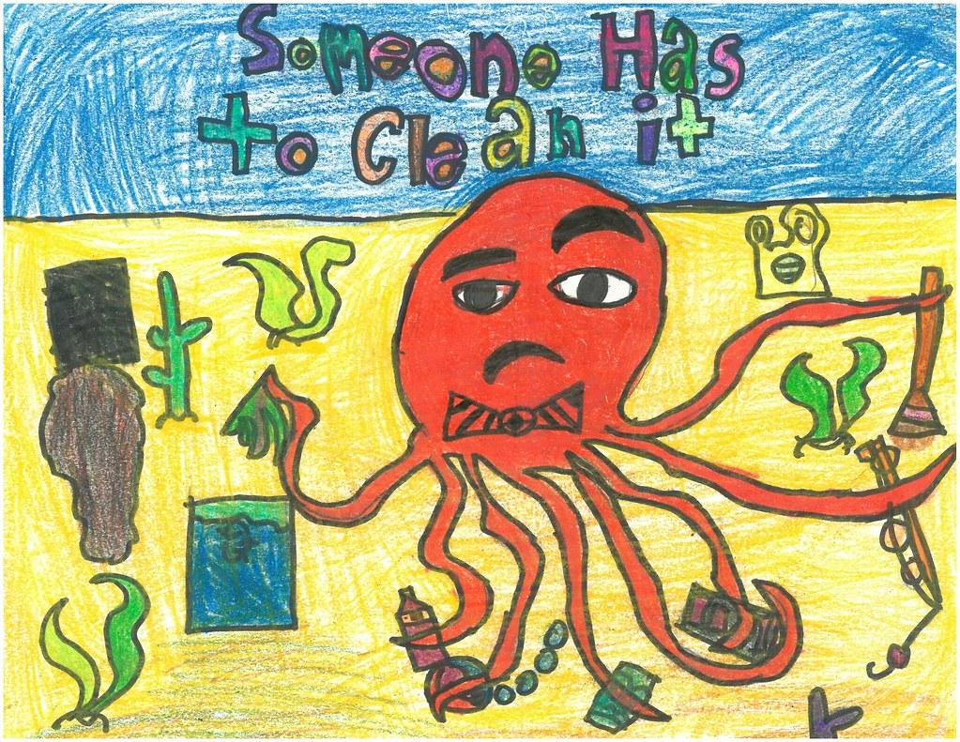
Sea Life Threatened

Slide 5
Our Current State of Plastic Pollution
About 8.3 billion tonnes of plastic has been produced since the 1950s – the weight of roughly a billion elephants or 47 million blue whales.
Only about 9% of this plastic has been recycled, 12% has been burned and the remaining 79% has ended up in landfills or the environment.
Up to 12.7 million tonnes of plastic enters the oceans every year.
The equivalent of a truckload of plastic enters the oceans every minute.
There are five trillion pieces of plastic in our oceans – enough to circle the Earth over 400 times.
Countries like Canada, the U.S., and the UK export plastic waste to various countries in Asia and Africa, offloading their trash problem to other communities.

Slide 6
Who is to Blame?
Annual plastic production has skyrocketed since the early 1950s, reaching 322 million tonnes in 2015. This does not include synthetic fibers used in clothing, rope and other products which accounted for 61 million tonnes in 2016. It is expected that plastic production will continue to increase, likely doubling by 2025.
Drink companies alone produce over 500 billion single-use plastic bottles annually.
Well known coffee company Starbucks produces 4 billion coffee cups each year.
Tens of billions of bags of chips are sold each year by companies like Pepsi Co.

Slide 7
What are real solutions to plastic pollution?
Government bans and restrictions for unnecessary and damaging plastic products or activities. Legislative reuse targets.
Mandated Extended Producer Responsibility (EPR) regulations and strategies to make producers and companies responsible for the damage plastic causes to our environment, make them accountable for the entire lifecycle and true costs of their products.
Government and corporate investment in reuse models and new ways to deliver products using less or no packaging.
Corporate phase-out of production and use of single-use plastic products and throwaway product models.
A shift in dominant public mindsets away from our throwaway culture focused on convenience being equal to disposal, toward a vision of healthy, sustainable and more connected communities.

Slide 8
Who Is Most Affected?
Scientists have documented 700 marine species affected by ocean plastic.[10]
Up to 9 of 10 seabirds, 1 in 3 sea turtles and more than half of whale and dolphin species have ingested plastic.
In the Canadian Arctic, 87% of birds have ingested plastics of some sort.
Crustaceans tested at the ocean’s deepest point, Mariana Trench, had ingested plastic.
People living along rivers and coastlines in China, Indonesia, the Philippines, Thailand, and Vietnam are the most impacted by plastic pollution. Low-income communities face more health impacts near plastic production sites, have greater exposure to toxins and waste, and bear the brunt of the impacts of improper plastic disposal and incineration.
Henderson Island in the South Pacific is the most plastic polluted of any island recorded to date.

Slide 9
“The impossible missions are the only ones which succeed.”
—Commandant Jacques-Yves Cousteau.
Reduce Your Use of Single-Use Plastics
Recycle Properly
Participate In (or Organize) a Beach or River Cleanup
Support Bans
Avoid Products Containing Microbeads
Spread the Word
Support Organizations Addressing Plastic Pollution

Slide 10
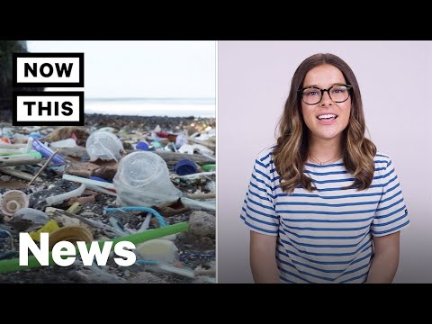

Slide 11
