Slide 1
Bullying
Ms. Jenna Diamantidis
District 30: Learning Technology Grant
P.S. 84 Q

Slide 2
Step 1: Define The Problem
How can we prevent bullying in our school?

Slide 3
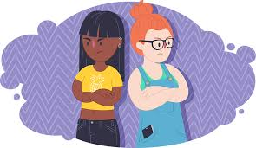
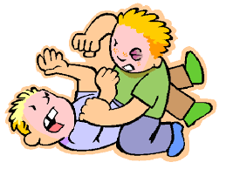
Turn & Talk …
How can you tell the difference between conflict and bullying?
Bullying is…
Bullying is not…

Slide 4
Conflict vs. Bullying
-Disagreement or argument when both students express their views.
-Equal power between all students involved.
-The student will stop and their behavior will shift when they are aware and realize they’ve hurt someone.
-The student’s goal is to hurt, harm or humiliate.
-Power is not equal. One student has more power over another student
-Student’s behavior will continue even when they realize they’ve hurt someone.

Slide 5
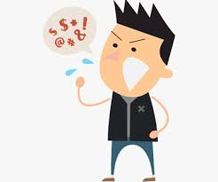
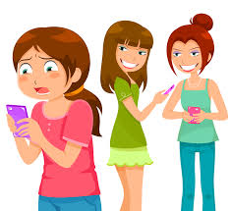
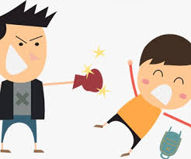
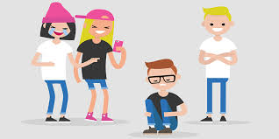
Types of Bullying
Verbal Bullying: Saying or writing mean things.
Physical Bullying: Hurting a person’s body or damaging items that belong to them.
Social Bullying: Hurting someone’s reputation or embarrassing them in person or through social media.
Cyber Bullying: Posting or sending negative, harmful, private or untrue information through social media.

Slide 6
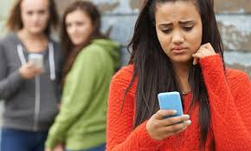
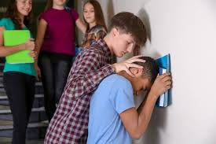
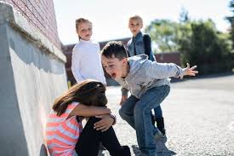
Have you been bullied before? How did this make you feel?

Slide 7
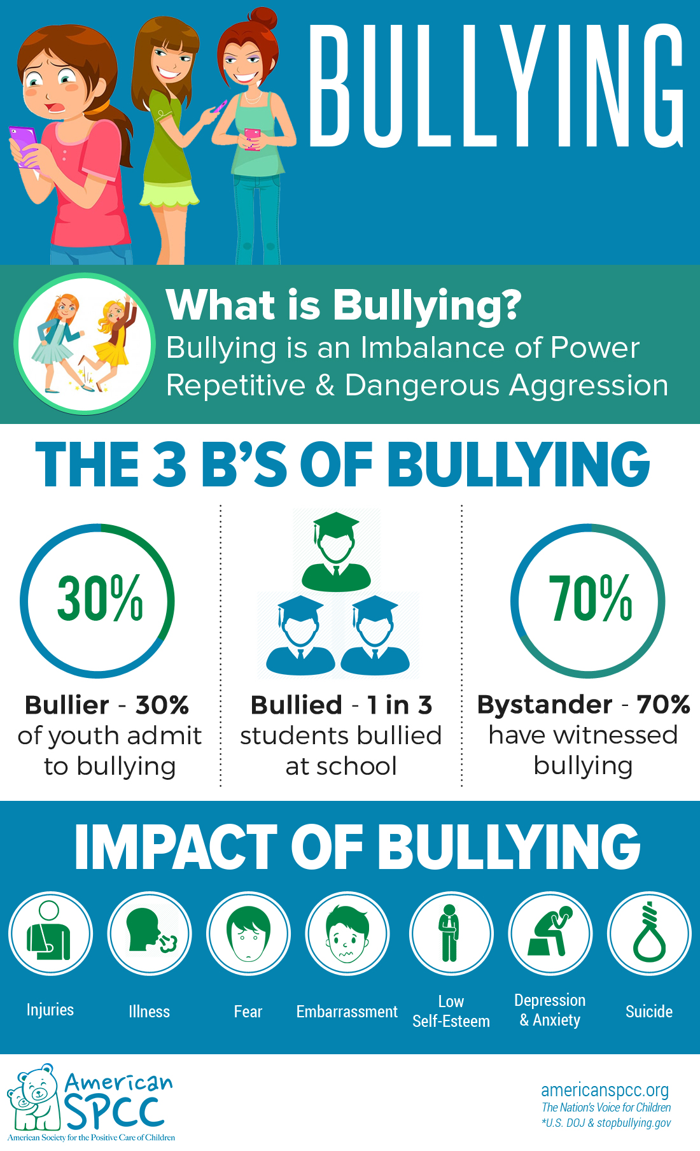
Step 2: Gather Evidence
The 2017 School Crime Supplement (National Center for Education Statistics and Bureau of Justice) indicates that, nationwide, about 20% of students ages 12-18 experienced bullying.
The 2017 Youth Risk Behavior Surveillance System (Centers for Disease Control and Prevention) indicates that, nationwide, 19% of students in grades 9–12 report being bullied on school property in the 12 months preceding the survey.

Slide 8
Step 3: Determine the Causes
Why do you think a student may act as a bully?
Is the bully having a difficulty making friendships?
Has the bully been bullied before?
Are the incidents being reported?
Turn & talk to a partner!
Add any other causes you may think of!

Slide 9
Step 4: Evaluate Existing Policies

Slide 10
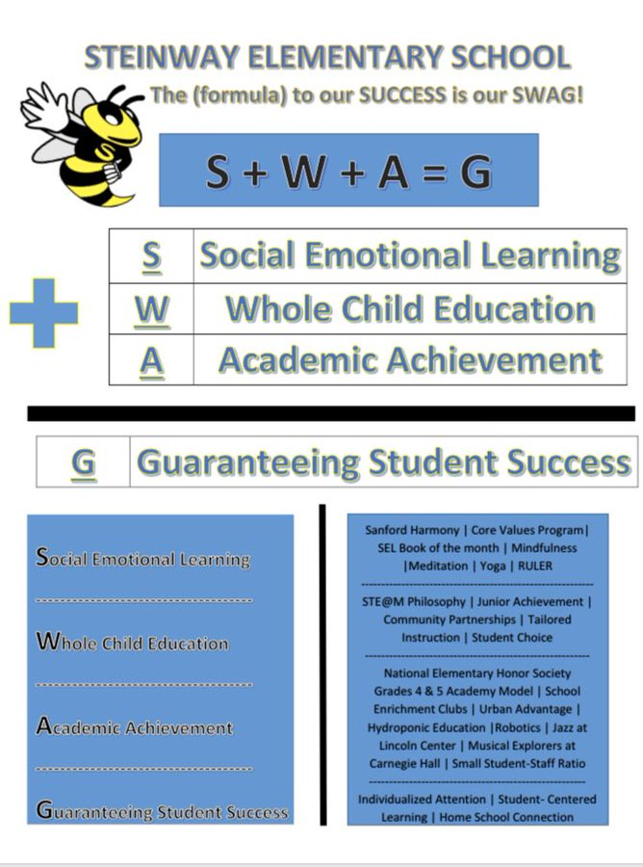
Step 5: Develop Solutions
Steinway SWAG
Sanford Harmony Curriculum
Core-Values Monthly Assembly
#GoodNewsCallOfTheDay

Slide 11
I Pledge to…
-treat everyone with respect.
-sprinkle a little bit of kindness each and every day.
-encourage my friends to help and stand up to bullying instead of being a bystander.
-include my peers, especially those who may be left out.
-report verbal, physical, social or cyber bullying to a teacher or trusted adult.
-never watch, laugh or join a group when someone is bullied.
-do better because I know better!

Slide 12
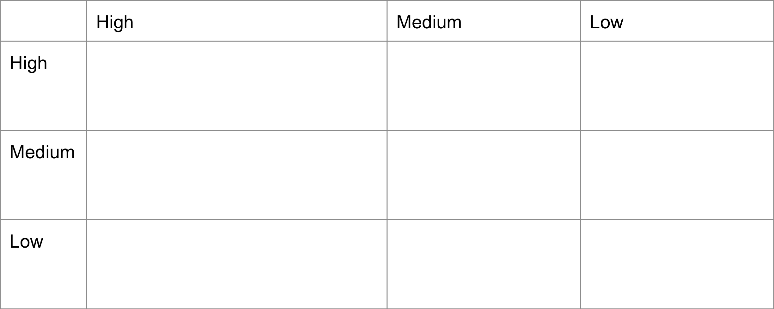
Step 6: Selecting the Best Policy
Model how to treat others with
kindness and respect!

Slide 13
RESPECT FOR ALL WEEK! February 10th - February 14th !
The NYC DOE has designated this week as R.F.A. We will continue to focus on promoting respect for diversity and creating inclusive school climates so that ALL students feel safe and respected!
Bee the “I” in Kind!

