Slide 1
School Lunch
Maureen Dey
PS 17 Queens

Slide 2
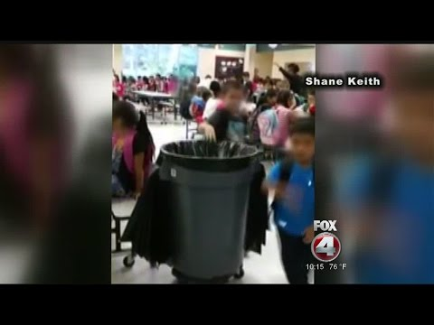
Is there a Problem?
Watch and see...

Slide 3
What is the Problem? Do we have a Do we have a problem at
our school with lunch
waste?
Let’s share our thoughts and write it down on the chart.

Slide 4
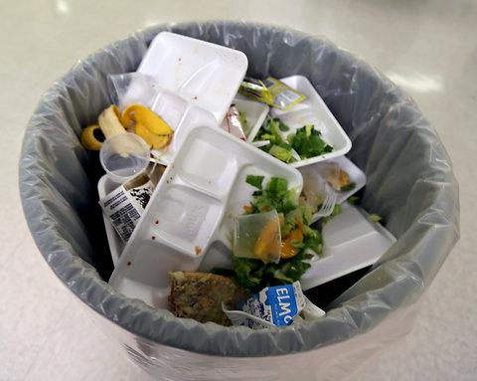
What is our Evidence?
What proof can we gather to show that there is a problem at our school?

Slide 5
What are the Causes of this Problem?
Possible Answers:
The students don’t like the lunch being offered
The students are made to take food even if they don’t want it (Ex: fruits and vegetables)

Slide 6
What is the Existing Policy?
In NYC every student is required to take a school lunch with ALL the sides whether they want it or not. If a student chooses to throw away their lunch even if they never opened it they can.

Slide 7
Develop Solutions...
H
Brainstorm and come up with
some ways to solve this problem

Slide 8
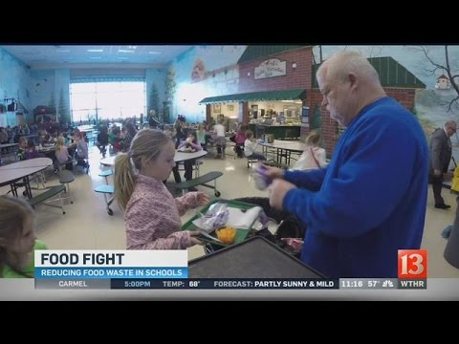
Watch the video and see if we can incorporate any of these solutions.
Take notes

Slide 9
Possible Solutions
Students don’t have to take the food that they don’t want to eat
Give leftover food to shelters and food pantries
Compost the food that is not eaten
Recycle

Slide 10
Select the Best Solution
Feasible - It will not cost any money or a lot of money to implement this solution
Timely - You can put the solution into action immediately
Effective - It will definitely solve the problem

Slide 11
Our Solution to the Problem is....
Reference

