Slide 1
Plastic Water Bottles
PS 17 - Science Class
Mrs. Dey

Slide 2
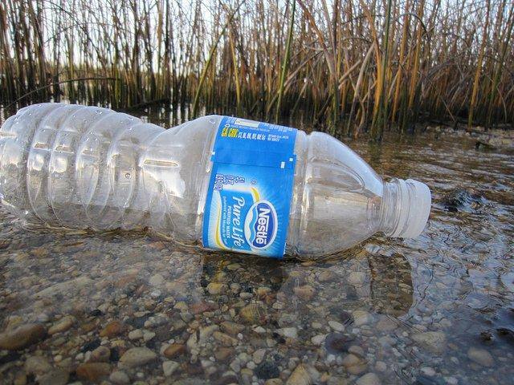
The Problem:
Plastic water bottles are not sustainable for the environment.
Plastic water bottles are not sustPaiPlPlastic water bottles are not sustainable for the environment.
nable for the environment.

Slide 3
Evidence:
1.) Only 1 in 5 plastic bottles are recycled
2.) Americans consume over 8.6 billion gallons of bottled water
3.) Most tap water is more heavily tested and regulated than bottled water
4.) Plastic water bottles can take between 400 and 1,000 years to decompose
5.) It requires 3 times the amount of water to produce a plastic bottle than it does to fill it
6.) Bottled water costs over 1,000+ times more than tap water
7.) Last year, the average American used 167 water bottles, but only recycled 38
8.) In many taste tests, tap water was preferred over bottled water
9.) The NRDC conducted a comprehensive four-year scientific study of 1,000 brands of bottled water. The results showed that one third of the bottled waters violated their own industry standards for water quality
10.) It takes 17 million barrels of oil to produce plastic bottles yearly. This could fuel 1 million cars for a year

Slide 4
Do We Have a Problem with Using Plastic Water Bottles in our School?
Let’s Find Out!
Let’s create and administer a survey to see if this is something we need to address in our school.
How many students per class are using plastic water bottles everyday?
How many teachers/staff are using plastic water bottles everyday?
What are the reasons why they are using plastic water bottles?

Slide 5
Identifying Causes:
What are the reasons why there is a problem with plastic water bottles in our school:
Students do not own reusable water bottles
It’s easier to buy plastic water bottles
The cafeteria only provides milk and not everyone likes to drink milk
Students do not like to use the water fountains

Slide 6
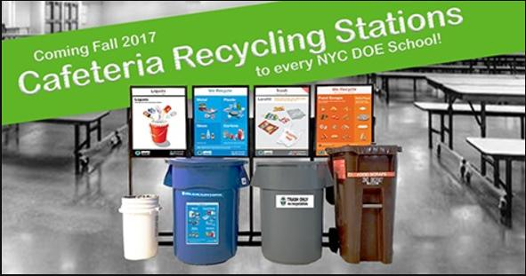
Existing Policies:
Students and teachers should be recycling in the classroom

Slide 7
Develop Solutions:
1. Use a Reusable Water Bottle
2. Dispose of Plastic Bottles Properly: DO NOT LITTER/ Recycle
3. Have a refillable water station in the cafeteria.

Slide 8
What is the Best Solution?
Our solution needs to be cost effective.
Our solution has to be something everyone can do.

