Slide 1
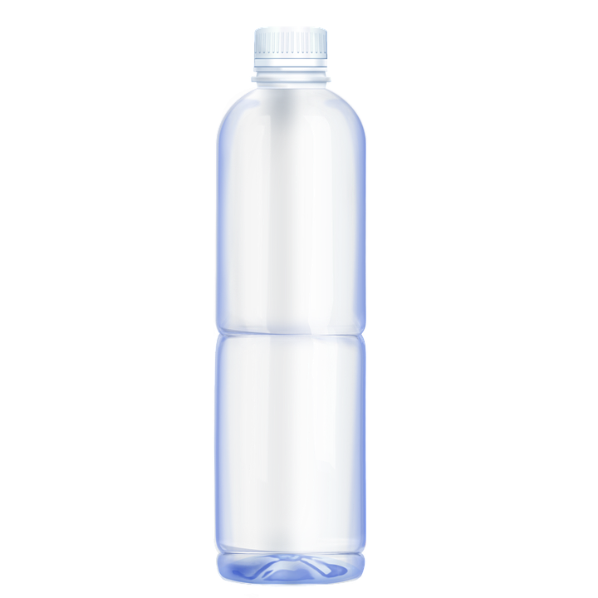
P astic Bott es in NY
By: Liam Cleary

Slide 2
An outline of the Public Policy Analyst Six Steps
1- Define the problem
2- Gather evidence
3- Identify causes
4-Evaluate a policy
5- Develop solutions
6- Select best solution (feasibility vs effectiveness)

Slide 3
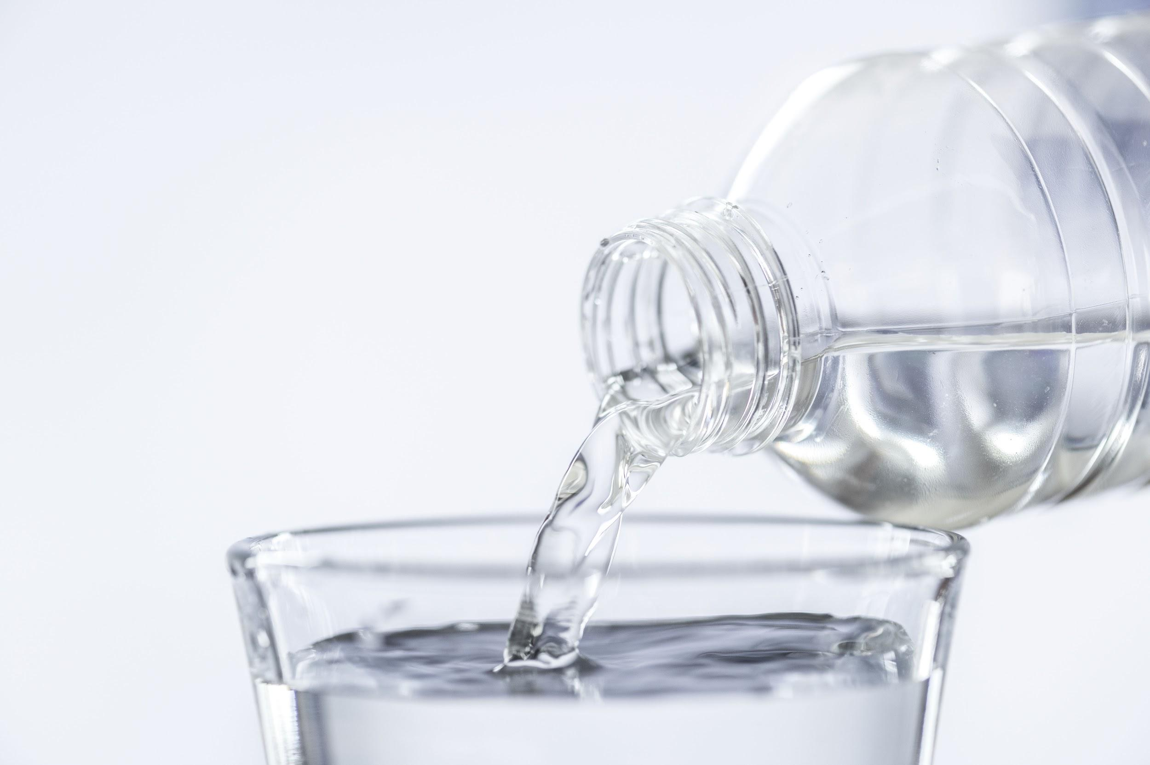
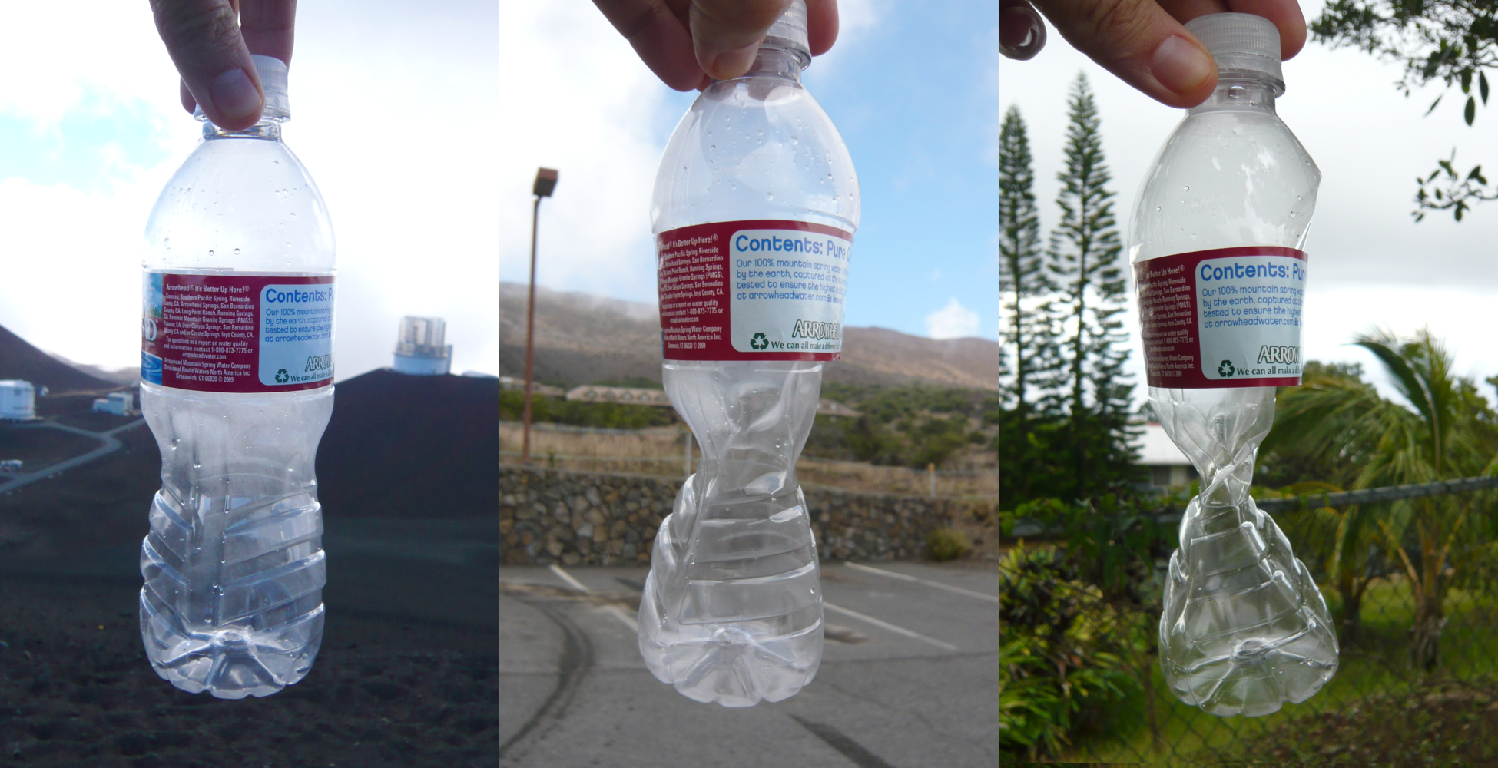
Define Problem: Why are plastics bottles bad for the environment?
How do you use plastic bottles?

Slide 4
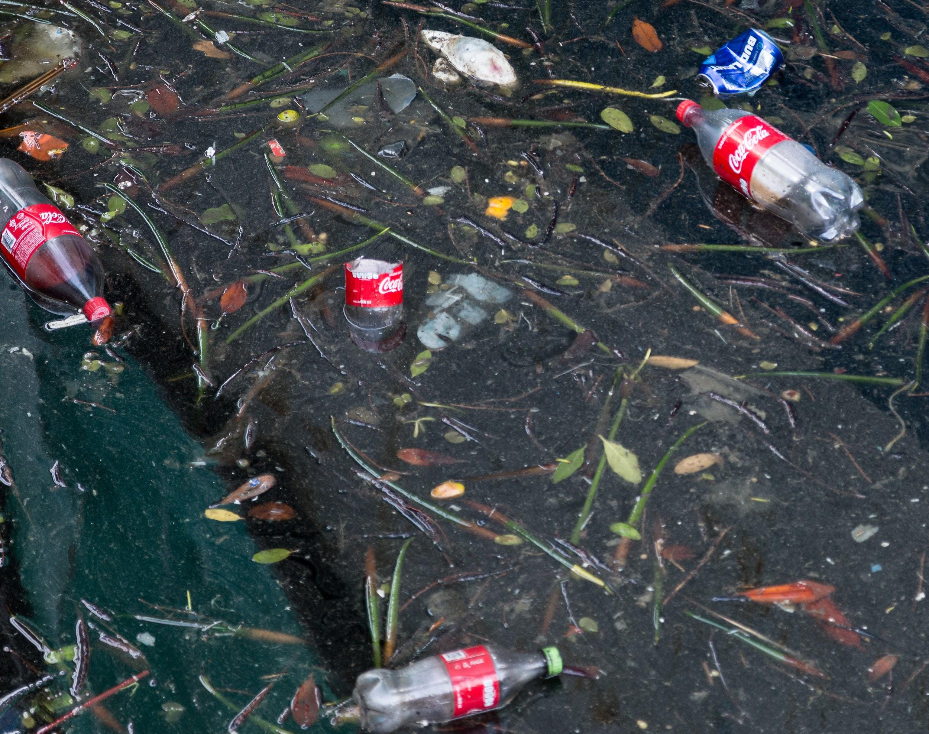
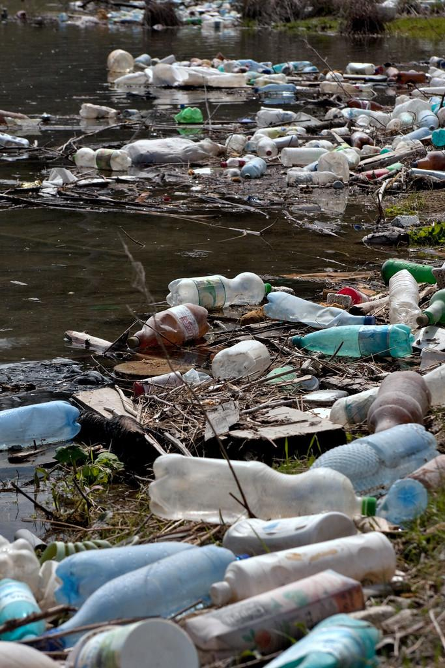
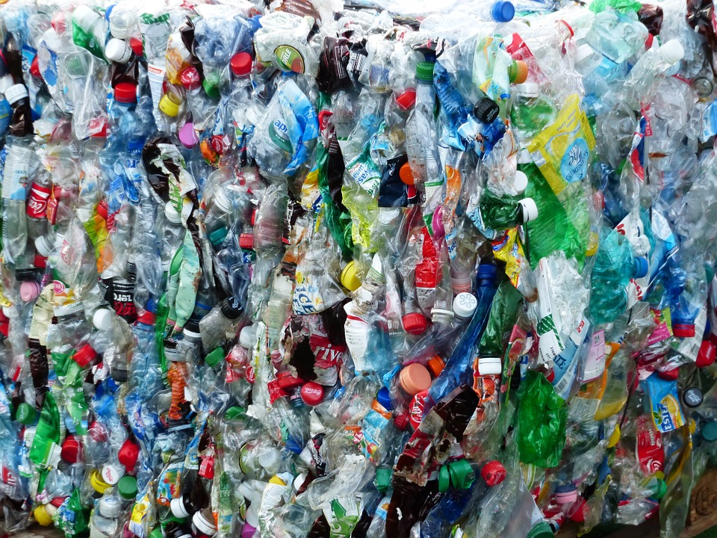
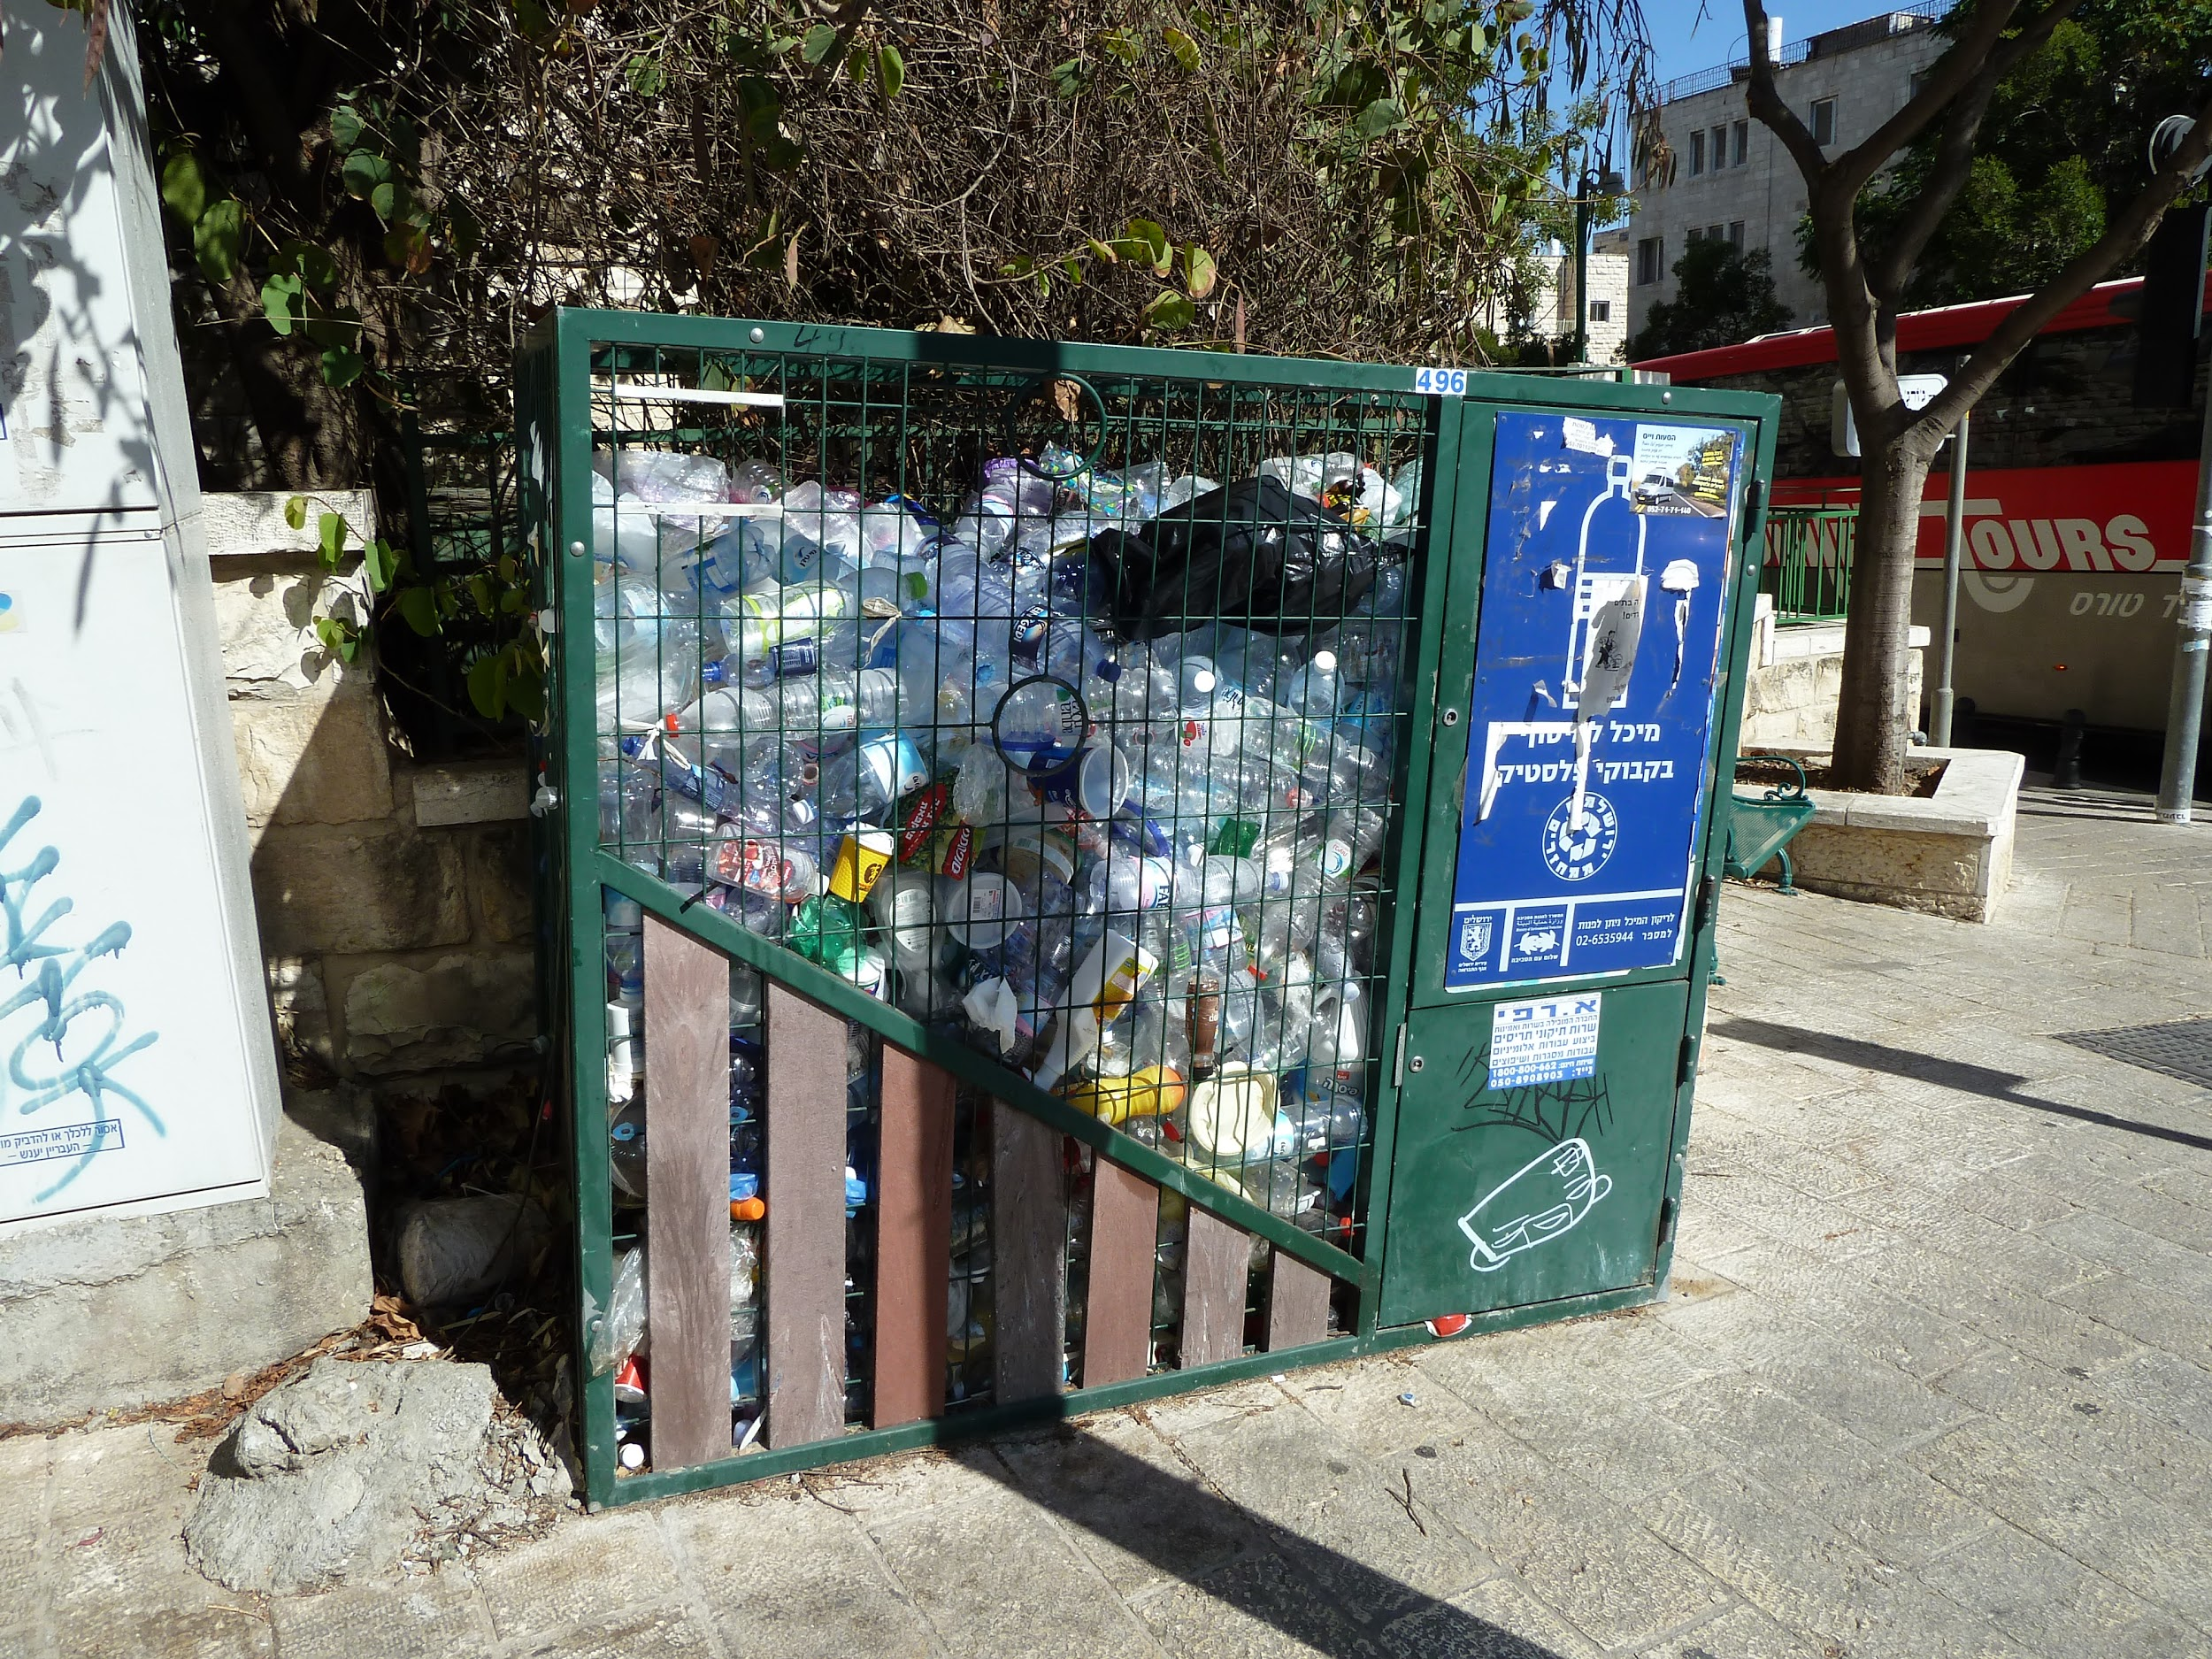
And when you are done………...

Slide 5
Gather Evidence
Americans used about 50 billion plastic water bottles last year. However, the U.S.'s recycling rate for plastic is only 23 percent, which means 38 billion water bottles – more than $1 billion worth of plastic – are wasted each year
Nearly all Americans (99 percent) drink water – tap, filtered, or bottled, and among them, 33 percent drink both bottled water and tap/filtered water equally.
Americans spent $11.8 billion dollars on bottled water in 2012, the latest data available from the BMC. This represented a 6.5% increase from 2011, during which the bottled water industry made $11 billion. That $11.8 billion was spent on nearly 9.7 billion gallons of water, putting the average cost at $1.22/gallon
https://blog.arcadiapower.com/15-key-facts-statistics-bottled-water/
https://www.banthebottle.net/bottled-water-facts/

Slide 6
Identifying the cause of the problem
Why did bottled water become popular?
The popularity of bottled mineral waters quickly led to a market for imitation products. ... In the United States, the popularity of bottled water declined in the early 20th century, when the advent of water chlorination reduced public concerns about water-borne diseases in municipal water supplies.
Why are plastic bottles a problem?
Who’s to blame?

Slide 7
How do you dispose of your bottles? Garbage, recycle, use again, or toss away !
CLICK IT
HERE

Slide 8
Evaluate existing policy
The most common policy is to charge 5 cents per soda bottle. This was recently amended to include all plastic water bottles too.

Slide 9
Developing public policy solutions
*Determine various solutions that can be enacted to help with the problem of plastic bags
*Think about what other cities, and states have done
*Think about other new solutions
*Complete the attached worksheet to record your solutions

Slide 10
Select the best solution
*Your best policy should be effective and feasible
*This means that it can be done and that it is likely to be accepted by others
Feasibility
 | high | Medium | low
high
medium
low
Effectiveness

