Slide 1
Endangered Species
In Far Rockaway
Lenore Williams
The Randolph Holder School for Social Justice PS 253Q

Slide 2
Public Policy Analyst
Public Policy Steps
Define the problem
Gather evidence
Identify causes
Evaluate a policy
Develop solutions
Select best solution

Slide 3
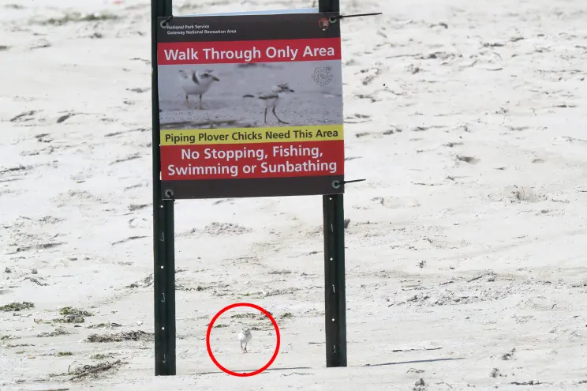
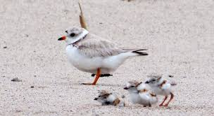
Define the Problem
There are three major endangered species in Far Rockaway Queens, they are:- Piping Plover (bird), Right Whale and the Diamondback Terrapin (turtle).
We are going to focus on the Piping Plover. According to New York State Development of Conservation Bureau of Wildlife, the following is the
category the Piping Plover falls under.
New York Status: Endangered Federal Status: Threatened

Slide 4
Gather the Evidence
1. Population Decline: The piping plover population has declined significantly over the past few
decades.
.
2. Habitat Loss: Piping plovers breed on sandy beaches, and their nesting sites are threatened by
habitat loss due to coastal development, erosion, and rising sea levels.
3. Predation: Piping plovers are preyed upon by a number of predators, including gulls, cats, and
raccoons.
4. Disturbance: Piping plovers are sensitive to human disturbance, and activities such as beach
recreation, dog walking, and vehicle traffic can disrupt their breeding, foraging, and roosting activities.
5. Declining population: The overall population of piping plovers has been declining over the past few
decades. According to the U.S. Fish and Wildlife Service, the species has lost approximately 40% of its
global population since the 1980s.
6 Restricted range: Piping plovers have a very limited breeding range, with most of the population
breeding on beaches and sand dunes along the Atlantic Coast, Great Lakes, and Great Plains regions of
North America. This makes them vulnerable to habitat loss and disturbance.

Slide 5
Identify the Causes
1
02
03
04
05
Habitat loss and degradation: Piping plovers require a specific type of habitat for breeding, nesting, and foraging.
Nesting disturbance: Piping plovers are sensitive to disturbance during their breeding season.
Predation: Piping plover eggs and chicks are vulnerable to predation by a variety of animals
Climate change: Rising sea levels and more frequent and intense storms associated with climate change pose a threat to the nesting and foraging habitats of piping plovers, particularly along the Atlantic coast.
Invasive species: The introduction of non-native species such as beach grasses and other plants can alter the habitat structure.

Slide 6
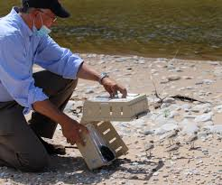
Evaluate an Existing Policy
One policy that has been put in place to protect the piping plover (Charadrius melodus) is the Endangered Species Act (ESA) in the United States. The ESA provides legal protection for species that are listed as endangered or threatened, including the piping plover.
The ESA has had some success in protecting the piping plover by providing legal protections for its habitat and limiting certain activities that may harm the species. For example, beach closures or restrictions during the breeding season have been put in place to reduce disturbance to nesting birds. The ESA has also supported research and monitoring efforts to better understand the species and its habitat needs and to guide conservation efforts.
While the ESA has provided some protection for the piping plover and other endangered species, it is not a perfect policy and faces ongoing challenges. Ensuring the effective implementation and enforcement of the ESA, as well as considering complementary approaches to conservation, will be critical for protecting the piping plover and other threatened species in the long term.

Slide 7
Develop Solutions
1. Education and outreach: Education and outreach can be a highly effective solution for protecting the piping plovers. Raising awareness among the public about the importance of the species and their conservation needs can help reduce disturbance to their habitats. This solution has high feasibility, as it can be implemented with relatively low costs and requires limited resources.
2. Beach management practices: Implementing beach management practices that minimize disturbance to piping plovers can be an effective solution, particularly during the breeding season. This solution has moderate feasibility, as it may require some coordination and cooperation among beach managers and users.
3. Habitat restoration and protection: Protecting and restoring the piping plover’s habitat is critical to its survival. This solution can be highly effective, but may require significant resources and political will, making its feasibility lower.
4. Predator management: Reducing predation pressure on piping plover eggs and chicks can be an effective solution, but may be more challenging to implement than other solutions due to ethical and legal considerations. Predator management has low feasibility, as it may require significant resources and could be controversial.
5. Research and monitoring: Continued research and monitoring of piping plover populations and habitat needs is important to guide conservation efforts, but may be costly and resource-intensive. Research and monitoring have moderate feasibility, as they may require specialized skills and resources.

Slide 8
Select the Best Solution
. Effectiveness
Feasibility
 | High | Medium | Low
High | Education and outreach | Beach management practices:
Medium |  | Research and monitoring
Low | Habitat restoration and protection | Predator management

Slide 9
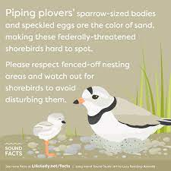
Conclusion
Overall, a combination of solutions is likely to be most effective in protecting and conserving the piping plovers. Solutions with higher feasibility, such as education and outreach and beach management practices, can be combined with more resource-intensive solutions such as habitat restoration and predator management to create a comprehensive conservation strategy.

