Slide 1
PPA- Unhealthy eating habits affect student learning
dtripotseris@schools.nyc.gov
P.S. 51Q

Slide 2
The Six Steps of PPA
Define the problem.
Gather evidence.
Identify the causes.
Examine and existing policy.
Develop new policies.
Select the best policy solution.

Slide 3
1
Define the Problem
To help students make healthy choices during lunch.

Slide 4
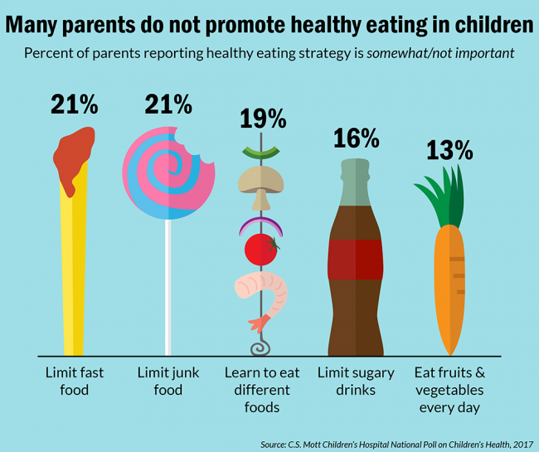
2
Gather Evidence
Student choices
Teacher observations

Slide 5

3
Identify the Causes
Convenience
Lack of Nutritional Knowledge
Social Influences

Slide 6
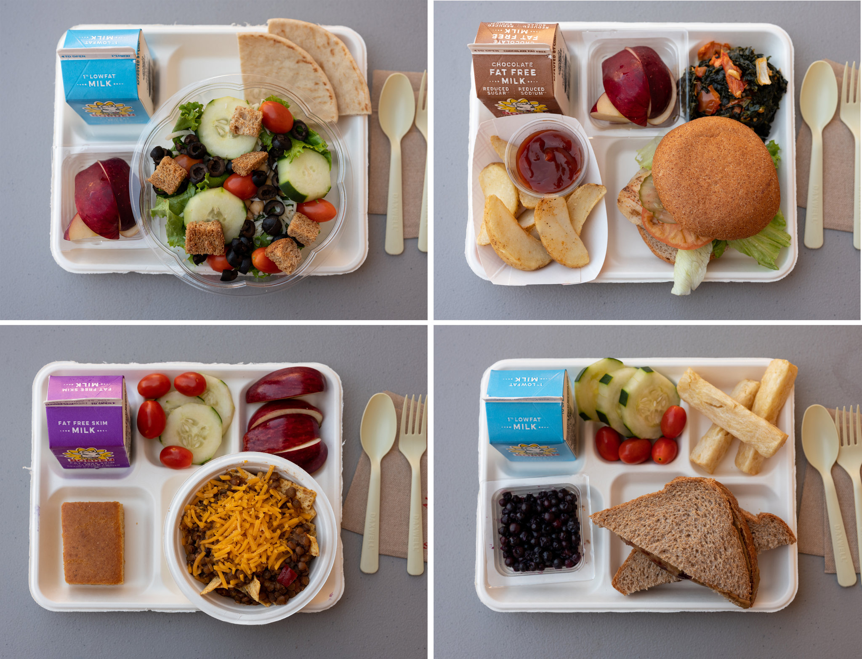
4
Examine an Existing Policy
Cafeteria food consists of a mix of healthy options.

Slide 7
5
Develop New Policies
Promote healthy eating to students.
Parents Workshops on nutritional knowledge

Slide 8
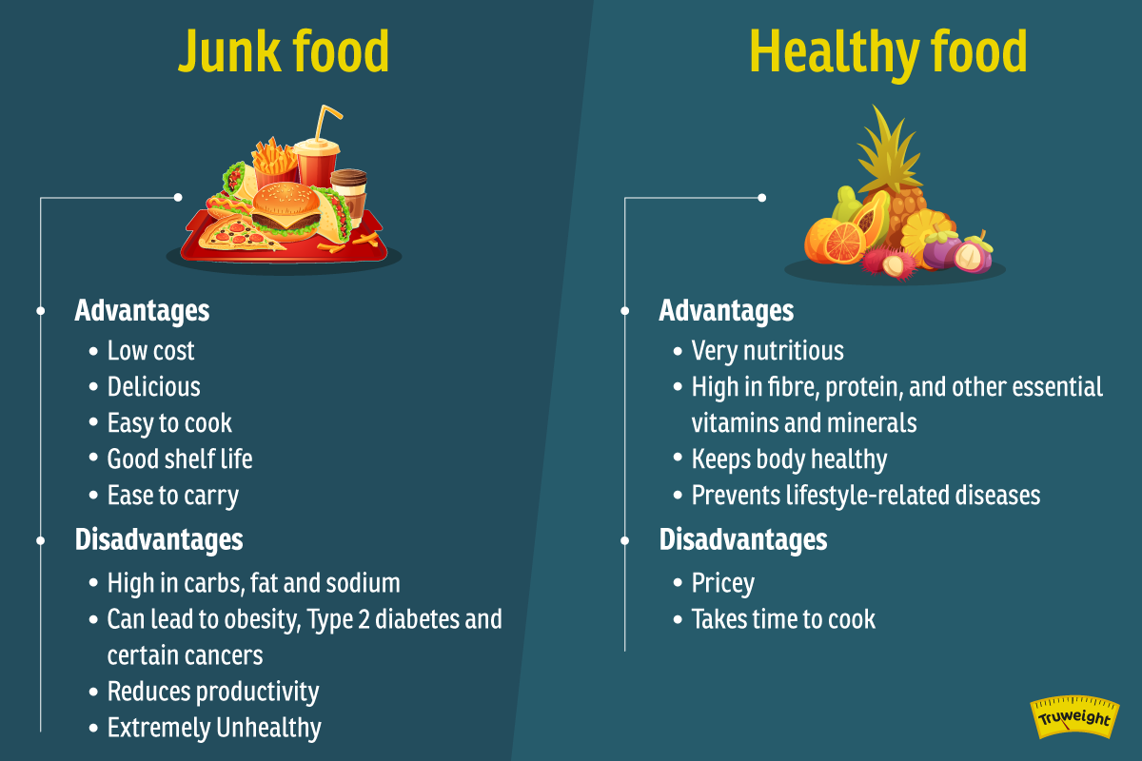
6
Select the Best Policy Solution

Slide 9

A picture is worth a thousand words

