Slide 1

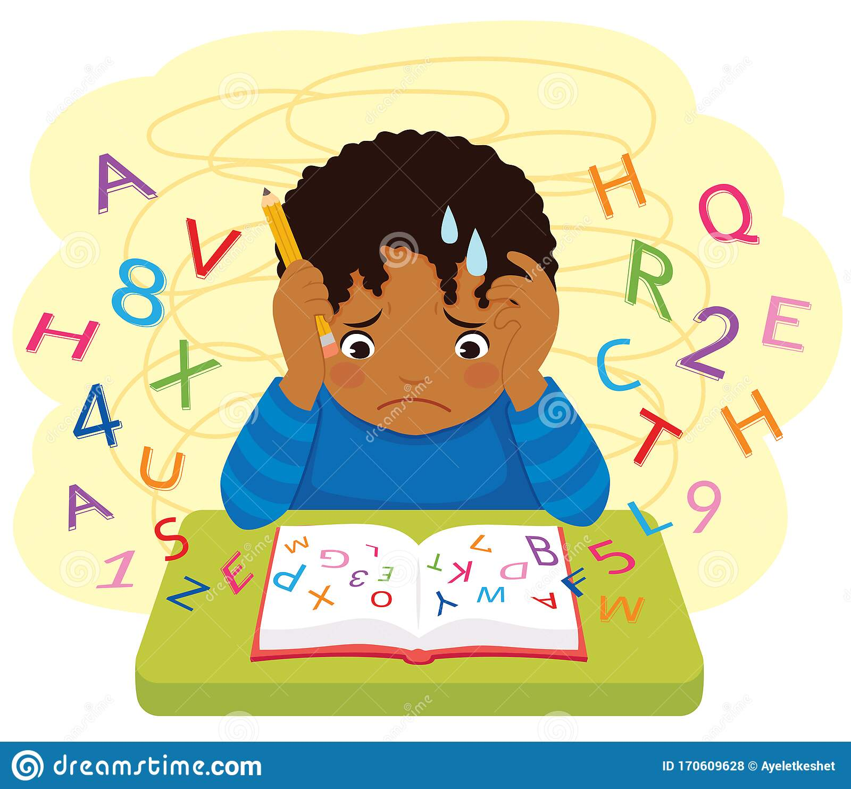
Leveling Up in Reading
Ms.Rodriguez
PS106Q- Lighthouse Elementary

Slide 2
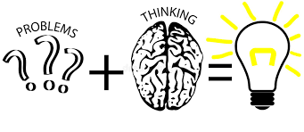
The 6 Steps of the Public Policy Analyst (PPA)
1. Define the Problem
2. Gather the Evidence
3. Identify the Causes
4. Evaluate an Existing Policy
5. Develop Solutions
6. Select the Best Solution (Feasibility vs. Effectiveness)

Slide 3

Engage
Think/Pair/Share:
Why is reading important?

Slide 4
Step 1: Define the Problem
Many students in our school are not reading on grade level.

Slide 5
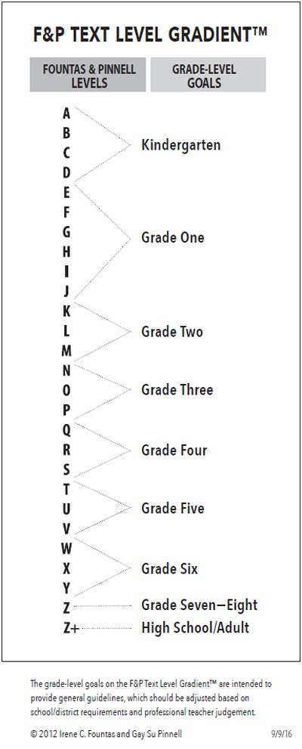
Step 2: Gather Evidence
Mid-Year Benchmark Reading Levels
Kindergarten | C
First Grade | G/H
Second Grade | L
Third Grade | O
Fourth Grade | R
Fifth Grade | U

Slide 6
Step 2: Gather Evidence
Percentages of Students Reading on/above
Grade Level- January 2022
Kindergarten | 19%
First Grade | 14%
Second Grade | 19%
Third Grade | 12%
Fourth Grade | 46%
Fifth Grade | 15%

Slide 7
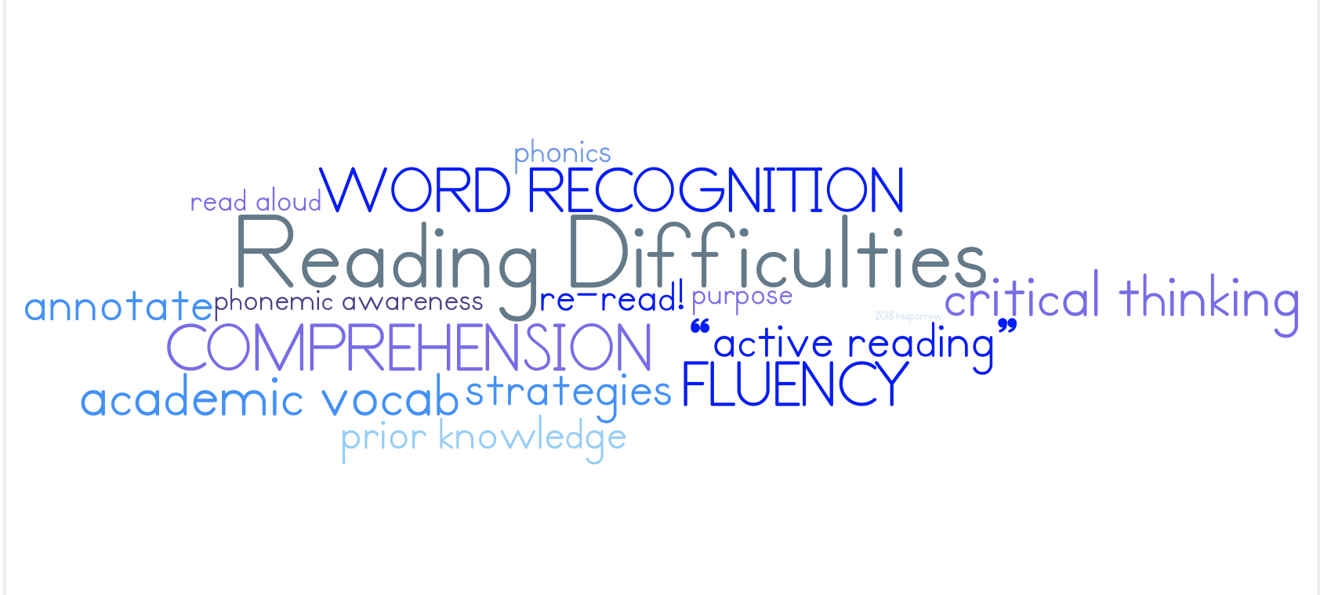
Step 3: Identify the Causes
Why might students have difficulty with reading?

Slide 8
Step 4: Evaluate an Existing Policy
What are some ways students are supported in reading?
Read Alouds
Guided Reading
Fundations
School Reading Challenge
What are some other policies in place?

Slide 9
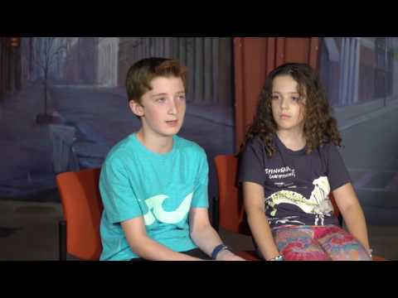
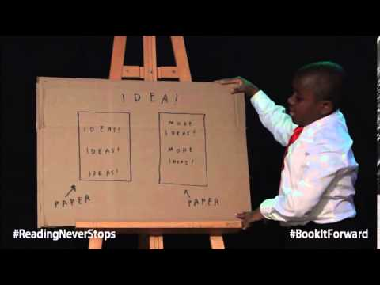
Step 5: Develop Solutions

Slide 10

Step 5: Develop Solutions
What are some ways we can improve the reading levels of students in our school?

Slide 11
Step 6: Select the Best Solution
Feasibility
 | High | Medium | Low
High
Medium
Low
Effectiveness

