Slide 1
Public Policy Analyst
Climate Change
MS. 137
Nina Oliva
noliva@schools.nyc.gov

Slide 2
Cause
One cause of this problem is …
Solution
One solution our school has about this problem is…
Lateness
Bullying
Poor grades
Racism
LT: We can understand public policy analytics by evaluating the social problem of climate
Success Criteria: I can complete the steps of PPA by using climate change as an example
Do Now: 60/60
Word of the Day
Social Problem:a problem that some people view at being undesirable
Choose one problem to write about in your school.

Slide 3
Public Policy Analyst
LT: We can understand public policy analytics by evaluating the social problem of climate change
Success Criteria: I can complete the steps of PPA by using climate change as an example
Define the problem
4. Existing solutions
2. Gather Evidence
5. Create Solutions
3. Determine the cause
6. Select best solution
That’s all!

Slide 4
School Community
Lateness
Bullying
Poor grades
Racism
Pollution
High crime rate
Drugs
Violence
LT: We can understand public policy analytics by evaluating the social problem of climate change
Success Criteria: I can complete the steps of PPA by using climate change as an example
Back
Determine the problem
Be Specific: determine a social problem.
Social Problem: a problem that some people view at being undesirable

Slide 5

Define the problem
Climate Change
LT: We can understand public policy analytics by evaluating the social problem of climate change
Success Criteria: I can complete the steps of PPA by using climate change as an example
Back
1.
the long-term changes in global temperatures and other characteristics of the atmosphere
Video

Slide 6
Gather Evidence
Find data about the problem
LT: We can understand public policy analytics by evaluating the social problem of climate change
Success Criteria: I can complete the steps of PPA by using climate change as an example
Next
2.
Where can you find information?
Find articles here
Find books here

Slide 7
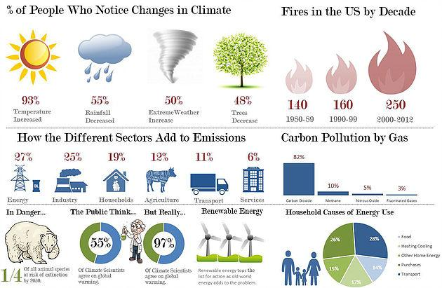
Gathering Evidence
LT: We can understand public policy analytics by evaluating the social problem of climate change
Success Criteria: I can complete the steps of PPA by using climate change as an example
Back
Next
Write 3 facts from the infographic here

Slide 8
Determine the Cause
LT: We can understand public policy analytics by evaluating the social problem of climate change
Success Criteria: I can complete the steps of PPA by using climate change as an example
Next
3.
If lawmakers can identify the factors that contribute to a social problem, then they can try to develop laws to eliminate or lessen those causes or factors.

Slide 9


Determine the cause
Climate Change
LT: We can understand public policy analytics by evaluating the social problem of climate change
Success Criteria: I can complete the steps of PPA by using climate change as an example
Back
Extra greenhouse gases in our atmosphere are the main reason that Earth is getting ________. Greenhouse gases, such as _______ _______ (CO2) and methane, trap the Sun's _____ in Earth's atmosphere.
It's normal for there to be some __________ gases in our atmosphere. They help keep Earth warm enough to live on. But too many __________ gases can cause too much _________.
The burning of _______ ______ like coal and oil increase the amount of CO2 in our air. This happens because the burning process combines carbon with _________ in the air to make CO2.
It's important that we monitor CO2 levels, because too much CO2 can cause too much warming on Earth. Several NASA missions have instruments that study CO2 in the atmosphere.
Warmer
Heat
Carbon Dioxide
Warming
Greenhouse
Greenhouse
Fossil Fuels
Oxygen

Slide 10
Existing
Solutions
LT: We can understand public policy analytics by evaluating the social problem of climate change
Success Criteria: I can complete the steps of PPA by using climate change as an example
Back
Evaluating the main existing solution that deals with a social problem is an important step in the process. Identifying both the advantages and disadvantages can suggest what parts of current solutions should be kept or strengthened, and what parts should be changed.
4.
If the existing solution seems to be not working, then it needs to be replaced.

Slide 11
Existing Solutions
LT: We can understand public policy analytics by evaluating the social problem of climate change
Success Criteria: I can complete the steps of PPA by using climate change as an example
Back
Next
Advantages
Disadvantages
Switch to sustainable (electric) transport. | This is a type of energy that is longer lasting. | There aren’t many rechargeable ports for things in public spaces.
Stay away from fossil fuels (coal, oil and gas)
Reduce how much people can shop
Reduce plastic
Invest in renewable (solar, wind, wave) energy.
Improve farming and encourage vegan diets.

Slide 12
Develop Solutions
LT: We can understand public policy analytics by evaluating the social problem of climate change
Success Criteria: I can complete the steps of PPA by using climate change as an example
Back
Next
5.
To develop a public policy solution for your social problem, it is helpful to consider some alternatives:
Eliminate or lessen the causes
Improve or strengthen the current policy
OR

Slide 13
Develop Solutions
LT: We can understand public policy analytics by evaluating the social problem of climate change
Success Criteria: I can complete the steps of PPA by using climate change as an example
Back
Next
What can we do
(in our school or our community)
to make this option easier?
Switch to sustainable (electric) transport. | Fundraise to have more charging ports installed for cars in all parking lots.
Stay away from fossil fuels (coal, oil and gas)
Reduce how much people can shop
Reduce plastic
Invest in renewable (solar, wind, wave) energy.
Improve farming and encourage vegan diets.

Slide 14


Solution
Low cost = community is more likely to start this solution
High cost = community is less likely to start this solution
Low effectiveness = This solution will not work
High effectiveness = This solution will work
LT: We can understand public policy analytics by evaluating the social problem of climate change
Success Criteria: I can complete the steps of PPA by using climate change as an example
Back
Select the best solution
Your best policy should rate highly in both:
Cost is low and Effectiveness

Slide 15
LT: We can understand public policy analytics by evaluating the social problem of climate change
Success Criteria: I can complete the steps of PPA by using climate change as an example
Select the best solution
Back
Low Cost
Medium Cost
High Cost
High
Effective
Medium
Effective
Low
Effective
Switch to sustainable (electric) transport.
Reduce plastic
Invest in renewable
(solar, wind, wave) energy.

Slide 16
LT: We can understand public policy analytics by evaluating the social problem of climate change
Success Criteria: I can complete the steps of PPA by using climate change as an example
You did it!

