Slide 1
Bullying at
P.S. 123Q
By: Michelle Kahan
STEM Teacher

Slide 2
The Six Steps of the Public Policy Analysis (PPA)
# 1: Define the Problem
# 4: Examine an Existing Policy
# 2: Gather the Evidence
# 5: Develop New Solutions
# 3: Identify the Causes
# 6: Select the Best Solution

Slide 3
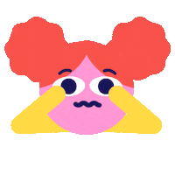
STEP 1: DEFINE THE PROBLEM
PROBLEM:
Students are bullying other students at P.S. 123Q.

Slide 4
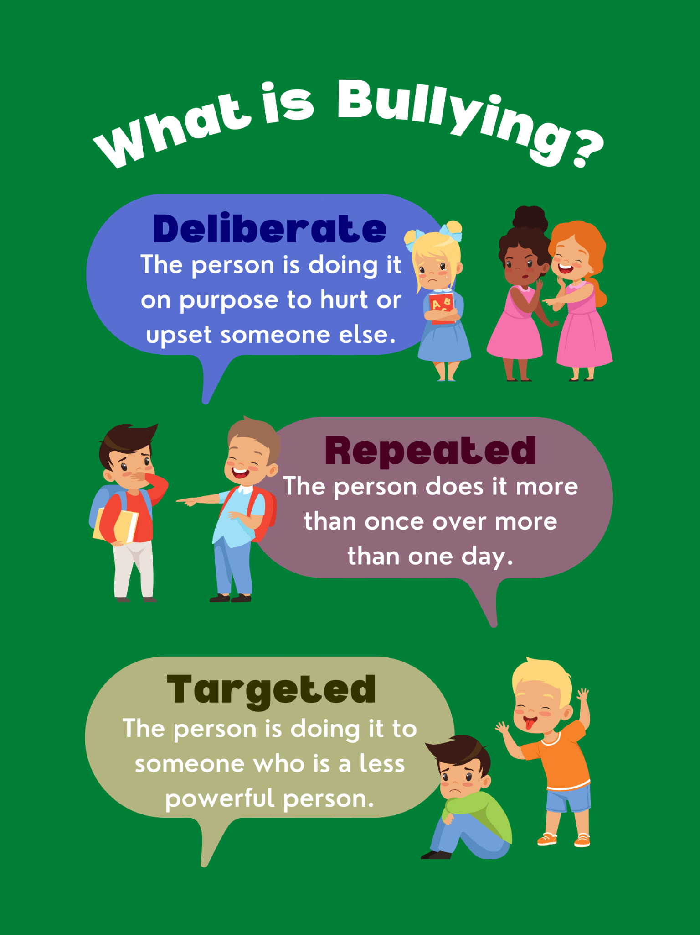
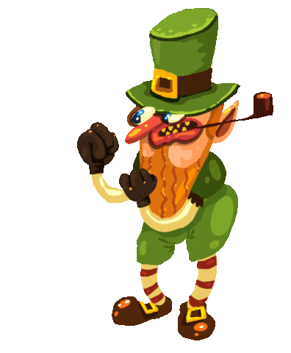
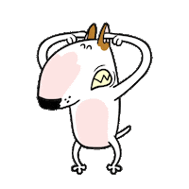
WHAT IS BULLYING?

Slide 5
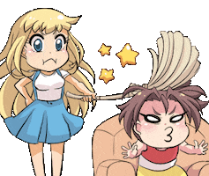
What Are Types of Bullying?
Types of Bullying
Physical Bullying
Verbal Bullying
Cyberbullying

Slide 6
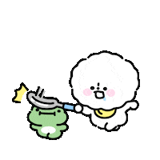
What is Physical Bullying?
Examples:
Hitting
Kicking
Shoving
Pushing
Tripping
Pinching
Damage of Property
Physical Bullying is when you hurt someone using physical actions.

Slide 7
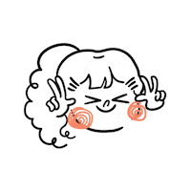
What is Cyberbullying?
Cyberbullying is when you are mean to someone on the internet or online game using your computer, phone, ipad, or any other device.

Slide 8
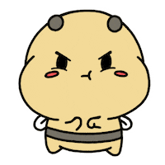
What is Verbal Bullying?
Examples:
Teasing
Name Calling
Putdowns
Insulting
Threatening
Making False Accusations
Verbal Bullying is when you hurt someone using your WORDS.

Slide 9
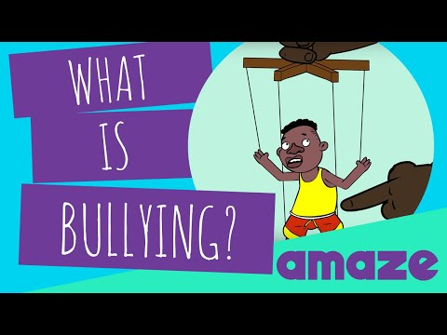
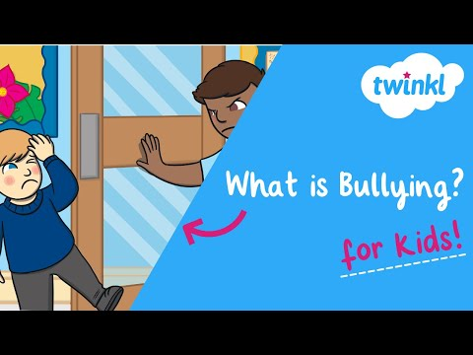
STEP # 2: GATHER EVIDENCE

Slide 10
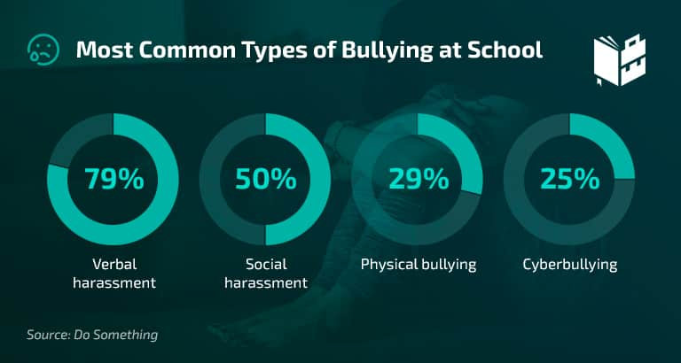
STEP # 2: GATHER EVIDENCE
Venus
Mars
Jupiter
Neptune
It’s terribly hot, and its atmosphere is extremely poisonous
It's full of iron oxide dust, which gives the planet its reddish cast
Jupiter is a gas giant and the biggest planet in the Solar System
It was named after the Roman god of wealth and agriculture

Slide 11
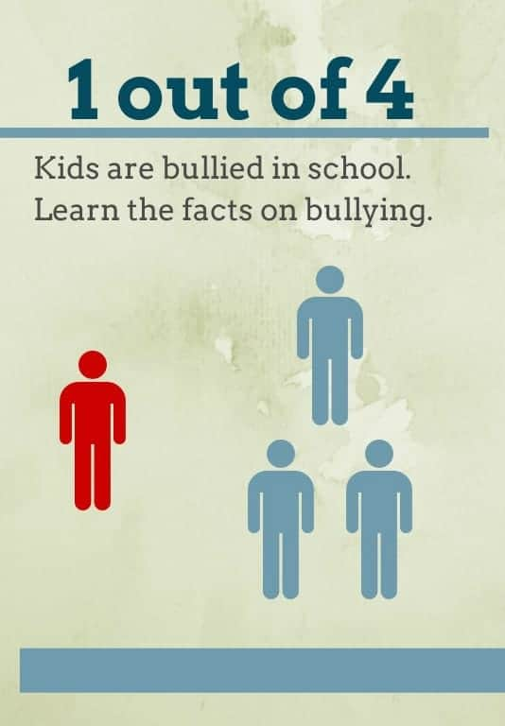
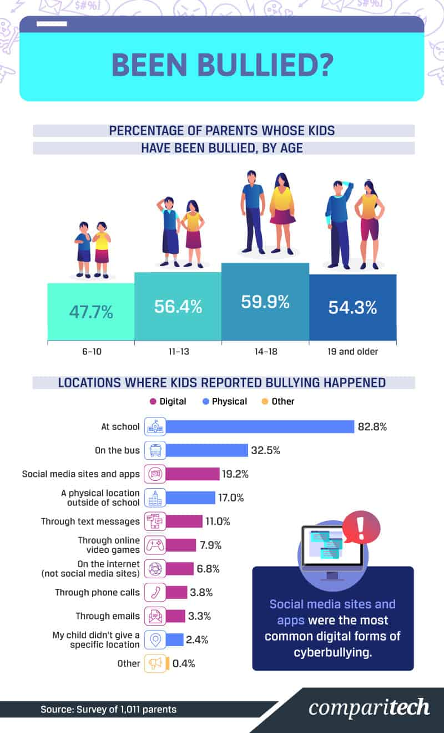
STEP # 2: GATHER EVIDENCE

Slide 12
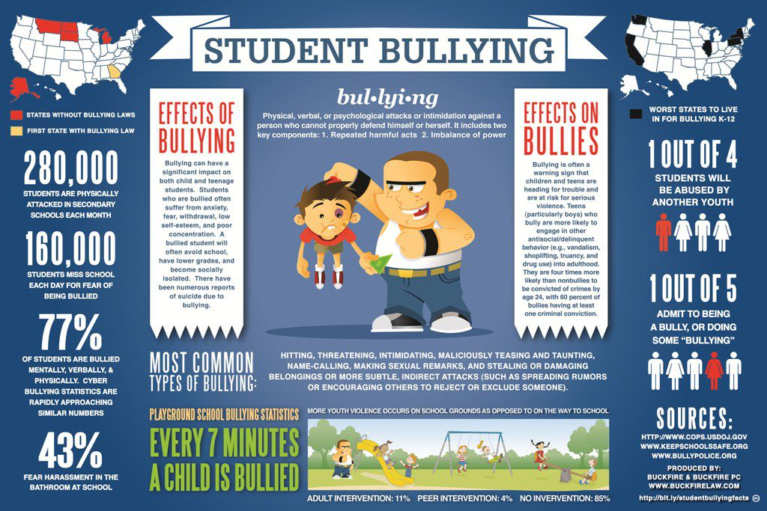
STEP # 2: GATHER EVIDENCE

Slide 13
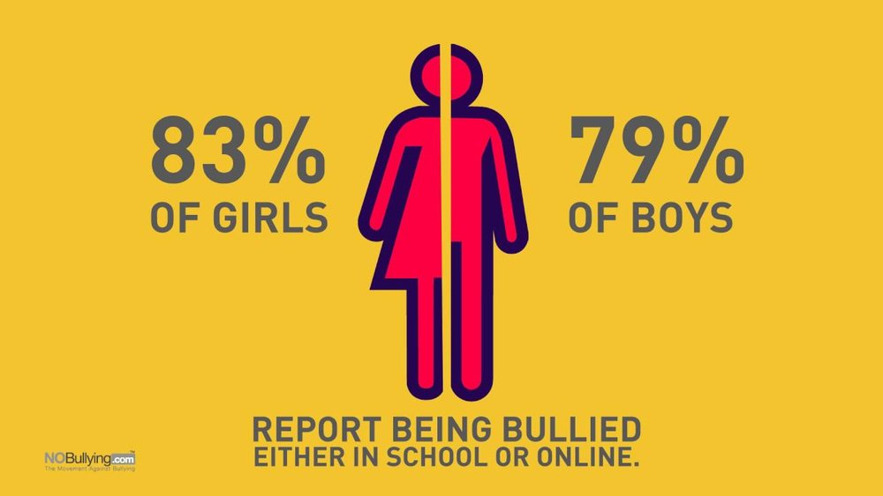
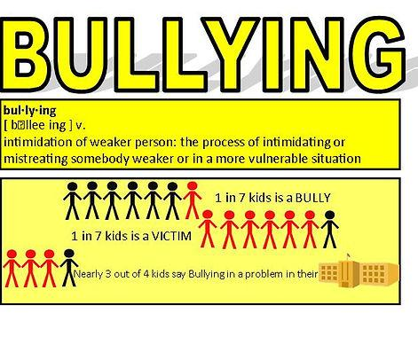
STEP # 2: GATHER EVIDENCE

Slide 14
STEP # 3:
IDENTIFY THE CAUSES OF THE PROBLEM
Why do you think someone might be a bully?

Slide 15
STEP # 3:
IDENTIFY THE CAUSES OF THE PROBLEM
Why do you think someone might get bullied?

Slide 16
STEP # 4: EXAMINE AN EXISTING POLICY

Slide 17
STEP # 5: DEVELOP NEW SOLUTIONS
What are some things we can do to stop bullying at P.S. 123Q?

Slide 18
STEP # 6: SELECT THE BEST SOLUTION
Which solution fits our school the best? Why?

Slide 19
STEP # 6: SELECT THE BEST SOLUTION
Effectiveness:
How well will it work?
Feasibility:
How easily can we make this happen?

Slide 20
STEP 6: SELECT THE BEST SOLUTION
 | HIGH | MEDIUM | LOW
HIGH
MEDIUM
LOW
FEASIBILITY
Increase support from guidance counselors/out of classroom staff
EFFECTIVENESS
Create and implement consequences for acts of bullying at P.S. 123Q
Increase education about bullying in school
Create anti-bullying flyers and posters

