Slide 1

RISING PRICES
at the
GROCERY STORE
Marissa Guskin
P.S. 124Q
MGuskin@schools.nyc.gov

Slide 2

What is the purpose of a Public Policy Analysis (PPA)?
Right… but what does all that mean?
Public policy analysis involves evaluating issues of public importance with the objective of providing facts and statistics about the extent and impact of the various policies of the government. The basic objective of public policy analysis is to assess the degree to which the policies are meeting their goals. ¹
What’s happening in your class, school, community, district, city, state, country, that is having a negative impact on you, and can you be a change agent to help solve the problem?
¹https://metrolyticsanalytics.com/why-public-policy-analysis-is-important/

Slide 3
Public Policy Analyst
Define the Problem
Gather the Evidence
Identify the Causes
Evaluate an Existing Policy
Develop Solutions
Select the Best Solution

Slide 4
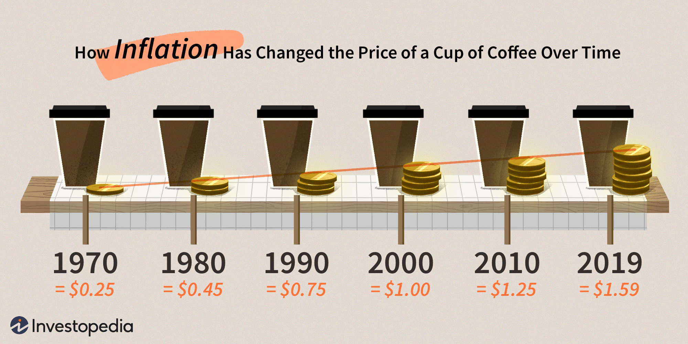
Define the Problem
Does it impact me?
Rising Prices at the Grocery Store
You may have noticed that when you’re grocery shopping with your grown-ups that they’re spending more than they used to.
Have you noticed that the price of a loaf of bread has increased?
Are your grown-ups paying more for a gallon of milk?
Are your snacks for school too costly to buy for an entire week?

Slide 5
How is this problematic?
Gather the Evidence
Families spending more money at the grocery store and getting fewer groceries which is leaving less money for other essentials (bills, fuel, cost of living).
Healthy foods are becoming more and more expensive so the only foods that are affordable are foods that are less healthy, therefore having an impact on overall health.
The National Consumer Price Index (CPI) inflation rate between 2010 and 2014 is 26.63% ²
The income growth rate is lower than the state average of 35.25% and the national average of 27.36%.²
Since the beginning of the 21st century, food prices have risen between 2.0% and 3.0% a year on average.³
² http://www.usa.com/11420-ny.htm
³https://www.thebalance.com/why-are-food-prices-rising-causes-of-food-price-inflation-3306099

Slide 6
Identifying the Causes
The problem that needs to be addressed is the rising costs of groceries at the grocery store.
Rising costs of groceries at the grocery store is a problem for several reasons including but not limited to:
Healthier foods becoming unattainable so healthier habits are harder to maintain
Single and dual income families are spending more at the grocery store and therefore leaving less money for other essentials
Global political and warfare issues are having an impact on families
Pandemic related job loss leads to reduction in income
Climate change is causing a supply and demand problem

Slide 7
Evaluating an Existing Policy
Price and Wage Controls ⁴
Price controls are government made minimum or maximum prices set for goods and services
Put in place to keep goods and services affordable
Short term benefits only
Long term can cause shortages, rationing, poor product quality, and illegal marketing
Minimum wages are set so employees can maintain a standard of living
⁴ https://www.investopedia.com/ask/answers/111314/what-methods-can-government-use-control-inflation.asp

Slide 8
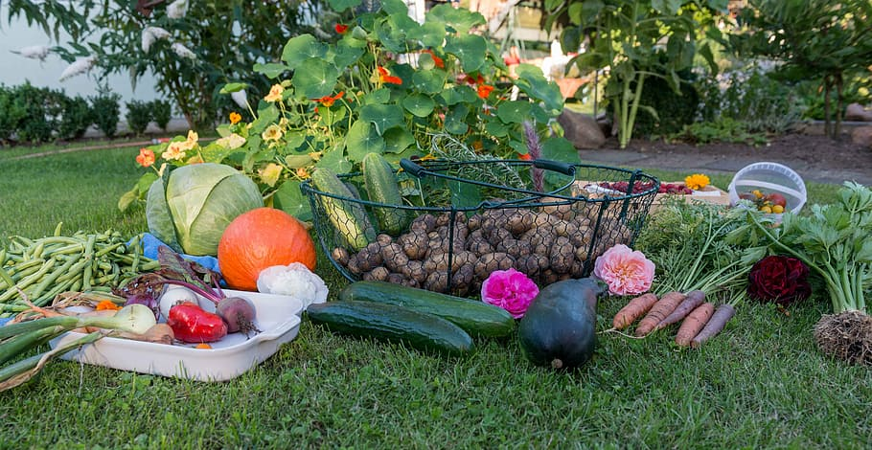
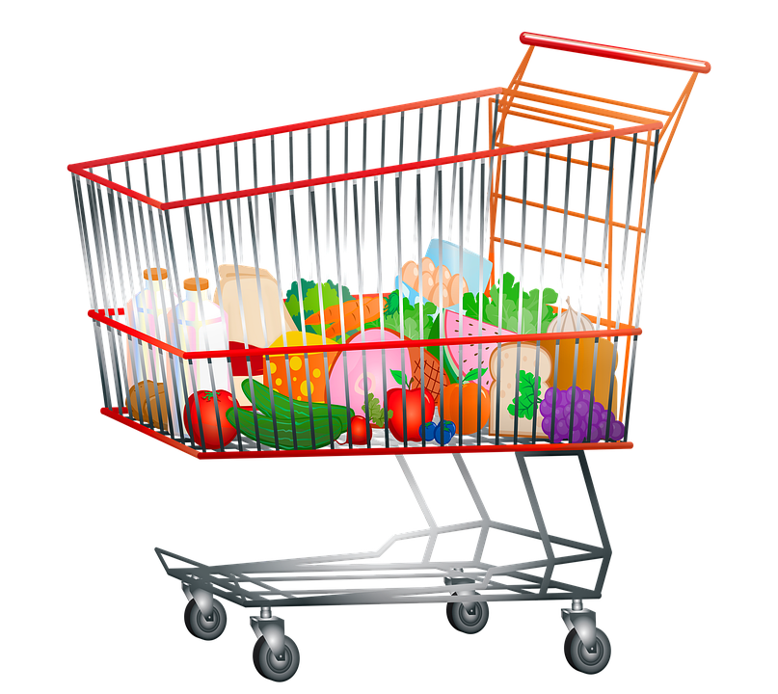

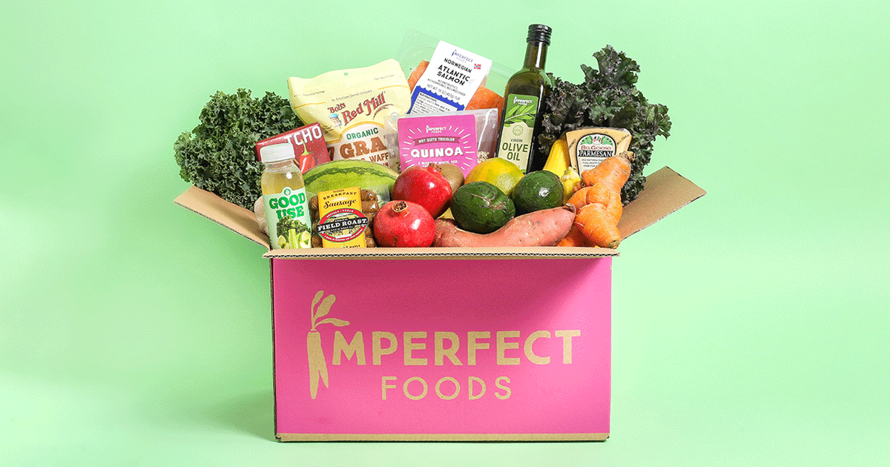
Develop Solutions
Resouces
Solution 1:
Solution 1:
Solution 2:
Solution 2:
Solution 3:
Solution 3:
What new ideas do you have to alleviate the problem of rising grocery store prices?
Click the pictures below to learn more about each solution.
Grow your own produce.
Buy fewer groceries and make the ones you have last longer.
Purchase discounted groceries from an online retailer like MisfitsMarket or ImperfectFoods.

Slide 9
Selecting the Best Solution
FEASIBILITY
 |  | HIGH | MEDIUM | LOW
 | HIGH |  | 1
 | MEDIUM |  | 3
 | LOW |  |  | 2
EFFECTIVENESS

