Slide 1
Managing BIG Emotions
Mrs. Faherty
2021- 2022 4th Grade
P.S. 90Q Horace Mann

Slide 2
Learning Target
I can use the PPA strategy to determine a solution to a problem.
Success Criteria
I can identify and describe the different parts of the PPA framework
I can collaborate with peers to gather evidence
I can evaluate solutions
I can contribute my ideas for the best solution

Slide 3
What is PPA?
PPA is an abbreviation for Public Policy Analyst. It's a fancy way of saying……
I can use this strategy to solve a problem:
I am facing | my school faces | my community faces
my grade faces | my class faces | my family faces

Slide 4
The 6 Steps of PPA
Define the PROBLEM
Gather Evidence
Identify Causes
What is something I need to do better?
What is a challenge for my class?
We need to gather research or conduct research
WHY is the problem happening?
Notes:
Add pictures ?

Slide 5
The 6 Steps of PPA
Examine Existing Policies
Develop New Solutions
Select the BEST solution
What is a classroom procedure that tries to help with this problem?
Can we change the current classroom procedures?
Can we create new procedures?
Choose only ONE solution that will be the easiest to implement and show better results

Slide 6
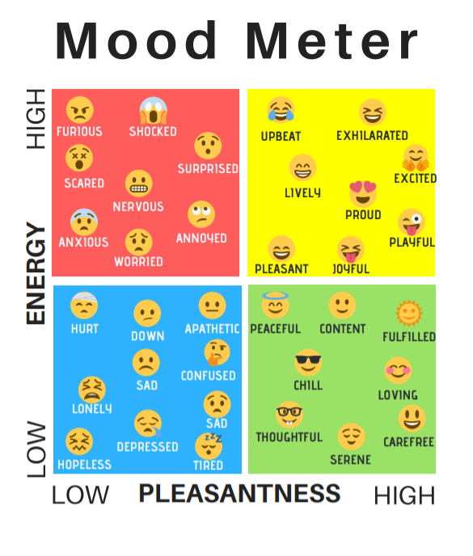
Have you ever…
Been in the red zone?
What did you do when you were in the red zone?
Notes:
Student engagement / connection

Slide 7

STEP 1: Define the Problem
Students in class 4-411 at P.S. 90Q sometimes have a difficult time being in control of intense emotions.

Slide 8
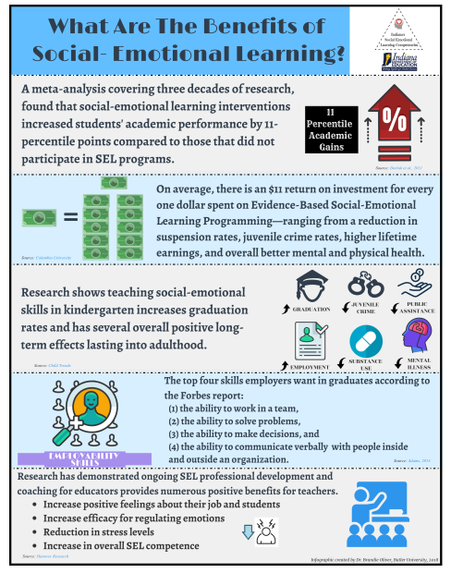

STEP 2: Gather Evidence of the Problem
Let’s survey our class to collect evidence about how we manage emotions when we are in the red zone
Let’s review research to see what the experts say about the importance of managing BIG emotions and learning
Notes:
Link menti meter
Link article or student friendly infographic

Slide 9
STEP 3: Identify Possible Causes of the Problem
Students might not be sure how to ask for help
Students might not be sure of the feeling they are having
Students might not feel comfortable using resources or prefer other options
Let’s Brainstorm the Rest Together….
Notes:
#4-5 turn and talk → group discussion

Slide 10
STEP 4: Examine An Existing Policy
At P.S. 90Q, students engage in an SEL time everyday. Each day begins with a Morning Meeting utilizing the mood meter check in and the Sanford Harmony program. Sanford Harmony fosters and supports social connections among all students to promote the social, emotional, and cognitive skills students need to successfully negotiate peer interactions, develop positive peer relationships, and thrive.

Slide 11
STEP 5: Develop New Solutions
On a post it, share one new solution
Share your ideas with your group members
As a class we will create a list
Notes:
w/ students

Slide 12
Evaluate Our Choices
Feasibility
 | High | Medium | Low
High
Medium
Low
Effectiveness

Slide 13

STEP 6: Select the BEST Solution

