Slide 1
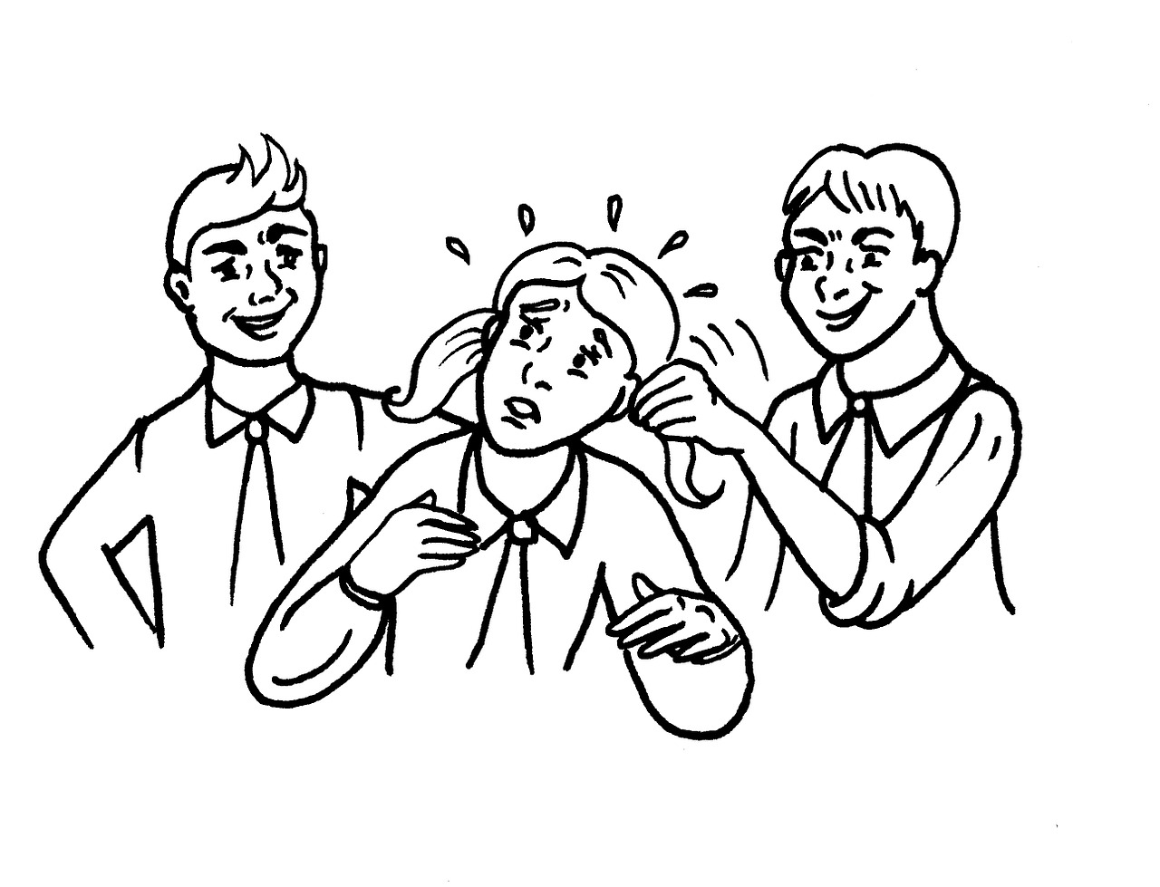
Social Problem:
Bullying in Queens Elementary Schools
Leanne Evelyn
P.S. 62 levelyn2@schools.nyc.gov
Notes:
What is the specific community location of the social problem? Your answer should include both the governmental authority

Slide 2
Public Policy Analyst Steps
Define the Problem:
Gather Evidence
Causes:
Evaluate:
Possible Solutions:
Select the Best Solution:
Notes:
Steps in the process

Slide 3
Bullying
Why does it matter?
Effects of Bullying
Bullying can affect everyone—those who are bullied, those who bully, and those who witness bullying. Bullying is linked to many negative outcomes including impacts on mental health, substance use, and suicide. It is important to talk to kids to determine whether bullying—or something else—is a concern.
Kids Who are Bullied
Kids who are bullied can experience negative physical, social, emotional, academic, and mental health issues. Kids who are bullied are more likely to experience:
Depression and anxiety, increased feelings of sadness and loneliness, changes in sleep and eating patterns, and loss of interest in activities they used to enjoy. These issues may persist into adulthood.
Health complaints
Decreased academic achievement—GPA and standardized test scores—and school participation. They are more likely to miss, skip, or drop out of school.
Notes:
What is the specific community location of the social problem? Your answer should include both the governmental authority

Slide 4
Bullying
Why does it matter?
Kids Who Bully Others
Kids who bully others can also engage in violent and other risky behaviors into adulthood. Kids who bully are more likely to:
Abuse alcohol and other drugs in adolescence and as adults
Get into fights, vandalize property, and drop out of school
Engage in early sexual activity
Have criminal convictions and traffic citations as adults
Be abusive toward their romantic partners, spouses, or children as adults
Bystanders
Kids who witness bullying are more likely to:
Have increased use of tobacco, alcohol, or other drugs
Have increased mental health problems, including depression and anxiety
Miss or skip school
Source
Notes:
What is the specific community location of the social problem? Your answer should include both the governmental authority
https://drive.google.com/file/d/1B3Lyg51oIpn3d_J8zMkixx_EEXwhHjLb/view?usp=sharing

Slide 5
Gather Evidence
Students completed a google form voicing their concerns and opinions about attending school at P.S. 62.
Check out their responses here!
What do you notice about the data collected?
What category has the most responses? The least? Why do you think this is?
What is the most important issue for students attending P.S. 62?
Notes:
Present evidence that a problem exists. Be as specific as possible and cite at least one source of data:

Slide 6
What does Bullying look like in P.S. 62?
Fighting
hitting/pushing
Saying mean words
Writting mean words/phrases on desk and walls
Name calling
Notes:
Briefly list several underlying factors that contribute to the problem that you have identified (support these factors with evidence):

Slide 7
Causes
Why do some students bully?
Children and teenagers who feel secure and supported by their family, school, and peers are less likely to bully. However, some youth do not have these types of support. Every individual is unique and there are many factors that can contribute to bullying behavior. A youth who bullies may experience one, several, or none of these contributing factors.
Peer factors
to attain or maintain social power or to elevate their status in their peer group.
to show their allegiance to and fit in with their peer group.
to exclude others from their peer group, to show who is and is not part of the group.
to control the behavior of their peers.
Family factors
come from families where there is bullying, aggression, or violence at home.
may have parents and caregivers that do not provide emotional support or communication.
may have parents or caregivers who respond in an authoritarian or reactive way.
may come from families where the adults are overly lenient or where there is low parental involvement in their lives.
Notes:
Briefly list several underlying factors that contribute to the problem that you have identified (support these factors with evidence):

Slide 8
Causes continued
Emotional factors
Some youth who bully:
may have been bullied in the past or currently.
have feelings of insecurity and low self-esteem, so they bully to make themselves feel more powerful.
do not understand other’s emotions.
don’t know how to control their emotions, so they take out their feelings on other people.
may not have skills for handling social situations in healthy, positive ways.
School factors
Some youth who bully:
may be in schools where conduct problems and bullying are not properly addressed.
may experience being excluded, not accepted, or stigmatized at school.

Slide 9
Evaluate the Existing Policy
P.S. 62 current policy on bullying:
Respect for All Week
During Respect for All Week on Monday, February 13 to Friday, February 17, 2023, schools across the city will have the opportunity to highlight and build upon ongoing programs to help students, staff and communities gain a better understanding of diversity. Schools may also start new initiatives that promote respect for diversity and focus on preventing bullying, intimidation, and bias-based harassment. Your child’s school is also encouraged to promote acceptance and understanding through theme-based lessons and activities. Suggested themes include:
Celebrating Kindness/Be an Ally
Anti-Bullying/ Cyberbullying
Respect for Diversity, Disability, Religious Acceptance and Racial Diversity
Gender Identity, Sexual Orientation and LGBTQ Pride and Acceptance
Friday, February 17, 2023 - National No One Eats Alone Day
Notes:
State one of the major existing policies that attempts to deal with the social problem:

Slide 10
Evaluate the Existing Policy
Respect for Week is an isolated week long event.
It does not address bullying problems that occur on a day to day basis.
RFA does not create long term solutions to bullying.

Slide 11
Possible Solutions
Suspend students who bully others repeatedly.
Take away playtime from classes /students that have bullies.
Reward the desired behavior,
using kind words,
being helpful,
If you see something say something.
Notes:
Propose at least three new/original public policy alternatives. Be sure that all of your public policy alternatives are at the same geopolitical level as your social problem. Each alternative must specify the actual government or government agency that will carry out the proposed action. List the proposal that your group considers the most promising first.

Slide 12
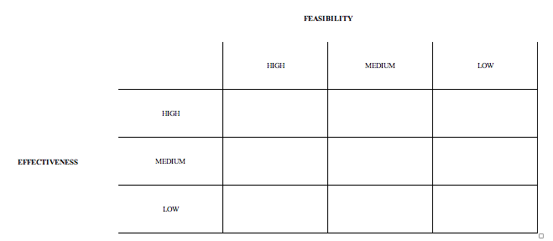
Select the Best Solution
Feasibility vs Effectiveness
Reward Positive Behavior
Suspend and Punish Bullies
Class/Student playtime taken away
Notes:
Chart

