Slide 1

Littering at P.S. 377Q
How can we fix it?
Graziella Esposito
P.S. 377Q

Slide 2

The 6 Steps of the Public Policy Analyst (PPA)
WE ARE PROBLEM SOLVERS!
Define the Problem
Gather the Evidence
Identify the Causes
Evaluate an Existing Policy
Develop Solutions
Select the Best Solution (Feasibility vs. Effectiveness)

Slide 3
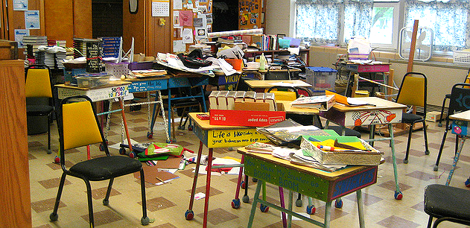
Step 1: What’s the Problem?
Problem: Students at P.S. 377Q are not cleaning up their mess and garbage in their classrooms and around the school.

Slide 4
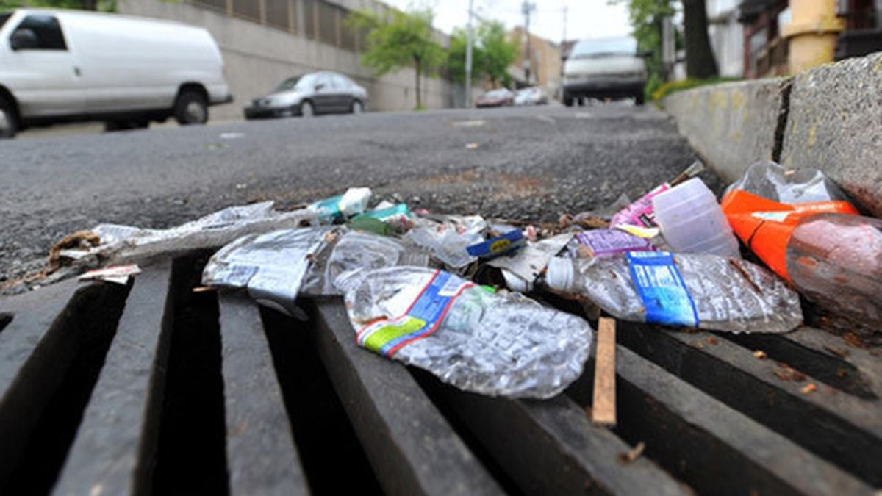
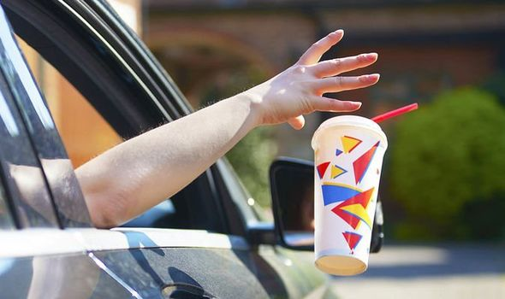
What is Littering?
Littering is when someone throws their garbage somewhere other than the garbage can. They might throw it on the floor or on the street.
Is littering good or bad? Why?
How do these pictures make you feel? Why?
Why do you think littering is happening at P.S. 377Q?
How do you think we can fix this problem?

Slide 5
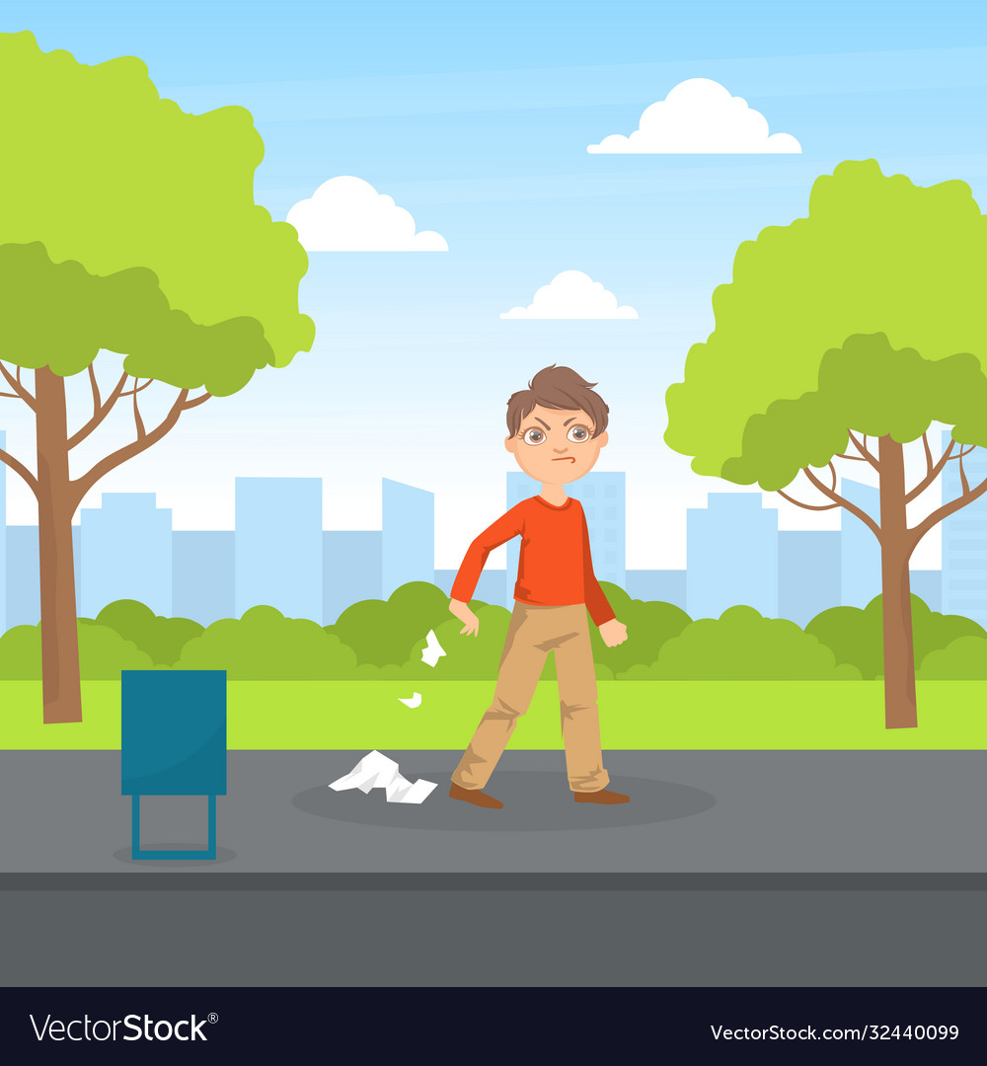

Step 2: Gather the evidence
How do we know littering is happening at P.S. 377?
Why is it happening?

Slide 6
Evidence
When you walk around our school (both inside and outside), there is a lot of garbage!
When Ms. Esposito walks around, she is picking up pieces of garbage, like paper, wrappers, and more.
The custodians have let us know that there is a lot of mess in and out of our classrooms.
Your turn!
How else do we know littering is happening inside and outside of our school?

Slide 7

Step 3: Identify the Causes
Let’s discuss…
Why do you think littering happening to our beautiful, new school?
Turn and talk with your partner.

Slide 8
Causes
There aren’t many garbage cans in our hallways and in the stairwells.
Our school community may not realize what it does to our school.
There is no one going around helping this problem we have.
Your turn! Anything else we should add?

Slide 9
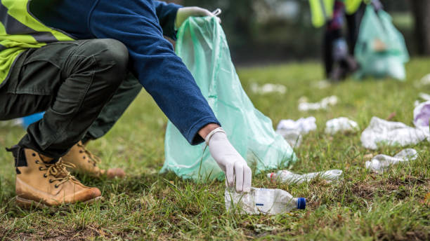
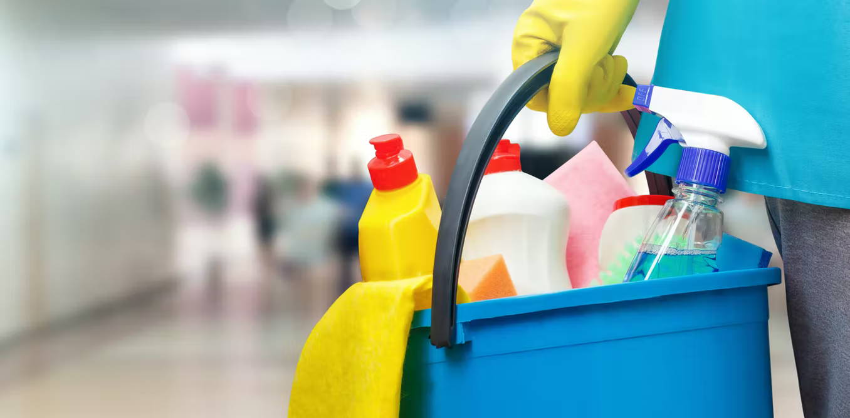
Step 4: Evaluate an Existing Policy
How do we already try to keep our school clean?
Garbage cans inside our classrooms.
Some students may see garbage on the floor and pick it up.
Our custodians clean the classrooms, hallways and around the school each day

Slide 10

Step 5: Develop a Solution
What can we do at P.S. 377 to stop littering?
Work with your partner to think of some ways, and then we will come together as a group to discuss.

Slide 11

Solutions:
How can we fix this problem?
Place garbage cans in the hallways and in the stairwells.
Create signs about littering to hang in the hallways, classrooms, and around the school building.
Choose students to be “Garbage Monitors” throughout the school. Each day, these monitors take a quick sweep throughout the school to check that everything is clean.
Hold assemblies for students to educate them about littering and what it does to our environment.

Slide 12
Step 6: Choose the BEST Solution
Which one do you think the best solution for right now?
Effectiveness: How well will it work? Will it make a change?
Feasibility: How easily can we make this happen? Is it going to cost a lot of money? Will it be hard to do?
Think, Jot, Pair, Share
Think about which one is the best solution for right now. Write it down.
Then, pair up with your partner to discuss your choice.
Be ready to share out!

Slide 13
Feasibility
 | High | Medium | Low
High |  | Place garbage cans in the hallways and in the stairwells.
Medium | Create signs about littering to hang in the hallways, classrooms, and around the school building.
Low
Effectiveness

