Slide 2
Public Policy Analysis
PPA steps to success?
Define the problem
Gather the evidence
Identify the causes
Evaluate the existing policy
Develop solutions
Select the best solution

Slide 3
Step 1: Define the problem
Bullying is an issue at MS226

Slide 4
What are the effects of Bullying?
Kids who are bullied can experience negative physical, social, emotional, academic, and mental health issues. Kids who are bullied are more likely to experience:
Depression and anxiety, increased feelings of sadness and loneliness, changes in sleep and eating patterns, and loss of interest in activities they used to enjoy. These issues may persist into adulthood.
Health complaints
Decreased academic achievement—GPA and standardized test scores—and school participation. They are more likely to miss, skip, or drop out of school.
A very small number of bullied children might retaliate through extremely violent measures. In 12 of 15 school shooting cases in the 1990s, the shooters had a history of being bullied.
Why does it matter?
Notes:
Move to section 1

Slide 5
What does Bullying look like at 226?

Slide 6
Step 2: Gather the evidence
Look at the results from our last school climate survey. 682 students responded!
What do you notice about the data?
Do you think it is accurate? Explain.

Slide 7
67% of students surveyed think that bullying is a problem at 226.
https://secure.panoramaed.com/nycdoe/understand/9047446/survey_results/20367815#/questions/topics/43026

Slide 8
54% say students Cyberbully each other!
https://secure.panoramaed.com/nycdoe/understand/9047446/survey_results/20367815#/questions/topics/43026

Slide 9
Step 3: Identify the causes

Slide 10
Why do students bully each other?

Slide 11
46% say students bully others based on Race or Culture!
https://secure.panoramaed.com/nycdoe/understand/9047446/survey_results/20367815#/questions/topics/43026

Slide 12
48% say students bully others based on Gender or Sexuality!
https://secure.panoramaed.com/nycdoe/understand/9047446/survey_results/20367815#/questions/topics/43026

Slide 13
54% say students bully others based on Weight or Disability!
https://secure.panoramaed.com/nycdoe/understand/9047446/survey_results/20367815#/questions/topics/43026

Slide 14
Step 4: Evaluate the existing policy

Slide 15
Under DOE policy, students may not harass, intimidate, bully or sexually harass other students. Students may also not discriminate against or harass, intimidate or bully students on the basis of actual or perceived race, color, citizenship/immigration status, religion, creed, national origin, disability, ethnicity, gender, gender identity, gender expression, sexual orientation, or weight.
Notes:
Move to section 4

Slide 16
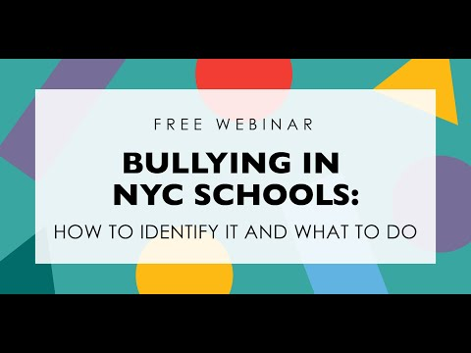
Step 4: Evaluate the existing policy

Slide 17
ADDRESSING BULLYING AND BIAS-BASED BEHAVIOR
Prevention and Intervention
Each school is expected to promote a nurturing school culture that promotes positive interpersonal and intergroup relations and respect for diversity among students and between students and staff. Schools should provide all students with a supportive and safe environment in which to grow and thrive academically and socially. The ability of students to learn and meet high academic standards and the school community’s ability to educate its students are compromised when students engage in discrimination or harassment, bullying, or intimidating behavior toward other students.
Schools should prevent bullying behavior through:
• Implementation of school-wide and classroom-based social and emotional learning strategies and positive approaches to discipline;
• Age-appropriate instruction on bullying prevention in each grade that is incorporated into the curriculum;
• Creation of a school-wide and classroom climate that supports racial, cultural and other forms of diversity, (i.e., clear communication of behavioral expectations, incorporation of lesson plans on prejudice reduction, modeling unbiased behavior, empathy development and cooperative learning); and
• Encouragement of parent participation in bullying behavior prevention initiatives.

Slide 19
What you can do if you are bullied
There are four ways to report this type of behavior:
File a complaint online (click the Get Started button below)
Notify a staff member at your school, including the Respect for All Liaison or Sexual Harassment Prevention Liaison, verbally or in writing
Call 718-935-2288
Email Respectforall@schools.nyc.gov
You can report any discrimination, intimidation, harassment (including sexual harassment), and/or bullying that happens:
in school
online (cyberbullying) including websites and social media
via phone, email or other digital means
while on school buses
while on school property
while off school property when the behavior threatens or has the potential to threaten the safety or well-being of the school community

Slide 20
Step 5: Develop solutions

Slide 21
What do you suggest we do to fix the bullying problems at 226?

Slide 22
Step 6: Select the best solutions

Slide 23
Step 6: Select the Best Solution
FEASIBILITY
E F F I C A C y |  | Low | Medium | High
 | High
 | Medium
 | Low

