Slide 1
Exploring the Problem of E- Waste at PS 63

Slide 2
The PPA Process
What is the problem?
Where is the evidence?
What are the causes?
What is the existing policy?
What policies can you create to correct the problem?
What is the best policy to correct the problem?

Slide 3
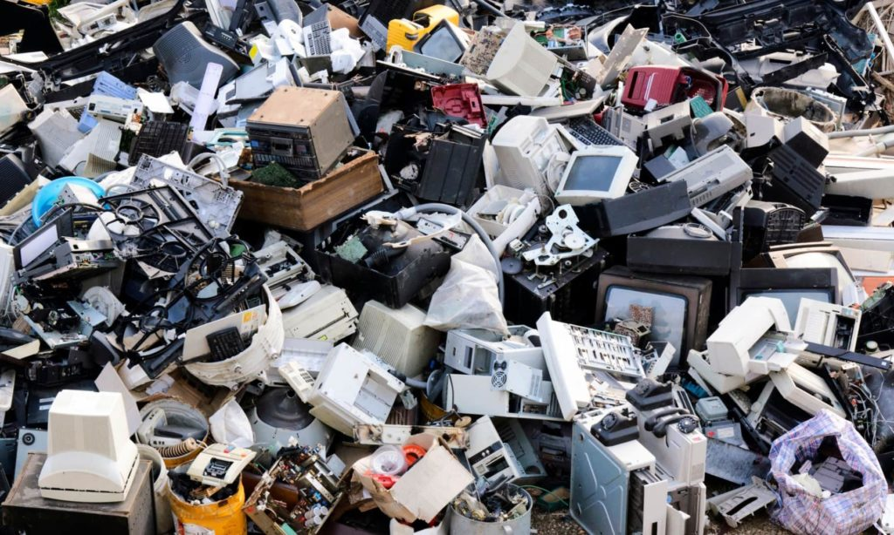
What is E-Waste?
E-waste is any electrical or electronic equipment that’s been discarded. This includes working and broken items that are thrown in the garbage or donated to a charity reseller like Goodwill. Often, if the item goes unsold in the store, it will be thrown away. E-waste is particularly dangerous due to toxic chemicals that naturally leach from the metals inside when buried.

Slide 4
What are some potential problems that E-waste can cause?
Fill up landfills
Contain toxic chemicals
Waste potentially valuable materials/resources
Pollute water supplies and landfills
Take up space
Creates a “cycle of waste” that leads to more wasted valuable resources

Slide 5
In what ways is E-Waste a problem at PS63?
There are thousands of electronic devices at PS63
Turnover rate of devices is high. Devices go out of warranty in 5 years.
A lot of broken devices that are economically unrepairable.

Slide 6
What is the evidence of an E-waste problem at ps63?
Find evidence in the form of pictures, testimony from students and teachers, classroom inventories…

Slide 7
WHat is the current policy for e waste disposal at ps 63?
Presently, a request is put in with the NYCDOE help desk to have a partner company come and remove the devices from the school. Must have 25 devices for pickup to be made.
Not all devices are eligible.
Some devices are picked up through the NYC Sanitation. These pickups are arranged by a custodian.
Unclear what happens to devices after that.

Slide 8
How is this a problem at ps63?
Storage of broken/obsolete devices awaiting pickup.
Potential lost opportunities to salvage devices for other projects
Lack of space to store obsolete or broken devices
Potentially repairable devices are deemed obsolete

Slide 9
Solutions for fixing the e waste problem at PS 63

Slide 10
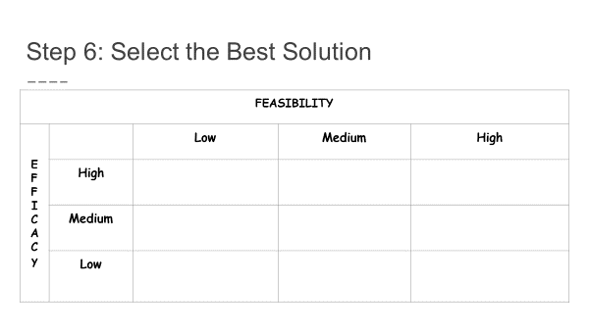
What’s the best solution?

