Slide 1
Poor Teacher/Student Relationships
Jessica Allen

Slide 2
The 6 Steps of the Public Policy Analyst (PPA)
1. Define the Problem
2. Gather the Evidence
3. Identify the Causes
4. Evaluate an Existing Policy
5. Develop Solutions
6. Select the Best Solution (Feasibility vs. Effectiveness)
Notes:
Discuss the 6 steps of PPA

Slide 3
How would you define a Positive relationship between teachers and students?
Discuss with your partner.
Notes:
Present question to classes… students discuss with their partners and then share out.

Slide 4
How would you describe your relationship with teachers?
Notes:
Present question to students. Have students share their thoughts and then short video.

Slide 5

Why are positive relationships important?
https://www.youtube.com/watch?v=7JTQKrjF14A&t=114s
Let’s watch this video…
Notes:
Share video with class

Slide 6
Define the problem
Eighth grade students and middle school teachers have a poor relationship.
Notes:
I must think of a better way of creating this problem

Slide 7
Students and teachers completed a google form with detailed questions about their opinions, feelings about the other.
https://docs.google.com/forms/d/16BDyI8O53GUeH9-izPEVDlpHsIdhjzotc2J2ShFcJJI/edit

Slide 8
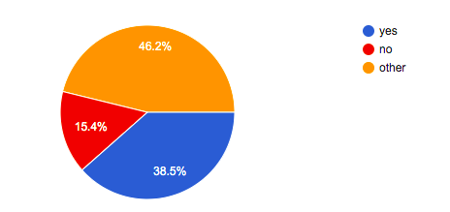
Here are Some Student results from the questionnaire:
Do you feel comfortable asking your teachers questions?
Notes:
Discuss: Why do some of you feel uncomfortable approaching teachers? Is it all teachers; if it is just some, then what makes some teachers more approachable than others?

Slide 9
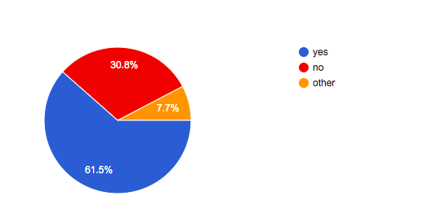
Here are some Student results from the questionnaire:
Do you feel like due to past/unrelated experiences your teachers dislike you or try to target you?
Notes:
Discuss: This is eye opening.

Slide 10
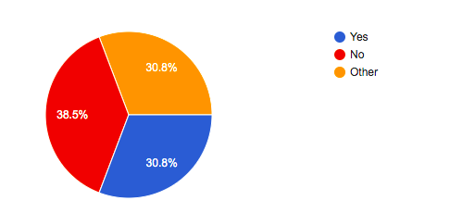
Do you feel like your teachers try to understand your interests?
Here are some Student results from the questionnaire:
Notes:
Let’s talk about this…1/3 of you feel your students understand you, ⅓ of you feel they dont and the other ⅓ are unsure…

Slide 11
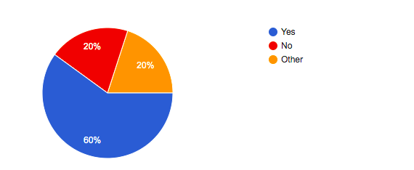
Teacher Results…
Do you feel respected by your students?
Notes:
Discuss with students: why do we thinking some teachers do not feel respected? What does respect look like to you?

Slide 12
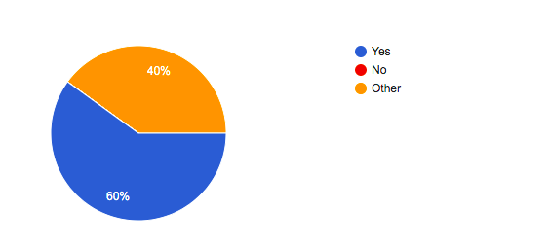
Teacher Results…
Do you feel connected to your students?
Notes:
Interesting…what might be hindering that connection with students.

Slide 13
Causes:
What do you think causes weak relationships between students and teachers?
Notes:
HAve students think about what may cause them to not all feel there is a strong connection with teachers.

Slide 14
Causes:
Lack of Personal Connection
“Personal connection with your students can also raise their intrinsic motivation to learn.[7] When students feel interested in their work for the sake of mastering it, they develop a love of learning that will benefit them for their entire lives. Plus, they’re also more likely to have positive attitudes towards their teachers, classes, and lessons.
Chronic Absenteeism
“And if a child isn’t in class, building relationships with these students can seem nearly impossible.”
https://www.waterford.org/education/teacher-student-relationships/
“students who have had poor experiences with adults in the past can have a hard time trusting teachers.”
Notes:
Discuss the major causes of poor relationships

Slide 15
What do we currently do as a community to foster positive relationships?
Notes:
Have students reflect on practices.

Slide 16
Solutions….
Create Clubs based on student/teacher interest. During extra-curricular period, teachers can lead clubs based on student interest.
During free periods, have teacher/student discussion time.
Teachers can set aside a period a week where they will have open door to any students.
Notes:
PResent solutions and have students discuss.

Slide 17
Feasibility
 | HIGH | MEDIUM | LOW
HIGH |  |  | Teacher/Student Clubs: It is during schedule so teachers do not need to dedicate any more time, all students will participate and it will bridge student and teacher interests.
MEDIUM |  | Free period talks… Will all teachers be willing to give up free time? WIll all students be willing to go?
LOW
effectiveness
Notes:
Discuss chart to see if students agree.

