Slide 1
Lack of Family Involvement
Sheryll Walker-Bryant
Ralph Bunche School
P.S.125
swalker@ralphbuncheschool.org

Slide 2
Steps of the Public Policy Analyst (PPA)
Define the problem
Gather the Evidence
Identify the Causes
Evaluate an Existing Policy
Develop Solutions
Select the Best Solution (Feasibility vs. Effectiveness)

Slide 3
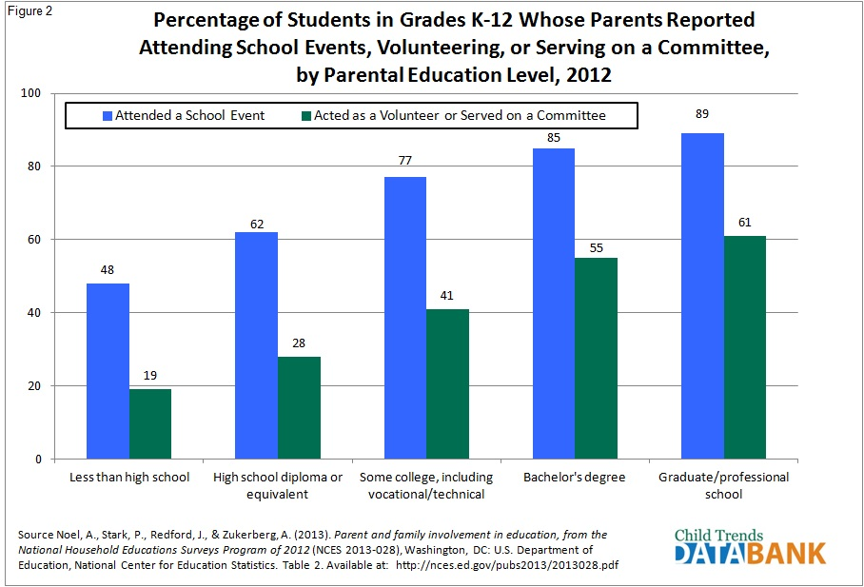
Define the Problem – PPA #1
Parents at P.S. 125 have little to none family involvement. How do we increase family involvement?
Activity: Complete Worksheet #1

Slide 4
Gather the Evidence - PPA #2
Research: “Why Is Family Involvement in Education Important?” by Karen Bogenschneider, Beth Gross, and Carol Johnson.
Research:
“Why Urban Parents Resist Involvement in their Children’s Elementary Education”, by Peter McDermott and Julia Rothenberg.
Activity: Complete Worksheet #2

Slide 5
Identify the Causes - PPA #3
Cultural Misunderstandings
Financial Concerns/Work Schedules
Diverse School Experiences among Families
Activity: Complete Worksheet #3

Slide 6
Evaluate an Existing Policy – PPA #4
What do schools do to increase family involvement?
NYCDOE Policies
Each school is assigned a Parent Coordinator
Schools are encouraged to host Family workshops
Most schools have a PA or PTA
Schools host Parent Orientations at the beginning of the school year

Slide 7
Develop Solutions
Host Cookouts
Promote family activities like “Game Night”
Hold a “Family Reading Night”
Provide a “Health & Fitness Night”
Arrange for a “Technology Night”
Hold a Parent University or Parent Academy to train parents in leadership skills

Slide 8
Select the Best Solution
In each group, think about which of the solutions on the previous slide may best be the course to increase family involvement.
List your reasons and be prepared to share with the larger group.

