Slide 1
By: J. Rivera
PS 125M
NEW YORK, NY
Are Co-location of Schools Fair for Everyone?

Slide 2
Public Policy Analyst (PPA) Steps
1. Define the Problem
2. Gather the Evidence
3. Identify the Causes
4. Evaluate an Existing Policy
5. Develop Solutions
6. Select the Best Solution (Feasibility vs. Effectiveness)

Slide 3
Defining the Problem
What is school co-location?
What is the impact of co-locations between charter and public schools?
Do you think co-location of schools is fair for everyone?

Slide 4
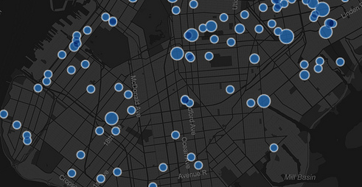
Number of Co-locating Schools
The Bloomberg administration opened 656 new schools in the last ten years, as an attempt to limit crowding, provide smaller class sizes and better utilize limited space. Buildings with just one school in them are not represented in this map.

Slide 5
Gathering Evidence
(Click on each link to read each side’s point of view)
The Charter School’s Argument
Public School’s Argument
Inside Co-location

Slide 6
Identify the Causes?
Working in Groups of 4-5…
Identify the reasons why charter schools believe they should be able to co-locate with a public school?
Identify the reasons why public schools are against charter schools co-locating?

Slide 7
Evaluate an Existing Policy
Former NYC Mayor Michael Bloomberg wanted to be known as the Education Mayor. His policies on co-locations created friction among public and charter schools. Read the following article:
A Schoolhouse Divided

Slide 8
Develop Solutions
(Work within the same groups)
Do you agree with the current co-location policies?
What changes (solutions) if any, would you like to see take place?
What will be needed to make these changes happen?
Present your solution to the class.

Slide 9
Select the Best Solution
Which solution presented is the most feasible?
Which solution presented is the most effective?

