Slide 1
Lack of Healthy Food Options in Our School
PS/MS 123
Mahalia Jackson School
Ms Kessler, LMS

Slide 2
Public Policy Analyst (PPA)
Let’s learn how to address the issue. Let’s:
Define the Problem
Gather the Evidence
Identify the Causes
Evaluate the Existing Policy
Develop Solutions
Select the Best Solution
(Feasibility vs. Effectiveness)

Slide 3
Today we will…..
1. Define the problem.

Slide 4
What makes a food UNHEALTHY?
Read this article to learn more!

Slide 5
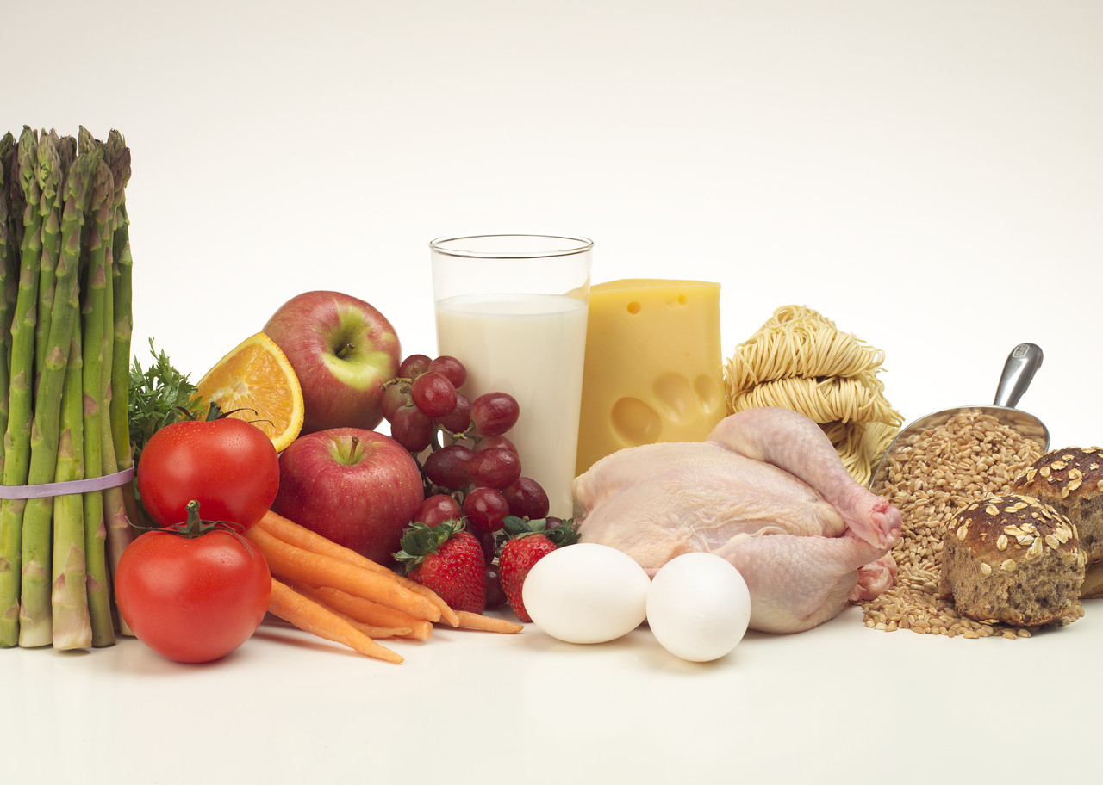
Why is this food healthy?

Slide 6
It’s after school and you’ve worked SO HARD all day.
You are famished! What are your options for a snack?
Talk to your group…what could you get? From where?

Slide 7
Can you buy healthy food from:
The corner store? Y N
A supermarket? Y N
A street vendor? Y N
Where are you most likely to go?

Slide 8
Imaginary field trip to corner store…….
Close your eyes and imagine you are walking through the aisles at your local corner store.
What is on the shelves? What is in the display case?
Talk to your partners…do you think the things you can buy there are good for your body or not?
Why?

Slide 9
Can I Afford To Eat Healthy?
http://www.livestrong.com/article/434419-healthy-food-costs-vs-unhealthy-food-costs/

Slide 10
Groupwork: Define the Problem of unhealthy food in our school
http://flippedtips.com/plegal/tips/worksheet1.html

Slide 11
Next time we will...
2. Gather the evidence

Slide 12
References
http://www.wisegeekhealth.com/what-is-unhealthy-food.htm
accessed 9/15/14
http://www.livestrong.com/article/434419-healthy-food-costs-vs-unhealthy-food-costs/
accessed 9/15/14

