Slide 1
Racial Tensions in 2014 America
P.S./M.S. 123
Scott Paranada-Fried
September 23, 2014

Slide 2
The Public Policy Analyst Steps
Define the problem
Gather the evidence
Identify the causes
Evaluate an existing policy
Develop solutions
Select the best solution
http://flippedtips.com/plegal/tips/welcome.html

Slide 3
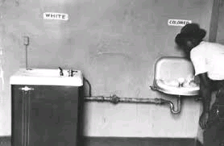
Racial tension or racism is prejudice towards someone of a different race based on the belief that one’s own race is superior.

Slide 4
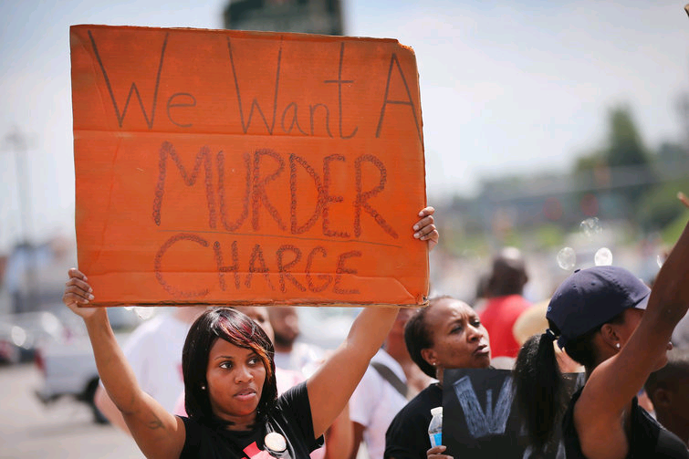
150 years after the Civil War and fifty years after the Civil Rights Act, there is still an enormous amount of racial tension in the United States.

Slide 5
In the last few months, there have been numerous incidents which illustrate the racial tension that still afflicts this country in 2014.

Slide 6
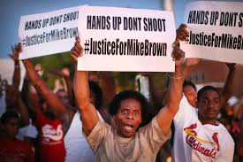
Ferguson, Missouri
On August 9, 2014, an unarmed man, Michael Brown was shot and killed by a police officer Darren Wilson.
Subsequently, riots erupted in the largely black community of Ferguson.
Police responded with military gear and tear gas.

Slide 7
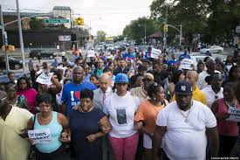
New York City, New York
On July 17, 2014, Eric Garner, a black man was placed in a chokehold by Daniel Pantaleo, a police officer.
Garner died as a result of the chokehold.
He had been selling “loosies” – single cigarettes illegally.
There were large, but peaceful protests in the days afterwards.

Slide 8
What are the causes of this racial tension?

Slide 9
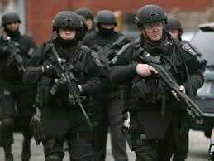
Militarization of the police

Slide 10
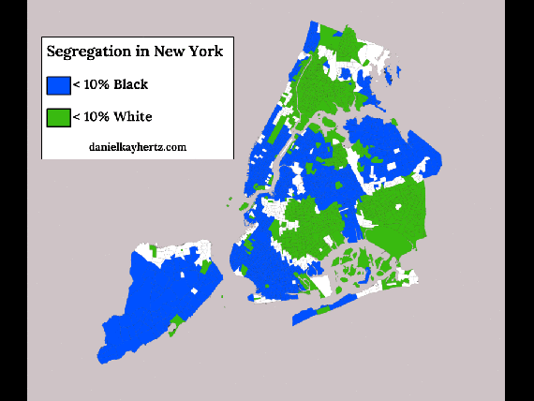
White flight and segregation
New York, NY
Ferguson, MO:
1990: Three-quarters white
2000: 50/50, Unemployment at 5%
2010: Two-thirds black,
Unemployment at 13%
See citation

Slide 11
Media Portrayal of Black Youths
Mainstream media often portray African-American youths, especially black men and boys, as criminals, crime victims and predators. These stereotypes can create a racially charged atmosphere that results in violence.

Slide 12
What is the existing policy?

Slide 13
Stop and frisk techniques:
The Stop-Question-and-Frisk program in New York City is a practice of the New York City Police Department by which police officers stop and question hundreds of thousands of pedestrians annually, and frisk them for weapons and other contraband.

Slide 14
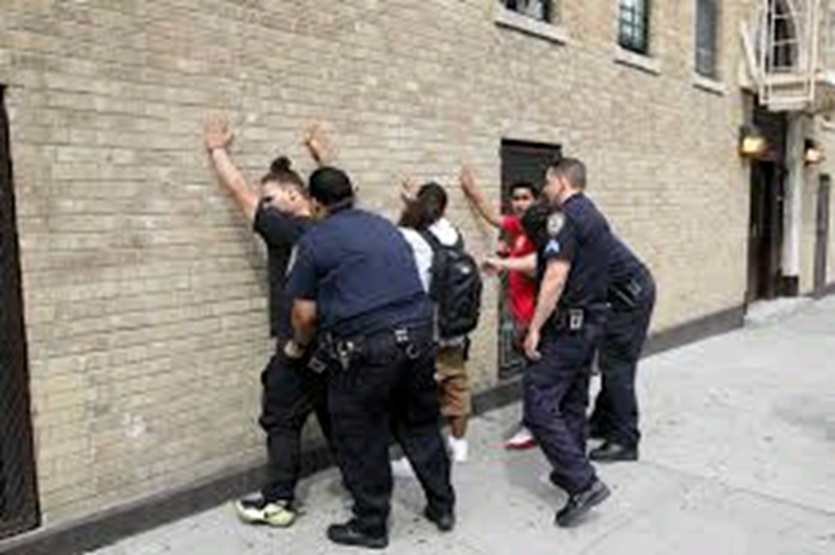
Stop and frisk in New York City

Slide 15
What are some solutions to resolving racial tensions?

Slide 16
Slowing down stop and frisk and retraining police officers
Community engagement by police
Look beyond race and ethnicity
Build self-identity first
Open all doors to everyone

Slide 17
Choosing the best solution
Assignment: Students will read a case study of what happened in Ferguson, MO and create a plan as a group for how the community can work together to diminish the tension between the residents and the police.

