Slide 1
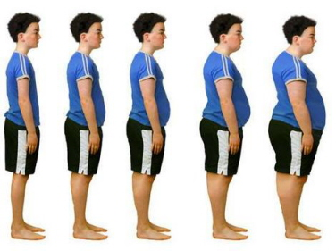
Childhood Obesity at PS 194M
Mrs. Coombs
PS 194M Countee Cullen
New york, new York
September 2014
mcoombs7@schools.nyc.gov

Slide 2
How would you feel if you WERE bullied for being “OVERWEIGHT”? Turn and talk to your partner. You will do a “Think Pair Share.” Jane will start. You each will have 30 seconds. Use the sentence frame: “If I WERE CALLED OVERWEIGHT, I would feel_____.”

Slide 3
Steps of the PPA
Define the Problem
Gather the Evidence
Identify the Causes
Evaluate an Existing Policy
Develop Solutions
Select the Best Solution

Slide 4
Step 1: Let’s define the problem.
CHILD OBESITY

Slide 5
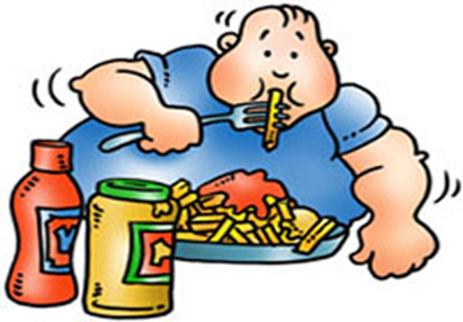
STEP 2: Gather THE EVIDENCE

Slide 6
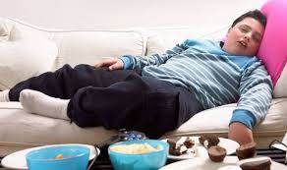
gather evidence
Make a list of different foods that you see or have seen brought to P.S. 194 for lunch or snack…
Make a list of responses:
________________
________________
________________

Slide 7
MEDIA REPORT
Http://w.cnn.com/2014/09/22/opinion/steinberg-obesity-puberty/
I would
show this
video of why we
should be concerned
about childhood obesity.

Slide 8
STEp 3 identify the CAUSES?

Slide 9
step 4 Evaluate an existing policy on CHILDHOOD OBESITY What are some actions taken in the prevention of childhood obesity? Use worksheet 4 http://www2.maxwell.syr.edu/plegal/TIPS/worksheet4.html

Slide 10
existing policy on CHILDHOOD OBESITY
Part 1-First Lady Michelle Obama recognizes this threat of obesity, and has taken up the cause with her Let's Move! initiative, encouraging families across the country to commit to living healthier lives. The Partnership for a Healthier America supports the First Lady's cause by encouraging, tracking and communicating commitments to healthier lifestyles from partner organizations - commitments that align with the priorities of the Partnership for a Healthier America. (citation)

Slide 11
Existing policy on CHILDHOOD OBESITY
Part 2- In collaboration with Let’s Move!, the Partnership for a Healthier America will work alongside the Federal government to build target industry-specific solutions to fight obesity that can be measured and tracked. Rather than award grants, engage in policy discussions, or develop programmatic activities, the Partnership concentrates on mobilizing leadership from across sectors and at every level to take action that can have a significant impact on organizational goals. (citation)
http://www.letsmove.gov/partnership-healthier-america

Slide 12
Step 5 Develop Solutions:
How can we solve the problem of childhood obesity at PS 194M?
Let’s examine…..

Slide 13
Lets examine…
How can childhood obesity at PS 194M be solved…Step 5 – Developing Solutions: Turn and talk to your group and come up with possible solution using Worksheet 5
http://www2.maxwell.syr.edu/plegal/TIPS/worksheet5.html

Slide 14
Step 6 Select the best solution
Increase healthy eating by getting children at our school to recognize the importance of a balanced diet and its contribution to overall health.
Have the children of PS 194M eat more fruits and vegetables during breakfast and lunchtime.
Make posters about healthy eating to hang in the school.
Engage in the school-wide program called Cookshop within the classrooms.

Slide 15
What Is The Best Public Policy Solution to the Problem of Childhood Obesity?
What Is The Best Feasible Plan and
Most Effective Plan?
By looking at the problem of childhood obesity and constructing your own knowledge obtained through the Public Policy Analyst Steps and Information gathered– Complete Worksheet 6:
Selecting The Best Public Policy Solution:
http://www2.maxwell.syr.edu/plegal/TIPS/worksheet6.html

