Slide 1
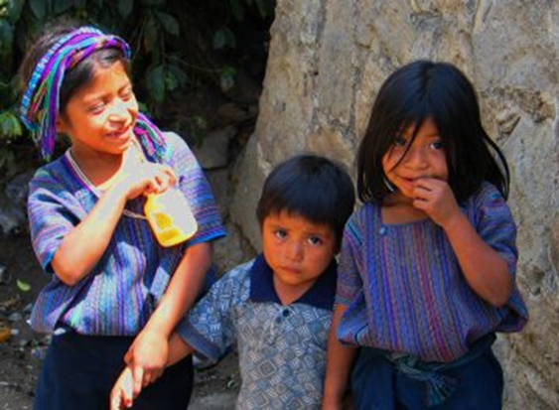
Children of Guatemala

Slide 2
Fanny Zucchiatti PS/MS 123 Third Grade
Public Policy Analyst Steps
Define the problem
Gather the evidence
Identify causes
Evaluate the policy
Develop solutions
Select best solution

Slide 3
In our quest to understand the power of reading, we will be reading a book entitled The Most Beautiful Place in the World by Ann Cameron. The story is about a seven year old boy named Juan who lives in Guatemala. In order to better understanding the challenges Juan faces , we will be taking a closer look at the daily problems faced by the children in Guatemala.

Slide 4
Step 1 of the PPA: Define the Problem What defines illiteracy?
The United Nations Educational, Scientific and Cultural Organization (UNESCO) defines an illiterate person as someone who can not, with understanding, both read and write a short, simple statement on his or her everyday life. A person who can only read but not write, or can write but not read is considered to be illiterate.

Slide 5
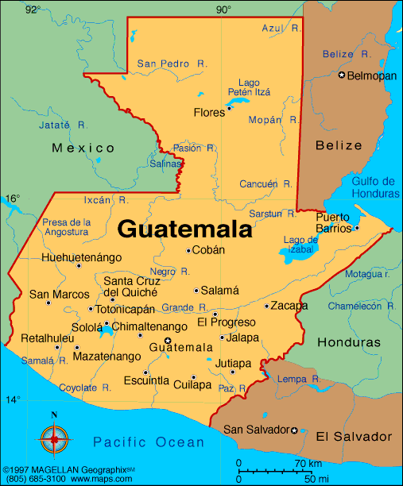
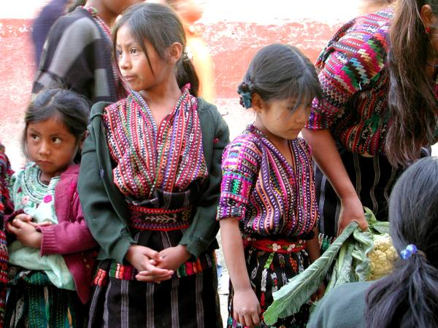
Guatemala is located in Central America at the southern tip of Mexico between the Caribbean Sea and the Pacific Ocean. Belize, El Salvador, Honduras, and Mexico all share land boundaries with Guatemala.

Slide 6
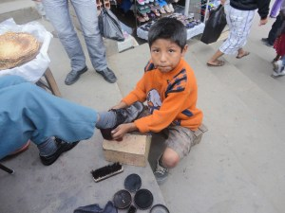
Guatemala has the highest illiteracy rate in Central America. Although students are required by law to attend school until the age of 15, an estimated two million children do not attend. Instead of going to school, frequently children are forced to go to work to earn extra income for their families.
Step 2 of the PPA: Gather the Evidence

Slide 7
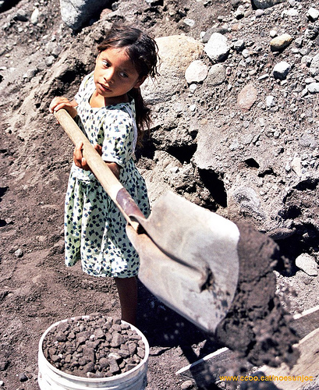
CHILD LABOR
The children of Guatemala who are part of the work force face many dangers and risks, such as; long and tiring working days; use of toxic chemicals; carrying heavy loads; handling dangerous items such as knives, axes and hot pans; insufficient or inadequate food and accommodation, and humiliating or degrading treatment including physical and verbal abuse and violence.

Slide 8
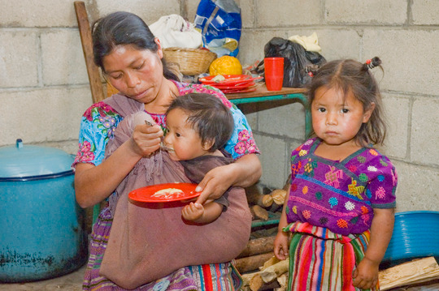
Approximately 75 percent of the population in Guatemala is estimated to live below the poverty line. Among this population, 60 percent of the children under 18 years of age live in poverty.
Step 3 of the PPA: Identify Causes

Slide 9
Poverty is the leading cause of illiteracy in Guatemala.

Slide 10
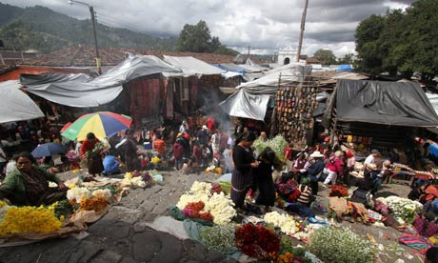
What defines poverty?

Slide 11
United Nations Definition Of Poverty
“Fundamentally, poverty is a denial of choices and opportunities, a violation of human dignity. It means lack of basic capacity to participate effectively in society. It means not having enough to feed and cloth a family, not having a school or clinic to go to; not having the land on which to grow one’s food or a job to earn one’s living, not having access to credit.”

Slide 12
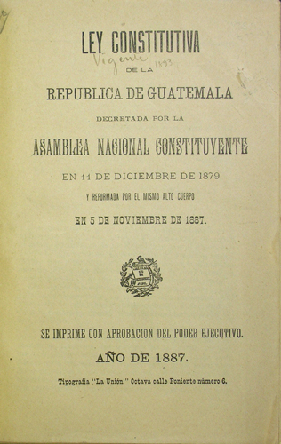
Step 4 of the PPA: Evaluate the Policy
Article 71: Right to Education
The freedom of education and educational standards is guaranteed. It is the obligation of the State to provide and facilitate education to its inhabitants without any discrimination whatever. The foundation and maintenance of cultural educational centers and museums is declared to be of public utility and necessity.

Slide 13
What possible solutions can we develop to help the children of Guatemala?
In your groups, discuss some possible solutions that would help the children of Guatemala gain the power of reading.
Think about:
What would make their lives better?
How could we guarantee they attend school?
What kind of programs could be created?
Complete the worksheet by describing one or two possible solutions.

Slide 14
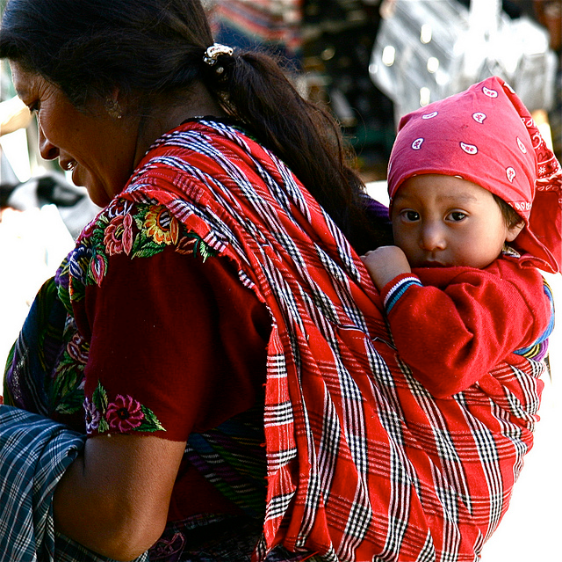
Step 5 of the PPA: Develop Solutions
Illiteracy is a Vicious Cycle
Families that live in extreme poverty often see school as an impossible cost. Even public schools carry costs, including books, uniforms, and transportation.
If parents have not experienced the benefits of education, such as an increased income and improved quality of life, they are less likely to send their own children to school.
Parents who grow up without education are less likely to send their own children to school.
They are more likely to send their children to work to provide the family with extra income.
This is how the vicious cycle of illiteracy begins.
 Possible solutions include providing
monetary incentives to parents. For each
child that actively attends school, parents
would receive a fixed regular payment to
supplement their family income.

Slide 15
Step 6 of the PPA: Select Best Solution
Breaking a Vicious Cycle
Education will create huge opportunities for the children of Guatemala. Instead of leaving school to work 14-hour days in the fields, children will have the chance to raise their income, engage their intellectual curiosity, and live in a more stable society.
Education breaks the cycle of poverty. In order to solve Guatemala’s illiteracy problem , the best solution would to put books into the hands of children. Creating community literacy programs and creating policies that insure a quality education for the all children of Guatemala will assure a positive future for generations to come.

Slide 16
Quote from The Most Beautiful Place in the World
“When I was seven, the teachers went from house to house, looking for children to enroll in school, but when they got to my house, my parents hid me in the woodshed. I watched between cracks in the boards, and listened. They told the teachers that they didn’t have any school-age children, not one. They were afraid if I went to school, I wouldn’t learn to work. They did it for my good, and I didn’t say anything or complain, but I always knew it was a mistake.”
Directions: Work with a partner and read the quote together. Ask questions about what you read, underline words you don’t know or can’t figure out, and write possible answers to your questions.

Slide 17
Is there hope for the children of Guatemala?

