Slide 1
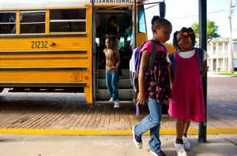
Homelessness
NYC Public Schools
By: Golderina Venson
PS 194M
First grade
gvenson@schools.nyc.gov

Slide 2
Public Policy Steps (PPA)
Define the problem
Gather the Evidence
Identify the Causes
Examine an Existing Policy
Develop Policy Solutions
Select the best Solution

Slide 3
Defining the Problem Lets look at the picture!
What is happening in this picture?

Slide 4
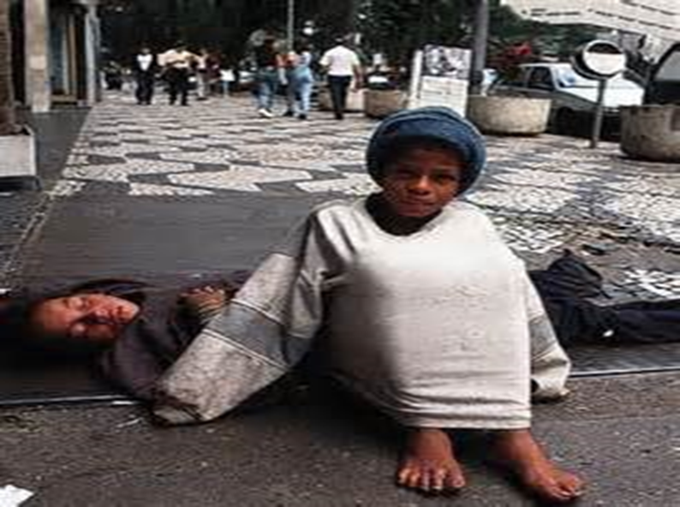
Defining the Problem
Looking at the picture, What is the problem?

Slide 5
Gather the Evidence
More than 53,000 city public-school students lack a permanent home — a fivefold increase over 2008, figures show.
As of October 2012, one out of every 20 public-school students was living in a shelter, at an address shared by multiple families or in a hotel or motel.
DOE data showed that from September 2011 to June 2012, 69,335 lacked permanent shelter at some point. From September 2012 to late April 2013, 68,938 did.

Slide 6
Gather the Evidence
Since 2008 homelessness in Public schools has increased by 400%.
Video http://www.nbcnewyork.com/feature/education-nation/Homeless-High-School-NYC-Department-of-Education-Glorioso-City-Hall-130499603.html

Slide 7
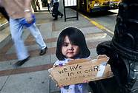
Identify the Causes
Discuss with a partner, what you know about homelessness.
Give two statements of what you know.

Slide 8
Examine an Existing Policy
The New York City Department of Homeless Services
http://www.nyc.gov/html/dhs/html/home/home.shtml
Choose one of the existing policies and analyze its advantages and disadvantages
Temporary Housing Assistance
Street Homelessness and Outreach
Client Advocacy Services

Slide 9
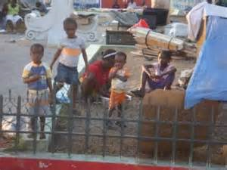
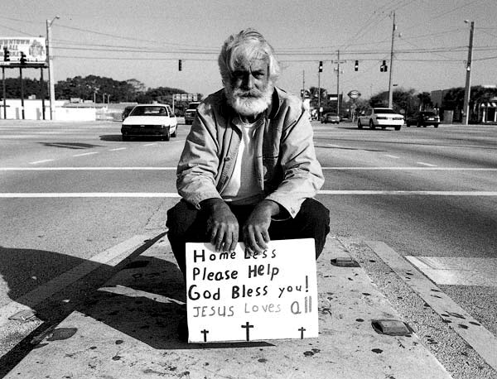
Developing Solutions
Discuss with a partner three ways we can prevent homelessness in NYC.

Slide 10
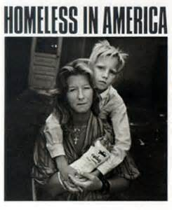
Selecting the Best Solution
We have each thought about three ways to prevent homelessness. Now lets think about which way is the best solution that would solve the problem.
Use the Solution Matrix to see how your solutions rate.
Think about how feasible and effective the solution is.

Slide 11
Sources:
http://nypost.com/2013/05/31/number-of-homeless-students-in-city-public-schools-continues-to-climb/
http://www.nbcnewyork.com/feature/education-nation/Homeless-High-School-NYC-Department-of-Education-Glorioso-City-Hall-130499603.html
http://www.nyc.gov/html/dhs/html/home/home.shtml
http://www.coalitionforthehomeless.org/
http://home.nyc.gov/html/acs/education/homelessstudents.html

