Slide 1
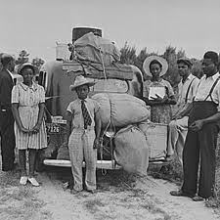
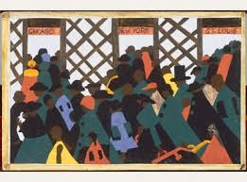
Racial Inequality in the Early 1900s The Great Migration
Ms. Soto
PS/MS 46
Grade 5
September 1, 2013

Slide 2
The Steps of the AHPPA
As a class, we will be using the steps of AHPPA (American History Public Policy Analyst). The AHPPA will help us better understand the social problems that we will be studying throughout the school year. Below are the steps to the AHPPA:
Define the problem
Gather the evidence
Identify the causes
Evaluate existing policy

Slide 3
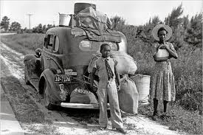
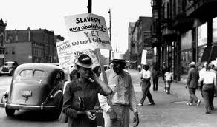
What is the Problem?
Racial inequality is the unfair situation in which some groups have more or less opportunities, money, and/or power based on race.
During the early 1900s in America, many African Americans still faced hardships and inequality. Even though there was some progress for the men and woman who traveled west, those who stayed in the south were treated unfairly and did not have the same opportunities.
When opportunity came knocking up North, many traveled to obtain jobs in factories and in search for a better life. They called this move the Great Migration. Did they find the life they were looking for?

Slide 4
The Evidence
You have read most chapters from Heart and Soul by Kadir Nelson. In your groups, discuss the hardships and inequalities that the men and woman faced during the time of the Great Migration.
Here are some examples:
Plantation owners in the south were not happy about the opportunities up north, so they did everything they can to keep many from leaving, including arresting them, banning Black newspapers, and stopping the trains.
It was difficult to find a decent place to live, not enough housing.
The good jobs were not available for them; and there was not enough work to go around to begin with.
Race riots and lynchings were occurring.
They did not get the same wages or treatment.
They even met unfair treatment in the military.
Black homes and businesses were being destroyed; people were getting assaulted.

Slide 5
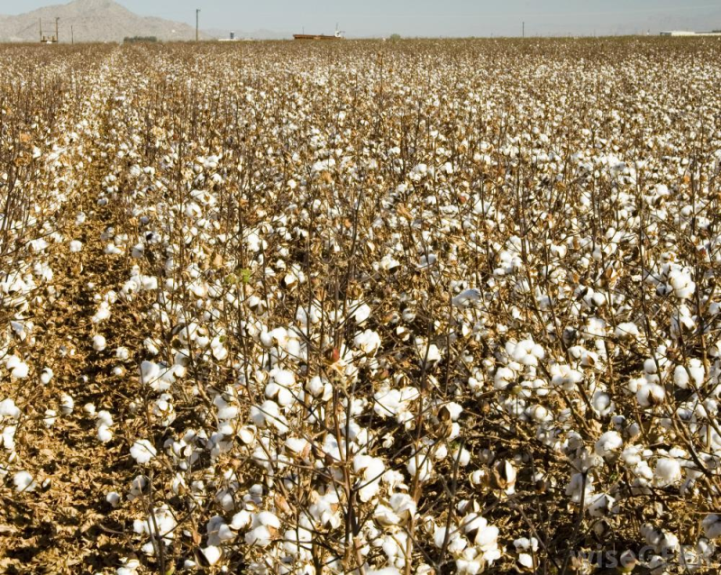
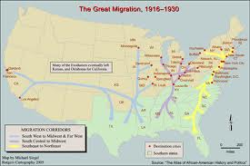
The Causes
Why did the Great Migration happen?
There was a shortage of workers in factories up north because many were going off to war.
Southern blacks were recruited and offered jobs; southern families received good news from relatives up north encouraging them to move.
Floods destroyed farms in the South, and boll weevils were plaguing the cotton crops.
Even after the abolishment of slavery, southern blacks were treated unfairly and were physically harmed at times.

Slide 6
In your groups, discuss why you think the southern blacks were still treated unfairly once they arrived to one of the northern cities?
Think about:
In what situations were they treated unfairly?
How were they treated?
Why are they still being treated this way when the north was supposed to be filled with opportunities?
Use details from your texts to support your opinion.

Slide 7
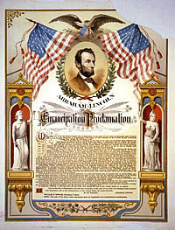
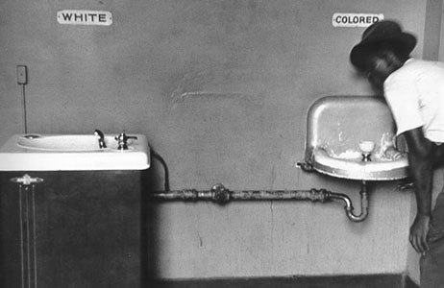
Existing Policy
Emancipation Proclamation was an order issued by President Abraham Lincoln on January 1, 1863. It stated that the slaves in the ten states that were still in rebellion were free. This Proclamation did not however outlaw slavery, and did not make the ex-slaves citizens.
Jim Crow Laws (1876 – 1965) Laws that
were created legalizing segregation by
race.

Slide 8
“Most folks my age and complexion don’t speak much about the past. Sometimes it’s just too hard to talk about—nothing we like to share with you young folk. No parent wants to tell a child that he was once a slave and made to do another man’s bidding. Or that she had to swallow her pride and take what she was given, even though she knew it wasn’t fair. Our story is chock-full of things like this. Things that might make you cringe, or feel angry. But there are also parts that will make you proud, or even laugh a little. You gotta take the good with the bad, I guess. You have to know where you come from so you can move forward.” (Heart and Soul by Kadir Nelson)

