Slide 1
Water Pollution in New York State
By: Justin Sgobbo
Corpus Christi School
4th Grade – September 2013
jsgobbo@ccschoolnyc.org

Slide 2
Review our Public Policy Steps (PPA)
Using the public policy model, how do we define the social problem of water pollution in our state?
Define the Problem
Gather the Evidence
Identify the Causes
Examine an Existing Policy
Develop Policy Solutions
Select the best Solution

Slide 3
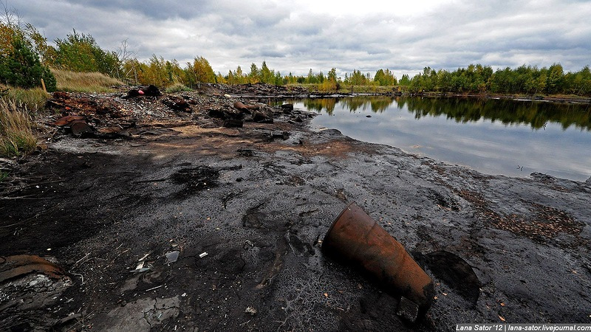
Which lake would you like to swim in?
Defining the Problem
Lake 1
Lake 2
http://us.123rf.com/400wm/400/400/majeczka/majeczka1201/majeczka120100011/11914809-beautiful-clean-lake.jpg
http://russiatrek.org/blog/photos/the-most-polluted-lake-in-the-world-located-near-dzerzhinsk/
Turn and talk to your partner and figure out what the problem is here.

Slide 4
Defining the Problem
What is the problem you observe in one of the
pictures?

Slide 5
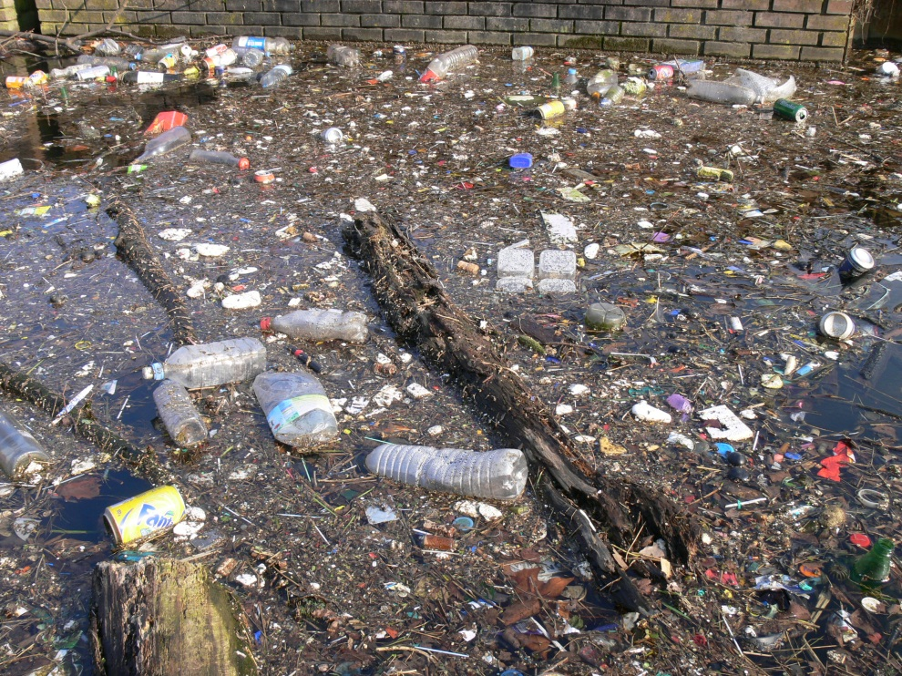
Identify the Causes
Turn and talk with your partner.
List at least three reasons why water pollution occurs in our state.
List at least three ways water pollution affects our life.
http://www.allskull.com/wp-content/uploads/2010/08/waterpollution.jpg

Slide 6
Looking at an Existing Policy
As New York State grew, problems with pollution increased.
In 1978 people living at Love Canal, near Niagara Falls (NY) were getting sick.
Their homes where built over an old canal that had been filled with chemical wastes from an old company that used to be there.
The old chemical waste caused many people to get sick.
The residents left their homes because they where getting sick.
Love Canal was cleaned up and it took 10 years for the area to be safe to live again.
The Love Canal disaster made many people create environmental groups to help care for our environment.
The effects of the Love Canal still exist today.
Love Canal Video

Slide 7
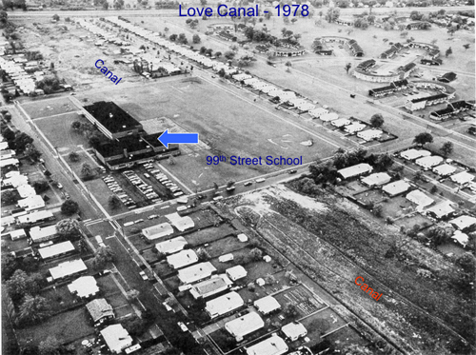
Looking at an Existing Policy
After the Love Canal problems the government made laws so that this disaster would not happen again.
In December of 1980 the government passed a law that makes companies that close factories responsible for all chemicals to be removed.
Another law was passed in October of 1986 that made companies responsible if they leave hazardous wastes.
The law also allows for the government to help people rebuild the polluted land if there is no company responsible for the hazardous waste materials.
Turn and talk with your partner ……..
What is a good part of these laws?
What is a negative part of these laws?
http://blogs.njit.edu/psp8/files/2010/12/lovecanal-middle500px.jpg

Slide 8
Developing Solutions
Turn and talk to your partner…….
Write down three ways we can prevent similar water pollution disasters from happening in our state?

Slide 9
Selecting the Best Solution
Now that you have come up with some solutions you have to think about if they could really be used.
Use the Solution Matrix to see how your solutions rate.
Some solutions are good ideas to prevent water pollution in New York State but it maybe to hard to do (feasibility).
Some solutions you may have are easy to do but won’t work (effectiveness).

Slide 10
Sources
http://people.hofstra.edu/j_b_bennington/121notes/pdfs/Superfund.pdf
http://www.wkbw.com/news/video/Former-Love-Canal-Students-Getting-Sick-166194666.html
New York State: Adventures in Time and Place. McGraw Hill, 2001

