Slide 1
WHAT WOULD LIFE BE LIKE WITHOUT RULES & LAWS…
Ms. Ponce
NDMS
October 21, 2013
PPAS PROJECT

Slide 2
Steps of the Public Policy Analyst (PPA)
Define the Problem
Gather evidence
Identify causes
Evaluate a policy
Develop solutions
Select best solution

Slide 3
STEP 1 - THE PROBLEM/s
Current school issues that affect both academic progress and school safety:
Cheating
Bullying
Inappropriate Dress
Lack of fire safety information

Slide 4
Problem: Cheating
STEP 2: EVIDENCE “CHEATING”

Slide 5
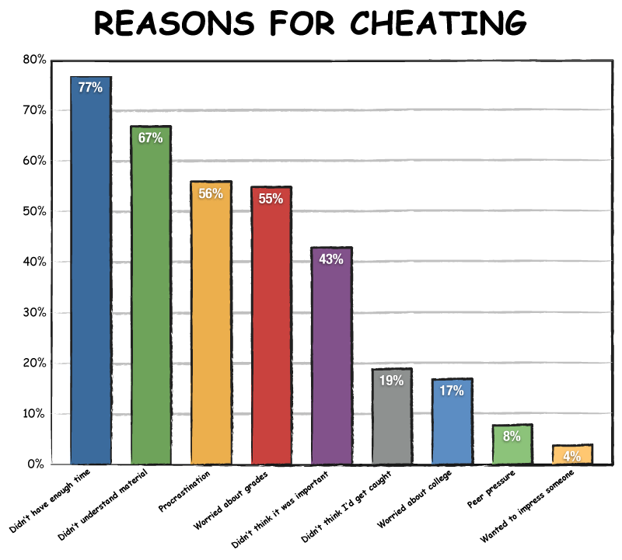
Problem: Cheating
STEP 3 CAUSES
STEP 3 IDENTIFY CAUSES

Slide 6
Problem: Cheating
A20Engaging in scholastic dishonesty which includes but is not limited to: a.Cheating (e.g., copying from another’s test paper; using material during a test which is not authorized by the person giving the test; collaborating with another student during the test without authorization; knowingly using, buying, selling, stealing, transporting, or soliciting, in whole or part, the contents of an unadministered test; substituting for another student or permitting another student to substitute for one’s self to take a test; bribing another person to obtain a test that is to be administered; or securing copies of the test or answers to the test in advance of the test) person in preparing written work for credit)
DisciplineCode http://schools.nyc.gov/NR/rdonlyres/188AF3E2-F12B-4754-8471-F2EFB344AE2B/0/DiscCodebooklet2013final.pd f
STEP 4 EXISTING POLICY

Slide 7
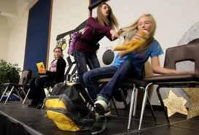
Problem: Bullying
STEP 2: EVIDENCE “BULLYING”

Slide 8
Problem: Bullying
STEP 3 CAUSE 1
Family risk factors for bullying:
A lack of warmth and involvement on the part of parents.
Overly-permissive parenting (including a lack of limits for children’s behavior).
A lack of supervision by parents.
Harsh, physical discipline.
Parent modeling of bullying behavior.¹
Victimization by older brothers.²

Slide 9
Problem: Bullying
STEP 3 CAUSE 2
Peer risk factors for bullying:
Friends who bully.
Friends who have positive attitudes about violence.¹
Some aggressive children who take on high status roles may use bullying as a way to enhance their social power and protect their prestige with peers.
Some children with low social status may use bullying as a way to deflect taunting and aggression that is directed towards them, or to enhance their social position with higher status peers.^{3, 4}

Slide 10
Problem: Bullying
STEP 3 CAUSE 3
Other Factors:
Bullying thrives in schools where faculty and staff do not address bullying, where there is no policy against bullying, and where there is little supervision of students—especially during lunch, bathroom breaks, and recess.
Models of bullying behavior are prevalent throughout society, especially in television, movies, and video games.⁵
When children are aggregated together, they associate with others who are similar to them or who have qualities or characteristics that in some way support their own behaviors.
For teenage girls, social aggression can be a way of creating excitement or alleviating boredom. It is also used as a method of gaining attention from other girls in order to secure friendships.

Slide 11
12.use non-confrontational methods to resolve conflicts;
DISCIPLIN ECODE http://schools.nyc.gov/NR/rdonlyres/188AF3E2-F12B-4754-8471-F2EFB344AE2B/0/DiscCodebooklet2013final.pdf

Slide 12
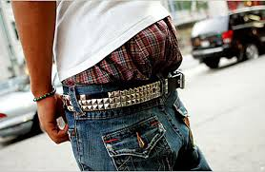
Problem: Lack of appropriate dress
STEP 2: EVIDENCE “Dress Code”

Slide 13
Problem: Lack of appropriate dress
STEP 3 CAUSE

Slide 14
Problem: Lack of appropriate dress
A student’s must Recognize that extremely brief garments such as tube tops, net tops, halter tops, tank tops, spaghetti straps, plunging necklines (front and/or back), clothing that exposes mid-section of the body, mini skirts, and see-through garments are NOT appropriate for school.
Ensure that all underwear is completely covered by outer garments.
Include footwear at all times.
Not include the wearing of hats in the building, except for acceptable documentation of medical or religious purpose.
STEP 4 EXISTING POLICY
Discipline Code:http://schools.nyc.gov/SchoolPortals/07/X427/AboutUs/Policies/Student+Dress+Code.htm

Slide 15
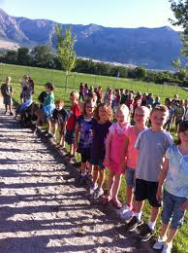
Problem: Lack of fire safety
STEP 2 EVIDENCE “Fire Drills”

Slide 16
Problem: Lack of fire safety
STEP 3 CAUSE
The purpose of fire exit drills is to ensure the efficient and safe use of the exit facilities available in the case of an emergency. Proper drills ensure orderly exit under control and prevent the panic that has been responsible for much of the loss of life in the major fire disasters of history. Order and control are the primary purposes of the drill. Speed in emptying buildings, while desirable, is not in itself an object, and should be made secondary to the maintenance of proper order and discipline.

Slide 17
Problem: Lack of fire safety
STEP 4 EXISTING POLICY
Fire and Shelter Drills
Fire drills are held to insure the safety of everyone in case of a fire. A fire/shelter drill is a silent procedure. There is no talking during the drill. Follow directions from your classroom teacher for dismissal. Fire/shelter drills may take place at any time and students must respond immediately so that the safe evacuation of the building may take place .
Fire Drillhttp://schools.nyc.gov/SchoolPortals/32/k383/aboutus/policies/genpolregs.htm

Slide 18
STEP 5 SOLUTIONS
Problem: Lack of fire safety
Students can create posters to hang around school indicating the current problem with the cause and policy to create an awareness of the issues,
Students can create a power point on one of the four Problems to educate peers
Student can bring issues to student government to tackle independently or cumulatively.

Slide 19
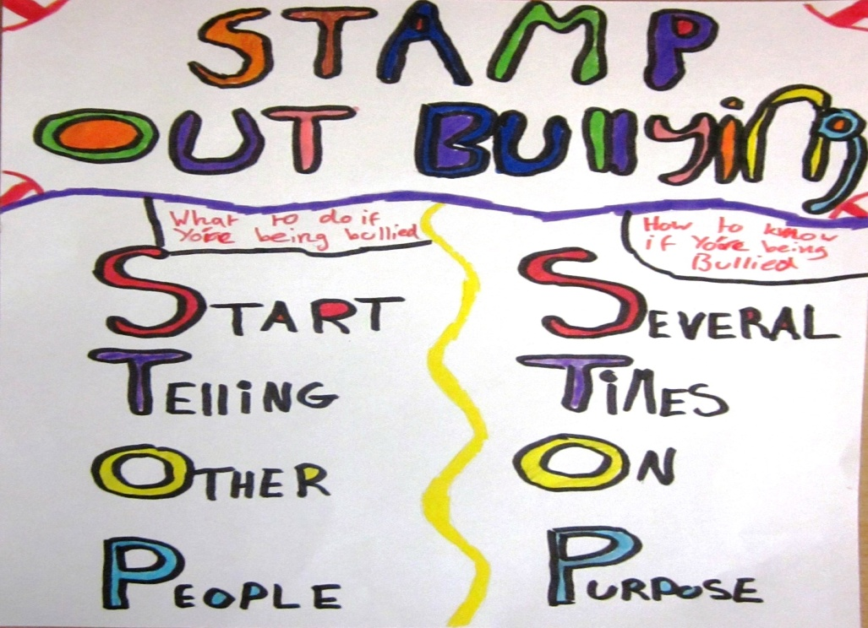
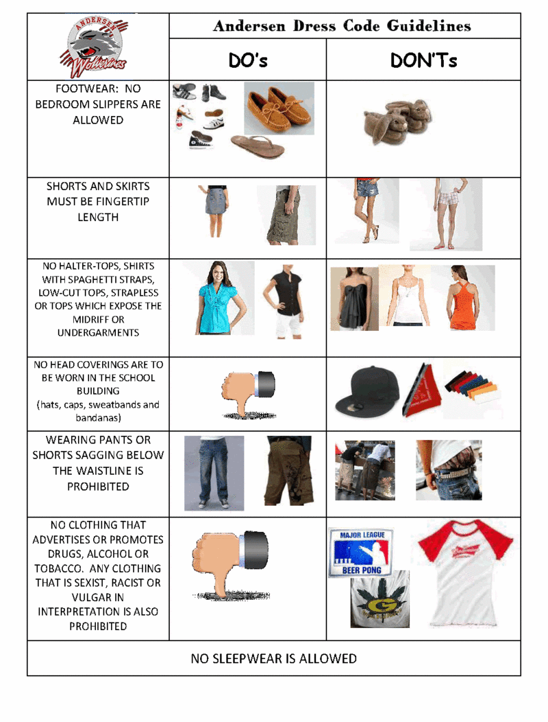
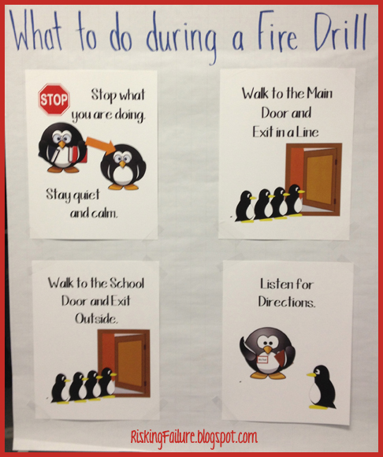
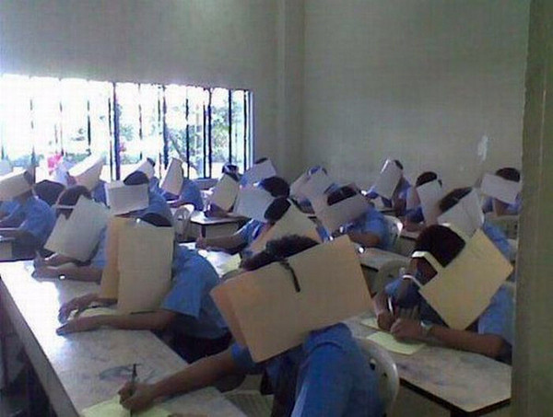
THE BEST SOLUTION
Problem: Lack of fire safety

