Slide 1
The Impact of Attendance on Academic Achievement
Brenda Fox
Donna Marhold
PS 125
The Ralph Bunche School

Slide 2
Steps of the Public Policy Analyst (PPA)
Define the problem
Gather the Evidence
Identify the Causes
Evaluate an Existing Policy
Develop Solutions
Select the Best Solution (Feasibility vs. Effectiveness)

Slide 3
Define the Problem - PPA #1
How do we prevent student absenteeism and its consequences?
Activity: Complete worksheet 1

Slide 4
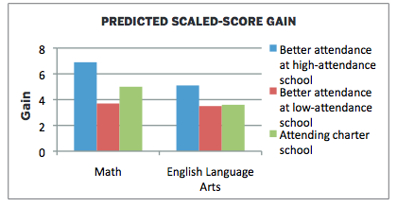
Gather the Evidence - PPA #2
Research: The Importance of Being in School: A Report on Absenteeism in the Nation’s Public Schools by Robert Balfanz & Vaughan Byrnes
Statistics: Taking Attendance Seriously-How School Absences Undermine Student and School Performance in New York City by Campaign for Fiscal Equity
Activity: Complete worksheet 2

Slide 5
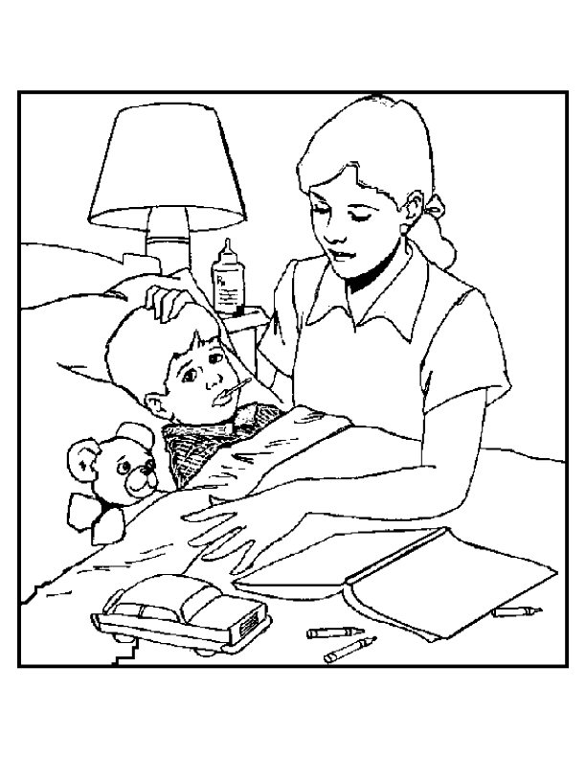
Identify the Causes - PPA #3
Health Issues
Homelessness
Dysfunctional Homes
Activity: complete worksheet 3

Slide 6
Evaluate an Existing Policy – PPA #4
What has been done to try to resolve this problem?
NYCDOE POLICIES
Phone call made to students home
Attendance teacher makes a home visit
ACS will become involved with family

Slide 7
Develop Solutions
Share students low performing data with parents
Parent workshops on correlation of students performance to attendance
School-Parent communication tool for attendance
Student attendance incentive program
Truant/youth officer intervention

Slide 8
Select the Best Solution
In each group, think about which of the solutions on the previous slide may be the best course of action in preventing frequent absenteeism.
List your reasons and be prepared to share with the larger group.

