Slide 1
PET Waste
CAN AFFECT
OUR HEALTH
Ms. Tyra S. Padgett
PS 194M - Countee Cullen
DST7DIVA@yYAHOO.COM

Slide 2
Steps of the Public Policy Analyst (PPA)
Define the Problem
Gather the Evidence
Identify Causes
Examine Existing Policy
Develop Solutions
Select the Best Solution

Slide 3
Why is it a problem?
http://cfpub.epa.gov/npdes/stormwater/menuofbmps/index.cfm?action=factsheet_results&view=specific&bmp=4
http://www.petwasteremovaldayton.com/Effects-Pet-Waste-Health-Yard.html
http://www.doggiepoopcrew.com/effects.html

Slide 4
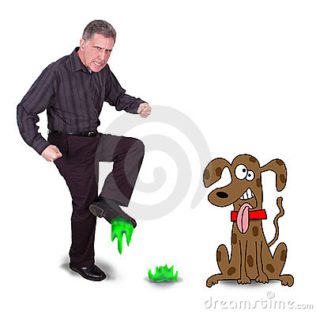
Has this ever Happened to you?

Slide 5
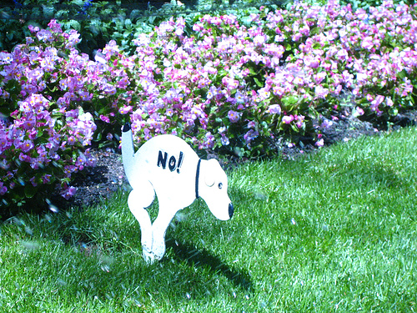
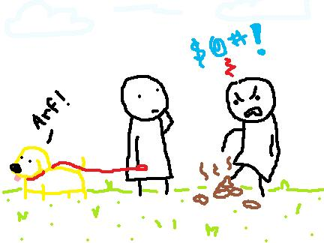
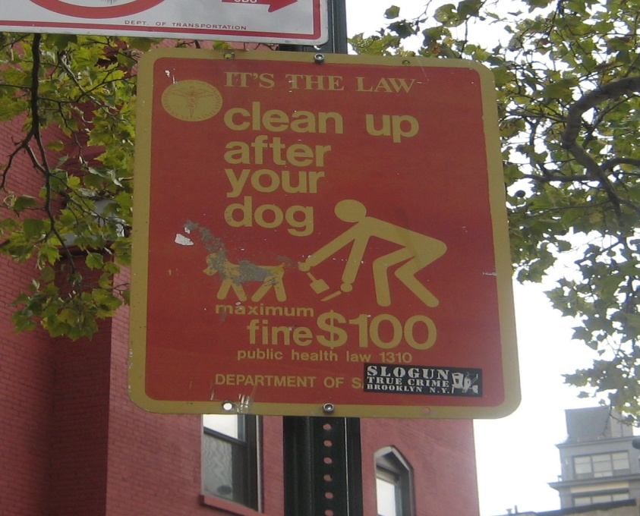
Causes
Lazy pet owners
Improperly disposed
Poor pet management polices

Slide 6
Existing Policies
New York state and local officials post signs encouraging pet owners to pick-up after their pets.
Some signs indicate a fine ranging from $25-$200 that the pet owner will incur if they are caught breaking the law.

Slide 7
Solutions
Public Awareness - Educate pet owners and the community about the serious health effects of pet waste
http://www.co.thurston.wa.us/health/ehrp/pdf/pet_waste_bro.pdf
Provide areas and poop bags for pet owners.
Establish a volunteer Poop Scooper Service in our community.

Slide 8
Best Solution (Feasibility vs. Effectiveness)

Slide 9
Bibliography
www.doggiedoonot.com
http://ephemeralnewyork.wordpress.com/tag/curb-your-dog-law/
http://www.doodycalls.com/resources_toxic_dog_waste.asp
http://cfpub.epa.gov/npdes/stormwater/menuofbmps/index.cfm?action=factsheet_results&view=specific&bmp=4
http://www.co.thurston.wa.us/health/ehrp/pdf/pet_waste_bro.pdf

