Slide 1
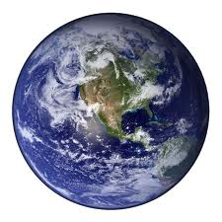
SAVE OUR SCHOOL
TIFFANY KING
PS 194
E: TKING071@AOL.COM

Slide 2
Have you ever came to school and seen a classmate with a bag like this?
http://www2.maxwell.syr.edu/plegal/ppae/ppae5.html

Slide 3
Have you ever came to school and seen a classmate with a bag like this?
http://www2.maxwell.syr.edu/plegal/ppae/ppae5.html

Slide 4
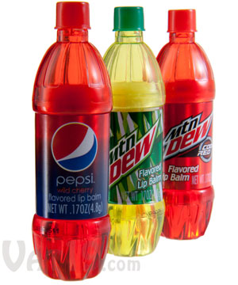
Have you ever came to school and seen a classmate with a bag like this?
Or a bottle like this?
http://www2.maxwell.syr.edu/plegal/ppae/ppae5.html

Slide 5
Step 1: What is the problem?
Students at PS 194 waste products that are bad for our earth.
http://www2.maxwell.syr.edu/plegal/ppae/ppae5a.html

Slide 6
Step 1: What is the problem?
Students at PS 194 waste products that are bad for our earth.
http://www2.maxwell.syr.edu/plegal/ppae/ppae5a.html

Slide 7
Step 1: What is the problem?
Students at PS 194 waste products that are bad for our earth.
http://www2.maxwell.syr.edu/plegal/ppae/ppae5a.html

Slide 8
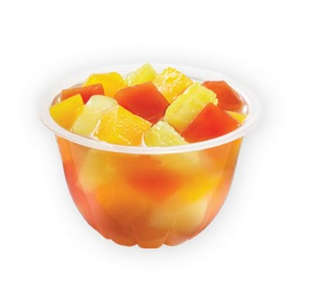
Step 1: What is the problem?
Students at PS 194 waste products that are bad for our earth.
http://www2.maxwell.syr.edu/plegal/ppae/ppae5a.html

Slide 9
Step 2: Where is the evidence?
Research says …
http://www.call2recycle.org/recycling-surveys-offer-some-surprising-results-waste-recycling-news/

Slide 10
Step 3: What are the causes?
http://www2.maxwell.syr.edu/plegal/ppae/ppae6.html

Slide 11
Step 3: What are the causes?
There’s no set rules for the school!!!
http://www2.maxwell.syr.edu/plegal/ppae/ppae6.html

Slide 12
Step 4: What is the existing policy?

Slide 13
Step 4: What is the existing policy?
THERE IS NONE!!

Slide 14
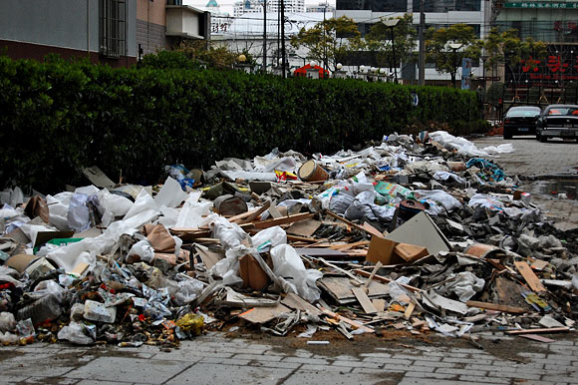
Step 4: What is the existing policy?
THERE IS NONE!!

Slide 15
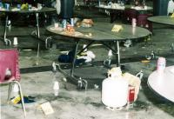
Step 4: What is the existing policy?
THERE IS NONE!!

Slide 16
Step: 5 What policies can you create to correct the problem?
http://www2.maxwell.syr.edu/plegal/ppae/ppae7.html

Slide 17
Step: 5 What policies can you create to correct the problem?
1. NON RECYCABLE PRODUCTS
http://www2.maxwell.syr.edu/plegal/ppae/ppae7.html

Slide 18
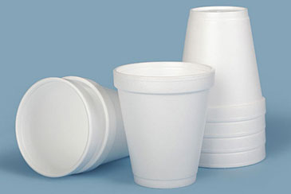
Step: 5 What policies can you create to correct the problem?
1. NON RECYCABLE PRODUCTS
GLASS
STYROFOAM
http://www2.maxwell.syr.edu/plegal/ppae/ppae7.html

Slide 19
Step: 5 What policies can you create to correct the problem?
1. NON RECYCABLE PRODUCTS
GLASS
STYROFOAM
2. RECEYCLE BINS
http://www2.maxwell.syr.edu/plegal/ppae/ppae7.html

Slide 20
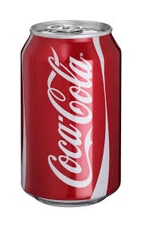
Step: 5 What policies can you create to correct the problem?
1. NON RECYCABLE PRODUCTS
GLASS
STYROFOAM
2. RECEYCLE BINS
Soda cans
Plastic
Paper
http://www2.maxwell.syr.edu/plegal/ppae/ppae7.html

Slide 21
Step: 5 What policies can you create to correct the problem?
1. NON RECYCABLE PRODUCTS
GLASS
STYROFOAM
2. RECEYCLE BINS
Soda cans
Plastic
Paper
3. RE-USABLE PRODUCTS ONLY
http://www2.maxwell.syr.edu/plegal/ppae/ppae7.html

Slide 22
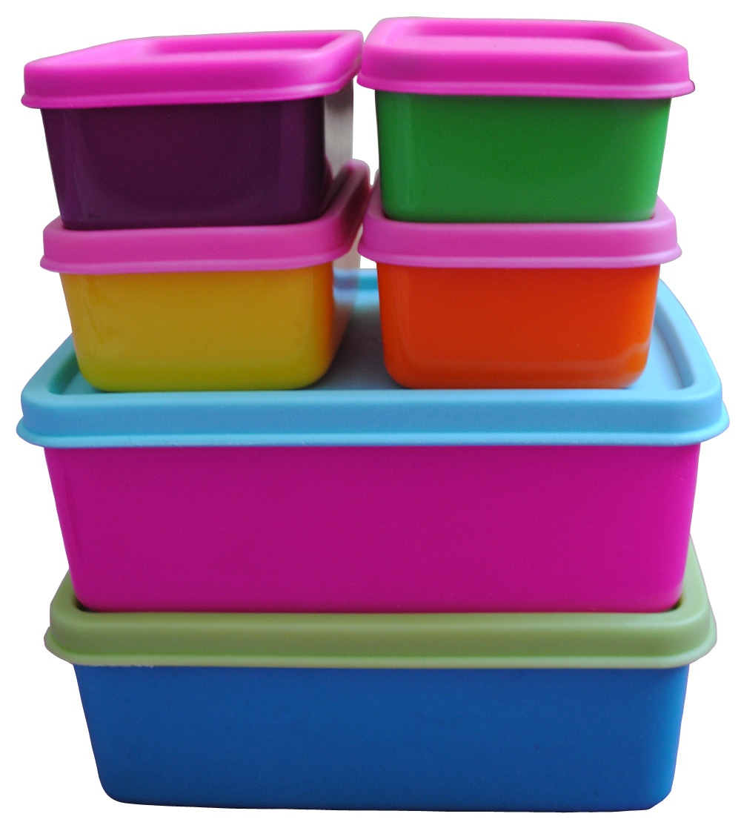
Step: 5 What policies can you create to correct the problem?
1. NON RECYCABLE PRODUCTS
GLASS
STYROFOAM
2. RECEYCLE BINS
Soda cans
Plastic
Paper
3. RE-USABLE PRODUCTS ONLY
ZIPLOCK BAGS
THERMOS
LUNCHBOX
TUPPERWARE
http://www2.maxwell.syr.edu/plegal/ppae/step5d.html

Slide 23
Step 6: What is the best policy to correct the problem?

Slide 24
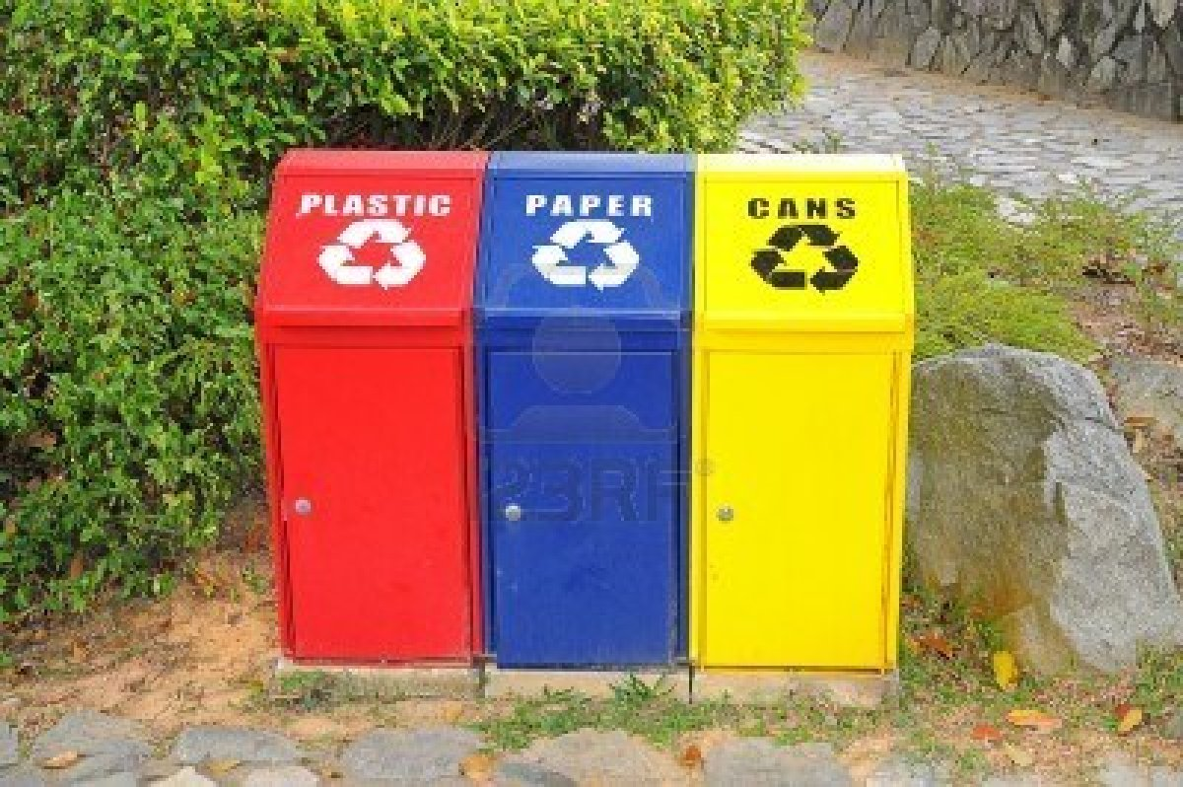
Step 6: What is the best policy to correct the problem?
RECYCLE BINS!!

Slide 25
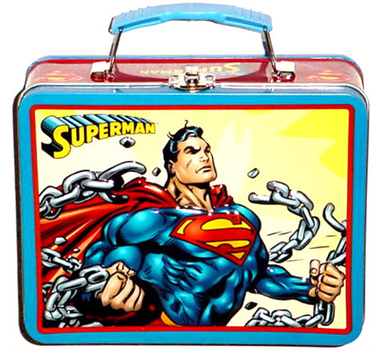
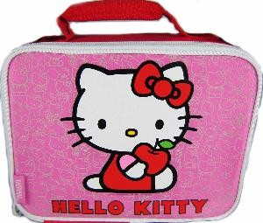
RE-USE!

Slide 26
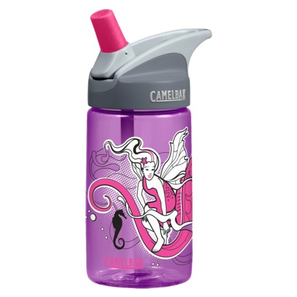
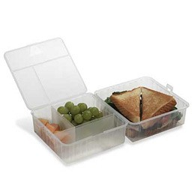
RE-USE!
RE-USE!

Slide 27
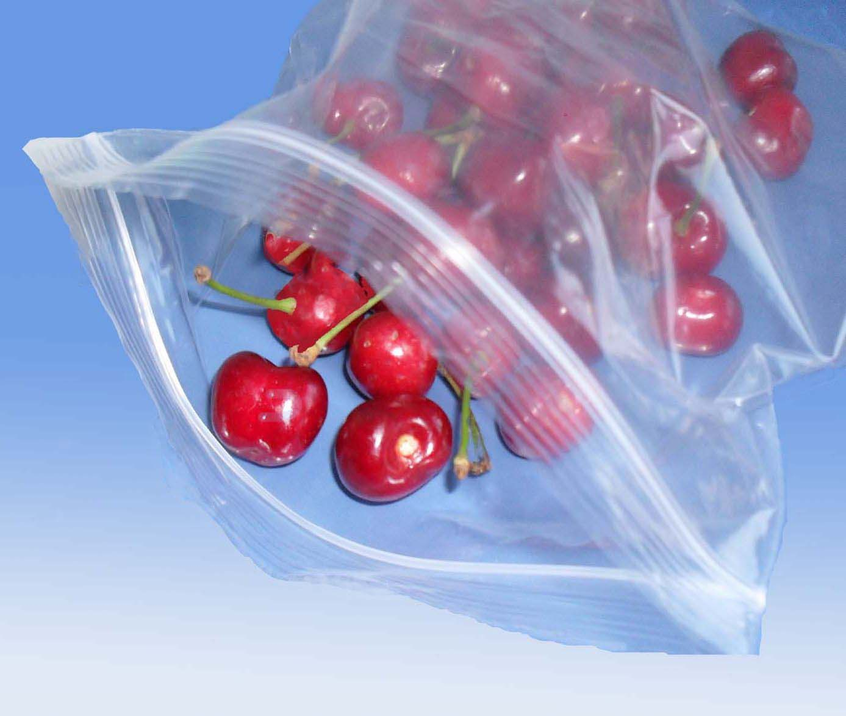
RE-USE!
RE-USE!
RE-USE!

